Slide 1
Abortion 101: Overview of Abortion Worldwide

Slide 2
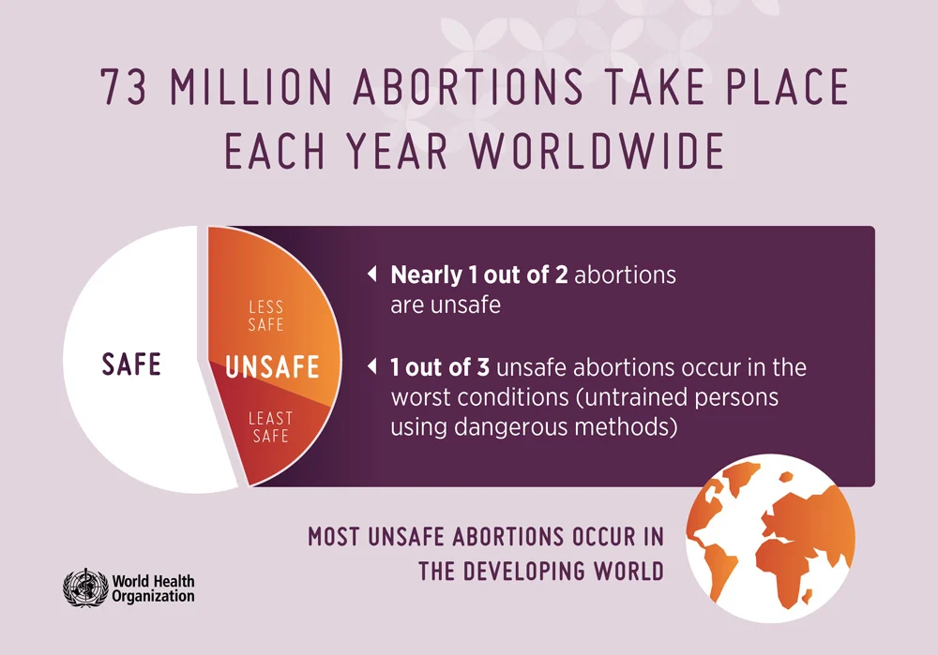
Abortion worldwide
Notes:
Let’s start with an overview of abortion worldwide:
73 million abortions take place each year worldwide.
Nearly 1 in 2 abortions are unsafe.
1 in 3 unsafe abortions occur in the worst conditions—untrained persons using dangerous methods.
Most unsafe abortions occur in lower-income countries.

Slide 3
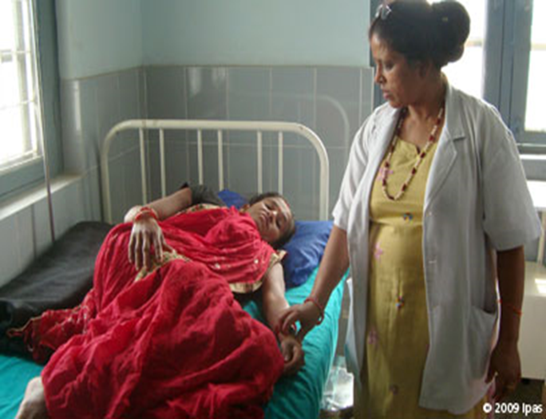
Abortion in lower-income countries
Of the ~33 million women who have unsafe abortions annually:
  97% are in lower-income countries
  ~7 million are treated for complications
  40% never receive treatment
  ~7 million suffer long-term disability
  ~44,000 die—91% of those deaths are in Africa and South-Central Asia
Notes:
97% of unsafe abortions happen in lower-income countries
Some women never seek care, and some will suffer, after seeking care or not, with long-term consequences.
Almost all of the global unsafe abortion-related deaths are in lower-income countries, mostly in Africa and South-Central Asia.

Slide 4
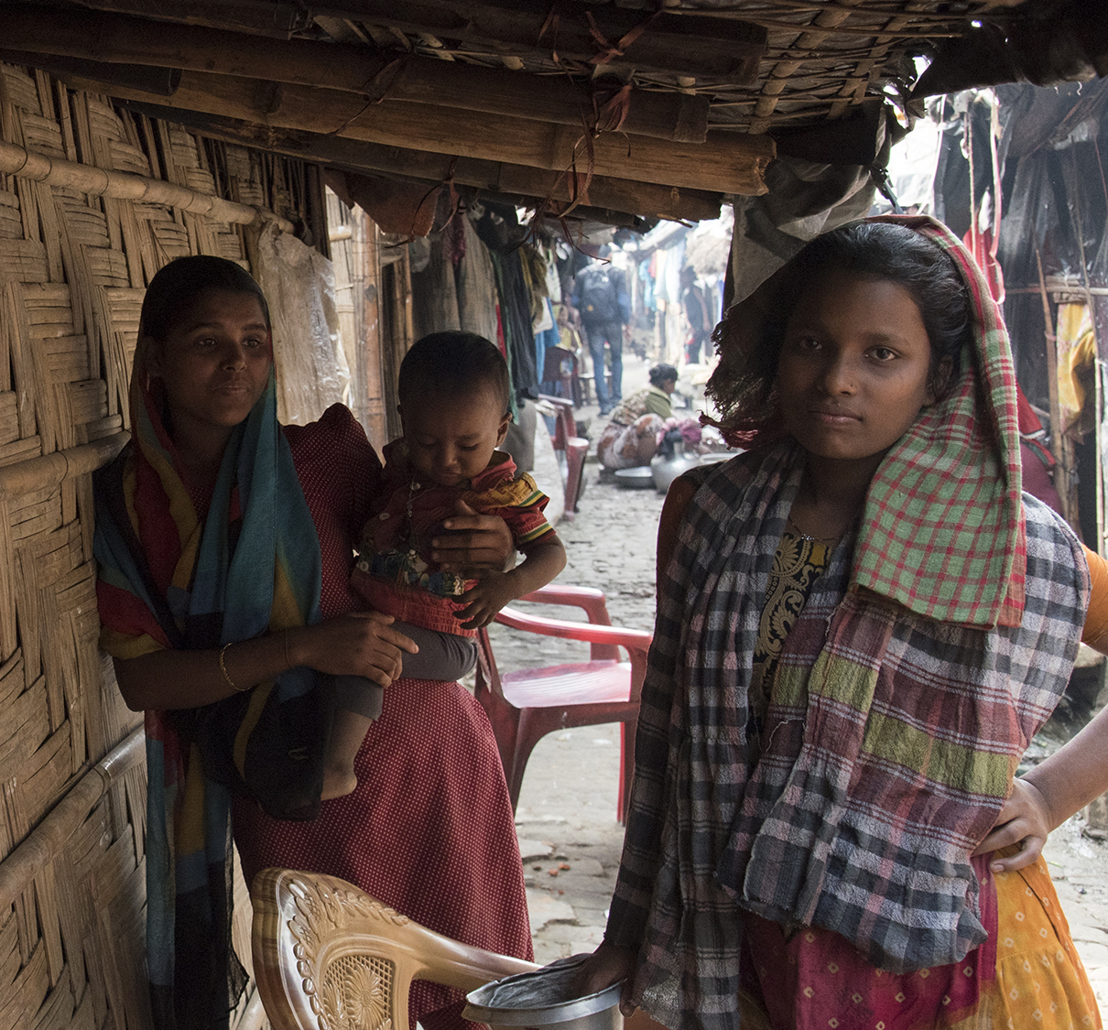
Abortion in humanitarian settings
Collapse of health systems means reduced access to:
  Emergency obstetric care
  Family planning
  Postabortion care (treatment for complications of unsafe abortion)
Women are at greater risk of sexual violence, which can lead to more:
  Unintended pregnancies
  Unsafe abortions
Notes:
Global data clearly indicate that unsafe abortion occurs in every country, regardless of legal or social context, because women everywhere experience unwanted pregnancies and many women are determined to end them.
For reasons listed on the screen, the need for safe abortion services likely increases in humanitarian settings.
Photo: Sushavan Nandy/NurPhoto/Getty Images

Slide 5

Complications of unsafe abortion account for
8-18%
of prenancy-related deaths globally
Notes:
8% to 18% of pregnancy-related deaths worldwide are due to unsafe abortion.
We do not know the magnitude of pregnancy-related deaths due to unsafe abortion in humanitarian settings.

Slide 6
Postabortion care
Postabortion care is a series of medical and related interventions designed to manage the complications of spontaneous and induced abortions, both safe and unsafe, and address related health-care needs
  Postabortion care is legal everywhere
  Postabortion care and people seeking it can still be judged and under-prioritized
Notes:
Postabortion care (PAC) is a series of medical and related interventions designed to manage the complications of spontaneous and induced abortions, both safe and unsafe, and address related health-care needs.
Postabortion care is legal everywhere.
But postabortion care and people seeking it can still be judged and under-prioritized.

Slide 7
Woman-centered, comprehensive abortion care
Takes into account women’s individual physical and emotional health needs, circumstances and ability to access care
Includes:
  Induced abortion
  Treatment of incomplete, missed or unsafe abortion
  Compassionate counseling
  Contraceptive services
  Related sexual and reproductive health services provided on-site or via referrals
Notes:
Woman-centered comprehensive abortion care (CAC) is a holistic model of care which includes a range of medical services, tailored to each woman’s circumstances and physical and emotional health needs.
It Includes:
induced abortion;
treatment of incomplete, missed or unsafe abortion
compassionate counseling;
contraceptive services; related sexual and reproductive health services provided on-site or via referrals to accessible facilities, and community-service provider partnerships

Slide 8
Myth: Abortion is too complicated
Fact: Abortion care is simple
  Induced abortion is a safe and simple medical procedure
  Midlevel providers can safely provide manual vacuum aspiration and medical abortion
  Manual vacuum aspiration and misoprostol are widely available and mifepristone availability is increasing
Notes:
Let’s discuss the misperception that abortion is too complicated to provide.
In fact, with proper training, early abortion is among the safest and simplest of all medical procedures:
Manual vacuum aspiration and medication abortion are the abortion methods recommended by the World Health Organization. These methods can be safely and effectively performed before 13 weeks of pregnancy by trained midlevel providers at the primary health care level. Neither requires electricity, running water or sophisticated equipment.
Moreover, most of the equipment, medications and infection-prevention procedures needed for safe abortion services are the same as those needed for basic emergency obstetric care and other gynecology services. The procedure is very similar to postabortion care—that is, treatment of complications from unsafe abortion. Therefore, an organization that supports primary health-care services could provide safe abortion services with little additional input.

Slide 9
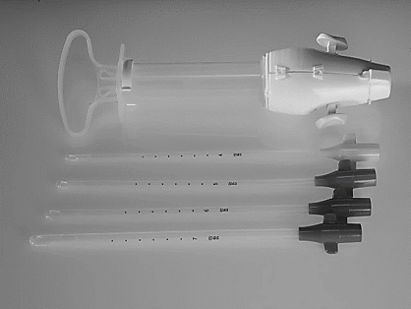
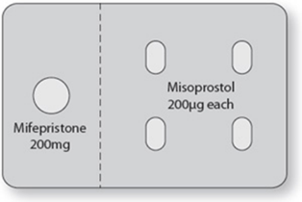
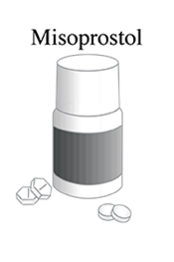
Abortion methods are safe and effective
WHO recommends both methods
Both are appropriate technology
Can be performed by many provider cadres
Manual vacuum aspirator = easy to use, clean and process; requires no electricity
Misoprostol = sometimes less expensive; often available for multiple indications
97%-99.5% effective
95%-98% effective
85+% effective
Notes:
Today we have excellent technologies that are affordable, effective, safe and have abundant evidence that they can be offered safely and effectively in low-resource settings at the primary care level.
The World Health Organization recommends manual vacuum aspiration and self-managed abortion with pills (using mifepristone + misoprostol) as the primary methods before 13 weeks (in the first trimester).
Where mifepristone is not available, misoprostol can also be used by itself.
[POINT OUT THE EFFICACIES OF THE METHODS LISTED ON THE SLIDE]
All of these methods are appropriate in crisis settings for the reasons you see here.
Manual vacuum aspiration (MVA) and medical abortion are not complicated to provide. They do not require running water. They do not require electricity or sophisticated equipment. And they can be done by many provider cadres such as nurses, midwives and clinical officers with no difference in effectiveness and complication rates compared to doctors.
MVA and medical abortion can be provided in a health center, in any facility that provides Basic Emergency Obstetric and Newborn Care or other similar services, and certainly in hospitals.
MVA and misoprostol are currently already available in the Reproductive Health Kit labeled for the management of miscarriage and complications of abortion.
Mifepristone is available to order through the UNFPA RH kit system as an additional commodity where it is approved in country.

Slide 10
“
Abortion, using medication or a simple outpatient surgical procedure, is a safe health-care intervention... In these circumstances, complications or serious adverse effects are rare.” —WHO, 2022
World Health Organization. (2022). Abortion care guideline. https://srhr.org/abortioncare/
Notes:
Abortion is a very safe medical procedure. In their 2022 abortion guideline, the World Health Organization states:
“Abortion, using medication or a simple outpatient surgical procedure, is a safe health-care intervention, when carried out with a method appropriate to the gestational age of pregnancy and – in the case of a facility-based procedure – by a person with the necessary skills. In these circumstances, complications or serious adverse effects are rare.”
It’s safer than childbirth.
Legal induced abortion is markedly safer than childbirth. The risk of death associated with childbirth is approximately 14 times higher than that with abortion. Similarly, the overall morbidity associated with childbirth exceeds that with abortion. [Source: Raymond, E., & Grimes, D. (2012). The comparative safety of legal induced abortion and childbirth in the United States. Obstetrics & Gynecology, 119, 215–219.

Slide 11
Frequency of serious adverse events
SERIOUS ADVERSE EVENTS | FREQUENCY
Serious adverse events after mifepristone and misoprostol before 13 weeks’ gestation (requiring hospitalization, surgery or blood transfusion) | 0.3%
Transfusion required with misoprostol alone before 13 weeks’ gestation | <1%
Serious adverse event from vacuum aspiration abortion before 13 weeks | <0.1%
Serious adverse events from self-managed abortion with pills after 13 weeks (transfusion, hemorrhage, laparotomy) | 1%
Serious adverse events from dilation and evacuation after 13 weeks (hemorrhage requiring transfusion, need for emergency surgery, or severe infection) | <1%
Death related to vacuum aspiration abortion before 13 weeks | 1/1,000,000 (0.0001%)
Death related to self-managed abortion with pills before 13 weeks | 1/100,000 (0.001%)
Death related to dilation and evacuation after 13 weeks | 3.3/100,000 (0.0033%)
Notes:
Complications do occur, but they are rare. These numbers come from large case series in experienced centers, so complication rates may be higher in centers with less experience or lower case volume.
These numbers are published in Ipas’s Clinical Updates in Reproductive Health.
Like every medical procedure, complications happen but are very rare.
More adverse events rates
Any adverse event with mifepristone and misoprostol up to 10 weeks gestation - <1%
Infection or bleeding requiring aspiration with misoprostol only up to 13 weeks gestation - 1-4%
Any adverse event from first-trimester vacuum aspiration abortion - <1%
Second-trimester medical abortion needing surgical evacuation - 8%

Slide 12
Long-term safety
Safe, induced abortion does not cause:
  Future infertility
  Breast cancer
  Severe psychological reactions
Notes:
When we talk with women about how first-trimester uterine evacuation is a safe and effective procedure and complications are very rare, many women will want to know about the long-term effects. Groups that are against abortion have disseminated a lot of misinformation about its long-term effects in an effort to restrict women’s access to abortion.
The facts are that abortion does not cause future infertility, breast cancer, or severe psychological reactions.

Slide 13
Myth: Abortion is illegal
Fact: Abortion is legal under some circumstances in most countries
International agreements support access to safe abortion for survivors of rape.
Such agreements include the Geneva Convention, Article 3; UN Security Resolutions 2106 and 2122; and the Maputo Protocol.
Indications for legal abortion | To save a woman’s life | To protect a woman’s physical health | To protect a woman’s mental health | Cases of rape or incest | Cases of fetal impairment | Economic or social factors | On request
Number of countries | 190 | 132 | 126 | 99 | 91 | 69 | 58
Notes:
Finally, let’s address the misperception that abortion is illegal in many settings.
Only a handful of countries ban abortion entirely: some are: Dominican Republic, El Salvador, Malta, Nicaragua and the Vatican to name a few
95% of the world’s population lives in a country where safe abortion is legally permitted under some circumstances.
(Note: This table is additive. This means that all countries listed “to protect a woman’s physical health” also permit abortion to save the life of the woman, etc.)
There are also a number of international and regional agreements, such as those indicated on the slide, that support the imperative to provide safe abortion in crisis settings for survivors of rape.

Slide 14
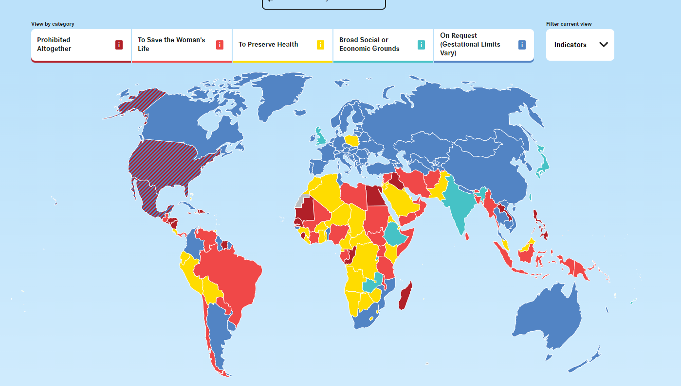
Worldwide trends
Over the past decades, nearly 50 countries have liberalized their abortion laws
Map is current as of January 3, 2023; the Center for Reproductive Rights has an online version updated in real time here → http://worldabortionlaws.com/map/
Notes:
Key Points:
Evidence shows that laws restricting or criminalizing abortion do not reduce the numbers of abortions that take place, rather they drive them underground and increase death and disability from UNSAFE abortion. Regardless of the legal context, women who want an abortion will find a way to get one and oftentimes will risk their lives to do so.
In many countries there are differences between what the law states and how the law is applied in practice.
In some settings, while the law may appear to be restrictive, in practice it may be liberally interpreted and therefore relatively easy for people to access safe abortion services. However, in other settings the law may allow for the provision of abortion under a range of different circumstances, but this may not be a reality for women in practice.
http://worldabortionlaws.com/map/

Slide 15
Abortion restrictions do not reduce the incidence of abortion
Notes:
Restrictive laws do not stop people from having abortions. In fact, abortion rates tend to be higher in countries with restrictive abortion laws.

Slide 16
Abortion restrictions do increase the proportion of abortions that are unsafe
Notes:
The proportion of abortions that are unsafe is much higher in countries where laws are more restrictive.

Slide 17

When safe abortion is not available, women:
Face delays in accessing safe services
Resort to seeking high-risk, unsafe abortions
Delay seeking care for complications of unsafe abortion
Are forced to risk their life and health to end a pregnancy
Are forced to become mothers against their will
Notes:
When safe abortion is not available, women:
Face delays in accessing safe services
Resort to seeking high-risk, unsafe abortions
Delay seeking care for complications of unsafe abortion
Are forced to risk their life and health to end a pregnancy
Are forced to become mothers against their will

Slide 18
Rationale for preventing unsafe abortion and providing safe abortion
Public health
Unsafe abortion is one of the leading causes of pregnancy-related mortality in lower-income countries worldwide
The resulting deaths and injuries are entirely preventable
Human rights
Criminalization of abortion and high rates of unsafe abortion violate women’s right to health, including their right to:
  Life
  Equality and non-discrimination
  Self-determination and to determine the number and spacing of children
  The benefits of scientific progress
Notes:
There are recognized public health and human rights rationales for preventing unsafe abortion.
While both are important, one or another may resonate better with different audiences. It is important to be aware of both.
The public health rationale is clear:
The substantial morbidity and mortality due to unsafe abortion is entirely preventable with access to safe abortion and contraception—and of course the provision of postabortion care services to treat complications of unsafe abortion wherever needed regardless of the abortion laws
From a human rights perspective:
International human rights law says that criminalization of abortion and high rates of unsafe abortion violate women’s right to health.
UN committees have also linked abortion to the human rights to life, to equality and non-discrimination, and to self-determination and to determine the number and spacing of children.

Slide 19

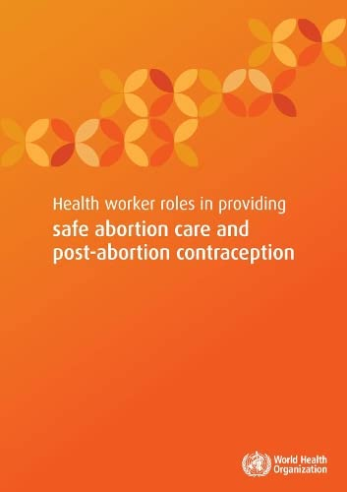
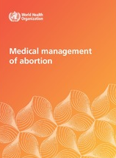
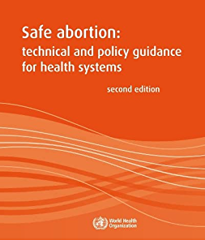
A more holistic abortion guideline
WHO released the new Abortion Care Guideline in 2022. It updates and replaces:
  Safe abortion: technical and policy guidance for health systems, second edition (2012)
  Health worker roles in providing safe abortion care and post-abortion contraception (2015)
  Medical management of abortion (2018)
Notes:
WHO released the new Abortion Care Guideline in 2022.
The guideline includes 54 evidence-based recommendations and two best practice statements focusing on law and policy, clinical services and service delivery.
The previous guidance focused on the safety abortion care and the new guidance also includes a focus on the quality of safe abortion care and being mindful of how women are treated throughout the process.
Using this holistic approach to the provision of quality abortion care, the Abortion Care Guideline carries a consistent message: access to quality abortion care is both a health and human rights issue.
This new guidance highlights centering the needs of the women. This is applicable to abortion self-care in that it is the preference of the woman in terms of opting for facility-based care, self-care or a combination of both.
The guidance also highlights the removal of medically unnecessary policy barriers that can limit access to care.

Slide 20
Thank you!
Notes:
Thank the following people:
Participants
Co-facilitators
Sponsoring/hosting organization

