Slide 1
Overview of unsafe abortion

Slide 2
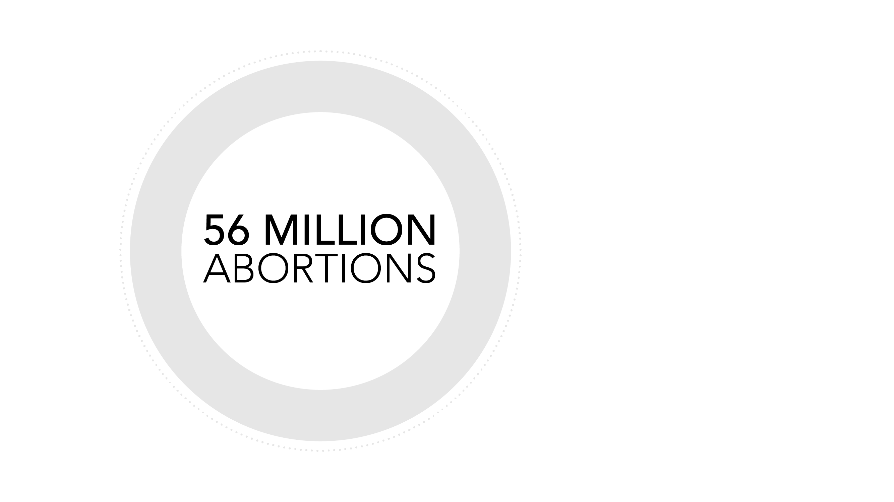
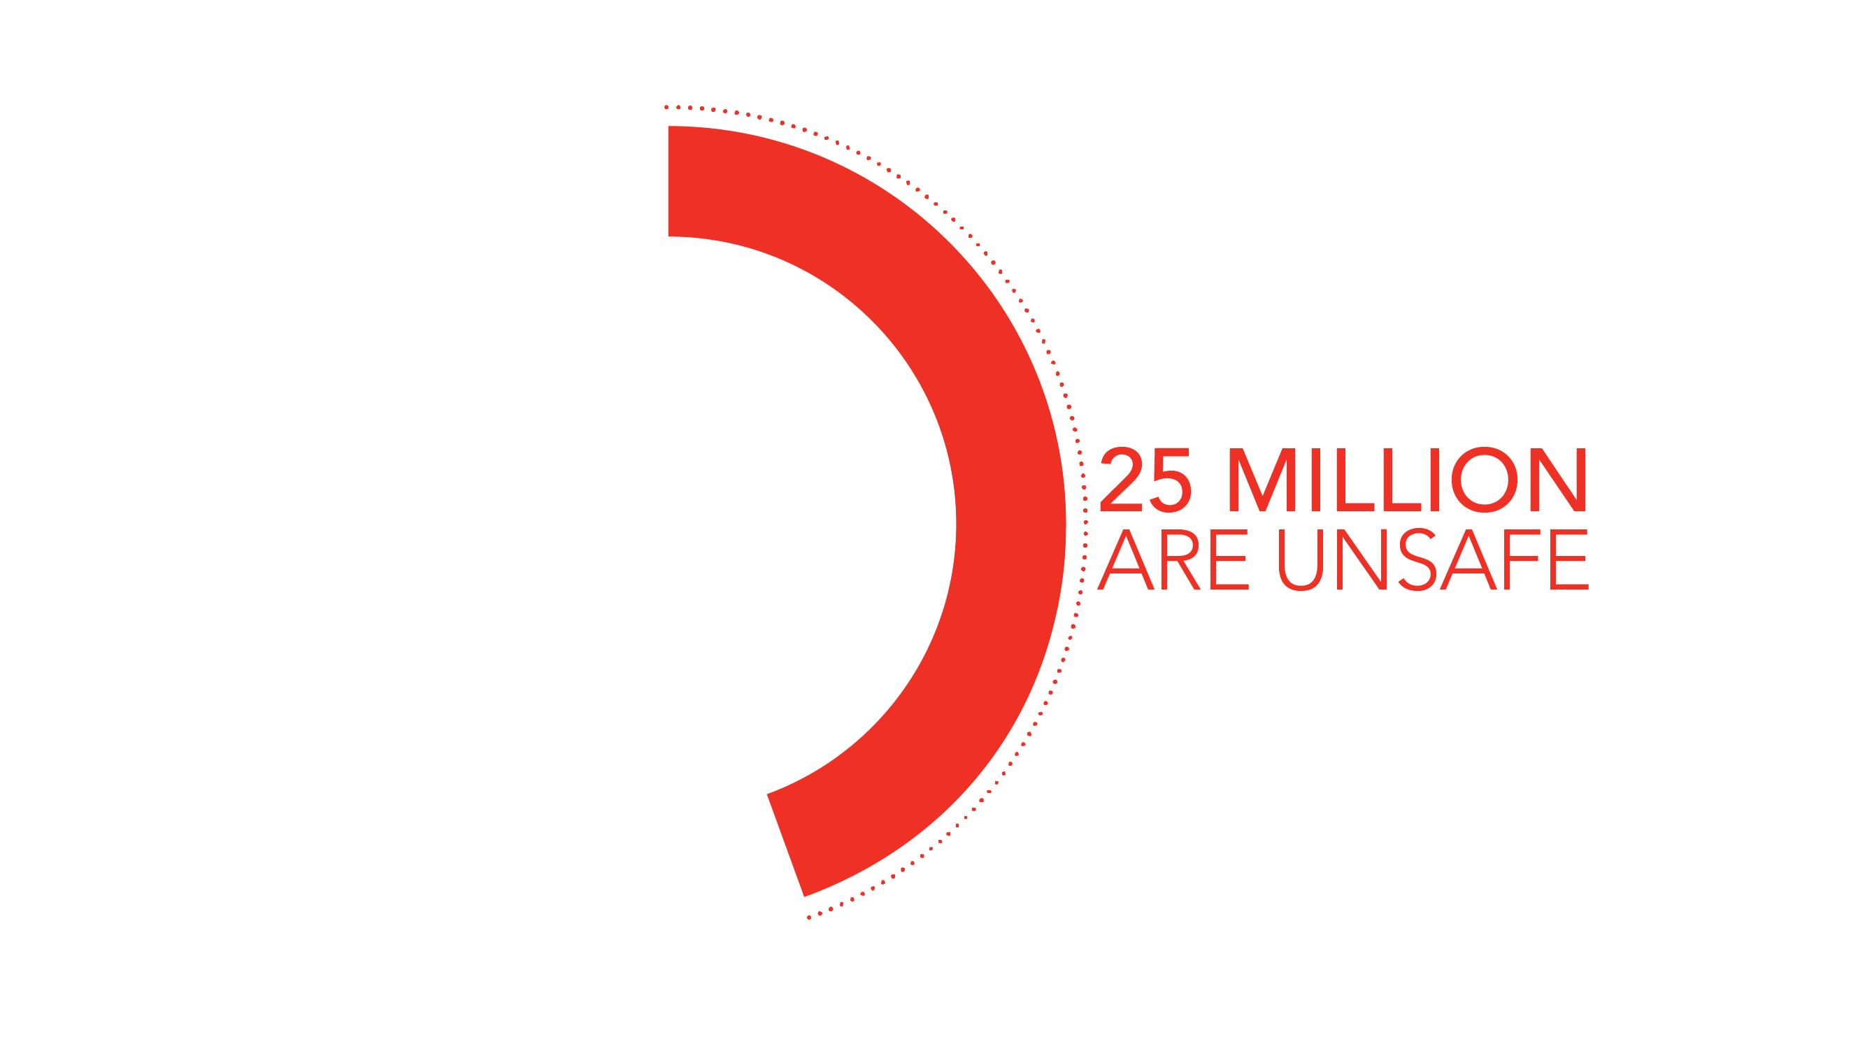
Notes:
*Click for animation*
56 million abortions occur each year worldwide
Of those, 25 million are unsafe abortions

Slide 3
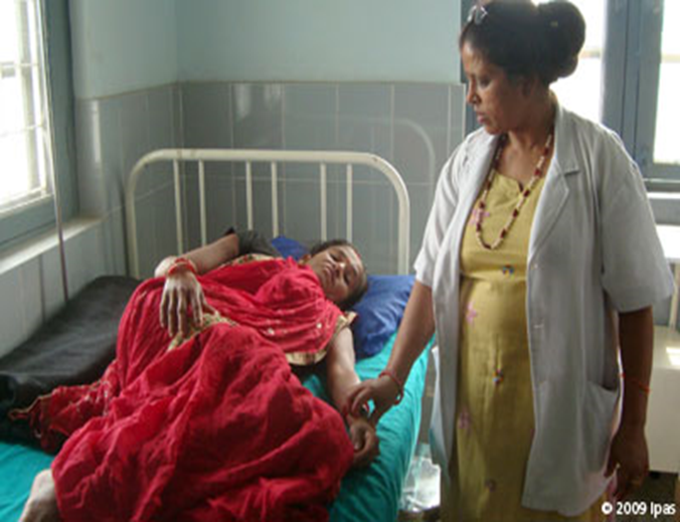
Abortion in developing regions
Of the ~25 million women who have unsafe abortions annually:
98% are in the developing world
6.9 million are treated for complications
40% never receive treatment
7 million suffer long-term disability
~44,000 die—91% of those deaths are in Africa & South-Central Asia
Photo © Ipas
Notes:
REVIEW SOME OF THE STATS…

Slide 4
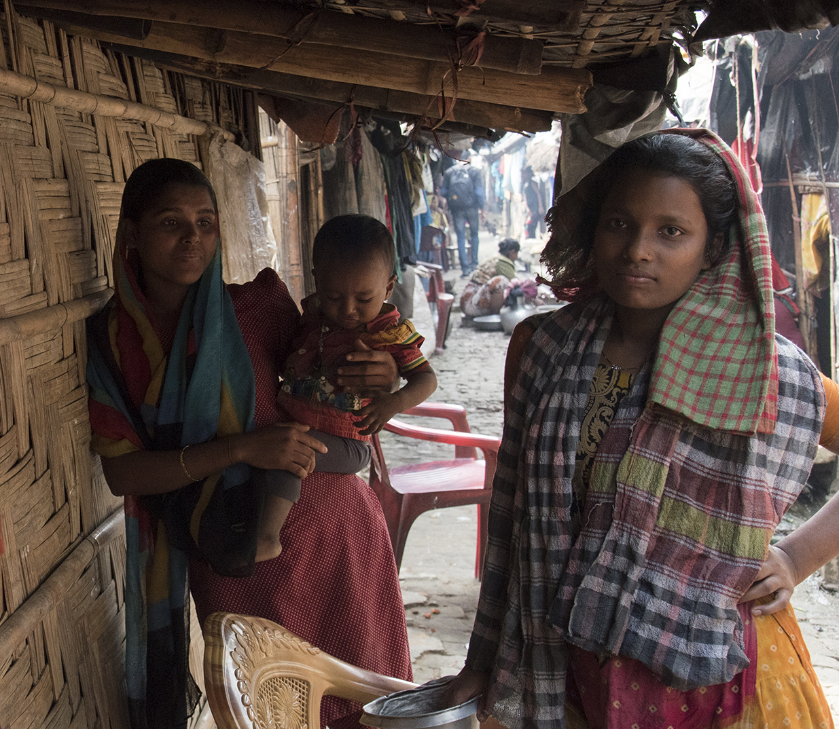
Abortion in humanitarian settings
Collapse of health systems means reduced access to:
  Emergency obstetric care
  Family planning
  Postabortion care (treatment for complications of unsafe abortion)
Women are at greater risk of sexual violence, which can lead to more:
  unintended pregnancies
  unsafe abortions
Photo: Sushavan Nandy/NurPhoto/Getty Images
Notes:
Global data clearly indicate that unsafe abortion occurs in every country, regardless of legal or social context, because women everywhere experience unwanted pregnancies and many women are determined to end them. For reasons listed on the screen, the need for safe abortion services likely increases in humanitarian settings.
Photo Sushavan Nandy/NurPhoto/Getty Images

Slide 5
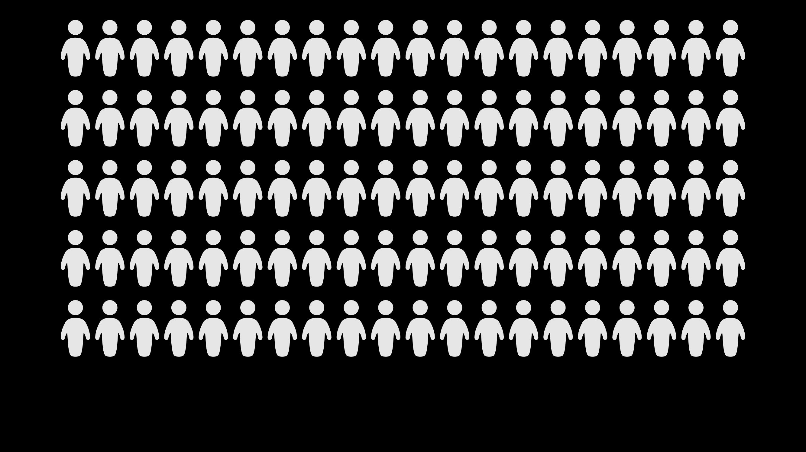
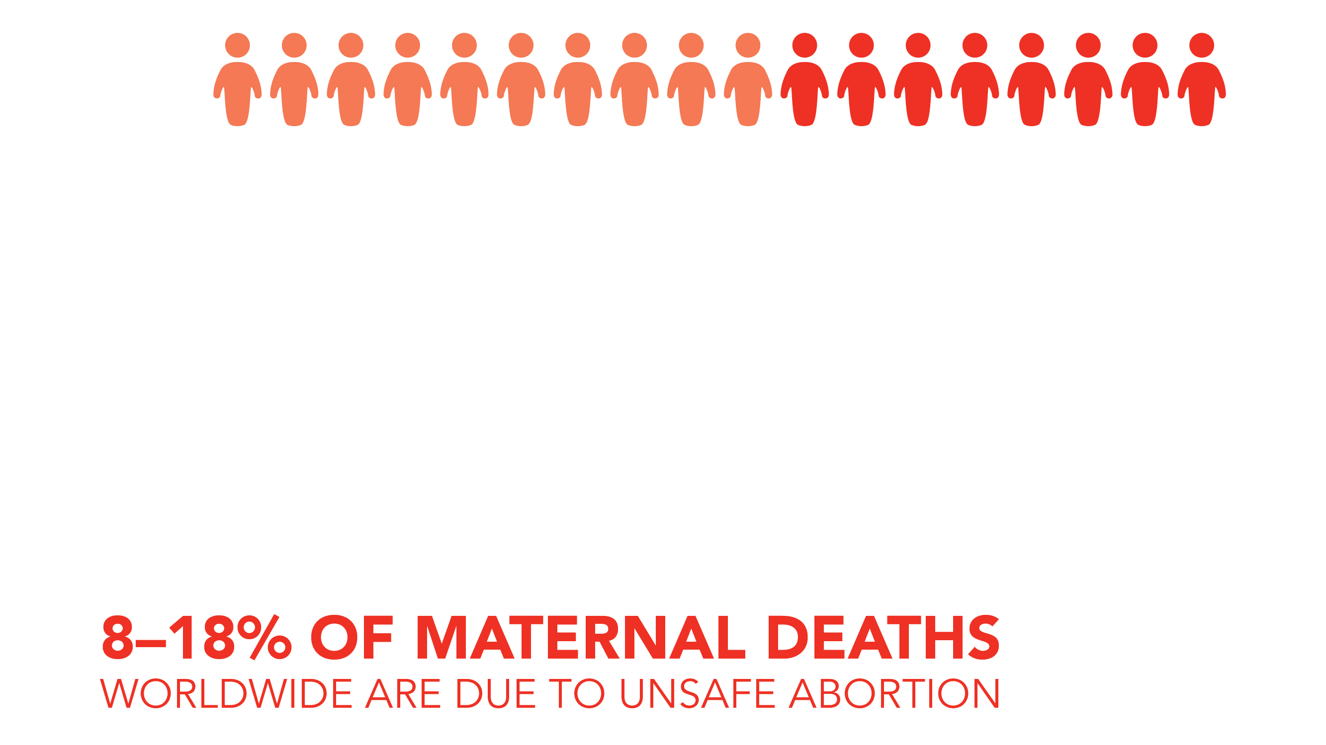
Notes:
*Click for animation*
8-18% of maternal deaths worldwide are due to unsafe abortion
We do not know the magnitude of maternal deaths due to unsafe abortion in humanitarian settings.

Slide 6
Abortion restrictions DO NOT reduce the incidence of abortion
Notes:
Restrictive laws do not stop women and girts from having abortions. In fact, abortion rates tend to be higher in countries with restrictive abortion laws.

Slide 7
Abortion restrictions DO increase the proportion of abortions that are unsafe
Notes:
The proportion of abortions that are unsafe is much higher in countries where laws are more restrictive

Slide 8
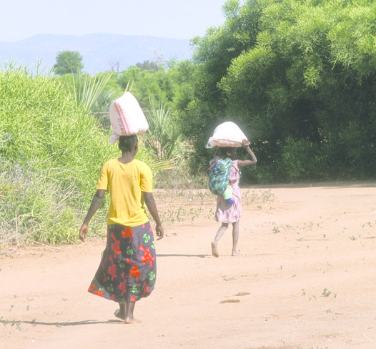
Abortion in developing countries
Women and girls who are poor, young, rural, disabled, or living in urban slums are most likely to suffer from unsafe abortions
Photo © Richard Lord
Notes:
Barriers to care in developing countries:
Legal and policy barriers such as restrictive or vague laws
Social and cultural barriers such as gender discrimination, poverty, abortion stigma or lack of social support
Health system barriers such as a lack of facilities or trained providers, low-quality care or a high cost of services

Slide 9
Poor women and girls are most likely to have an unsafe abortion and experience complications
Notes:
Women in low-income countries are most likely to have an unsafe abortion and, in turn, particularly likely to experience abortion complications. Furthermore, even within low-income countries, the poorest women have the least access to safe abortion care and are more likely to die from unsafe abortion.

Slide 10
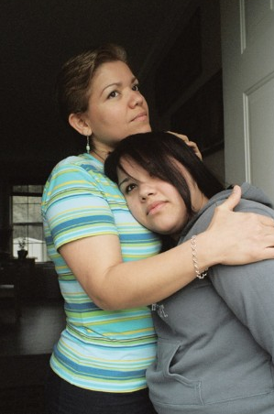
When safe abortion is not available, women:
Face delays in accessing safe services
Resort to seeking high-risk, unsafe abortions
Delay seeking care for complications of unsafe abortion
Are forced to risk their life and health to end a pregnancy
Are forced to become mothers against their will
Photo © Sara Gómez, Ipas 2008
Notes:
Use this slide to discuss some of the consequences when safe abortion is not accessible.

Slide 11
Rationale for preventing unsafe abortion
Public health
Unsafe abortion is one of the leading causes of maternal mortality in developing countries worldwide
The resulting deaths and injuries are entirely preventable
Human rights
Criminalization of abortion and high rates of unsafe abortion violate women’s right to health.
Additionally, this violates women’s right to:
  life
  equality and non-discrimination
  self-determination and to determine the number and spacing of children
Notes:
There are recognized public health and human rights rationales for preventing unsafe abortion.
While both are important, one or another may resonate better with different audiences. It is important to be aware of both.
The public health rationale is clear… the substantial morbidity and mortality due to unsafe abortion is entirely preventable with access to safe abortion and contraception—and of course the provision of postabortion care services to treat complications of unsafe abortion wherever needed regardless of the abortion laws.
International human rights law says that criminalization of abortion and high rates of unsafe abortion violate women’s right to health.
UN committees have also linked abortion to the human rights to life, to equality and non-discrimination, and to self-determination and to determine the number and spacing of children.

Slide 12
Thank you!

