Slide 1
Abortion care 101

Slide 2
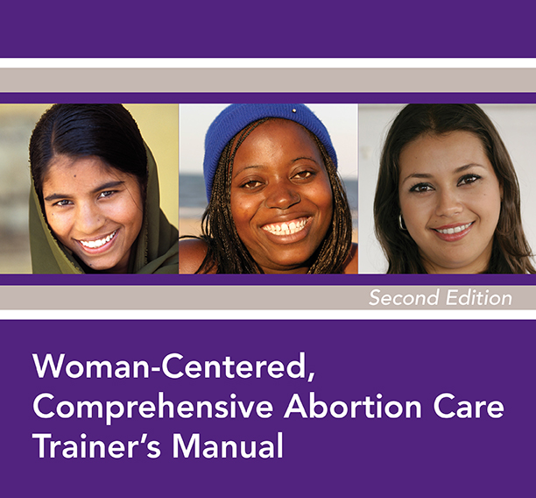
Notes:
The content of this presentation is largely from Ipas’s Woman-Centered Comprehensive Abortion Care curriculum. (The cover of the trainer’s manual is partially pictured on this slide.)

Slide 3
4 MODULES
Overview and guiding principles
Uterine evacuation methods
Contraceptive services
Ipas MVA instruments

Slide 4
MODULE 1: Overview and guiding principles

Slide 5
Rationale for preventing unsafe abortion
Public health
Unsafe abortion is one of the leading causes of maternal mortality in developing countries worldwide
The resulting deaths and injuries are entirely preventable
Human rights
Criminalization of abortion and high rates of unsafe abortion violate women’s right to health.
Additionally, this violates women’s right to:
  life
  equality and non-discrimination
  self-determination and to determine the number and spacing of children
Notes:
There are recognized public health and human rights rationales for preventing unsafe abortion.
While both are important, one or another may resonate better with different audiences. It is important to be aware of both.
The public health rationale is clear… the substantial morbidity and mortality due to unsafe abortion is entirely preventable with access to safe abortion and contraception—and of course the provision of postabortion care services to treat complications of unsafe abortion wherever needed regardless of the abortion laws.
International human rights law says that criminalization of abortion and high rates of unsafe abortion violate women’s right to health.
UN committees have also linked abortion to the human rights to life, to equality and non-discrimination, and to self-determination and to determine the number and spacing of children.

Slide 6
Abortion is a safe medical procedure
“When performed by skilled providers using correct medical techniques and drugs, and under hygienic conditions, induced abortion is a very safe medical procedure.”
– World Health Organization
Notes:
The World Health Organization states: [read what’s on slide]

Slide 7
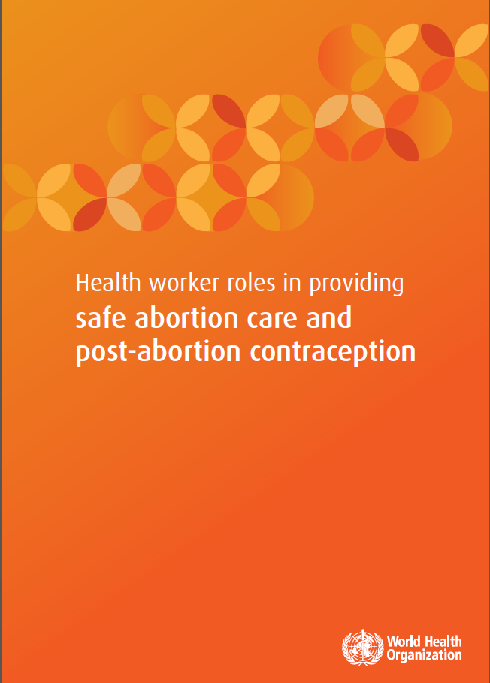
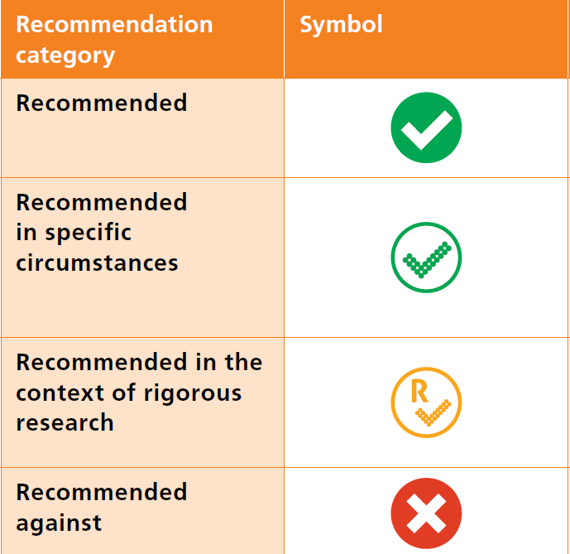
Increased support for task sharing in abortion care
Notes:
The World Health Organization (WHO) released this excellent guidance in 2015 on task sharing in safe abortion care and postabortion contraception.
This guidance provides evidence-based support for different cadres of health workers and women themselves performing different aspects of abortion care.
When you go into the document, you will see that first-trimester abortion care with manual vacuum aspiration (MVA) and medical abortion is “recommended” for nurses, midwives, and other advanced associate clinicians such as clinical officers, physician assistants and nurse practitioners.
[POINT OUT WHAT THE SYMBOLS MEAN IN THE CHART ON THE SLIDE]
This task-sharing guidance is recommended. The benefits of implementing this option outweigh the possible harms. This option can be implemented, including at scale.

Slide 8
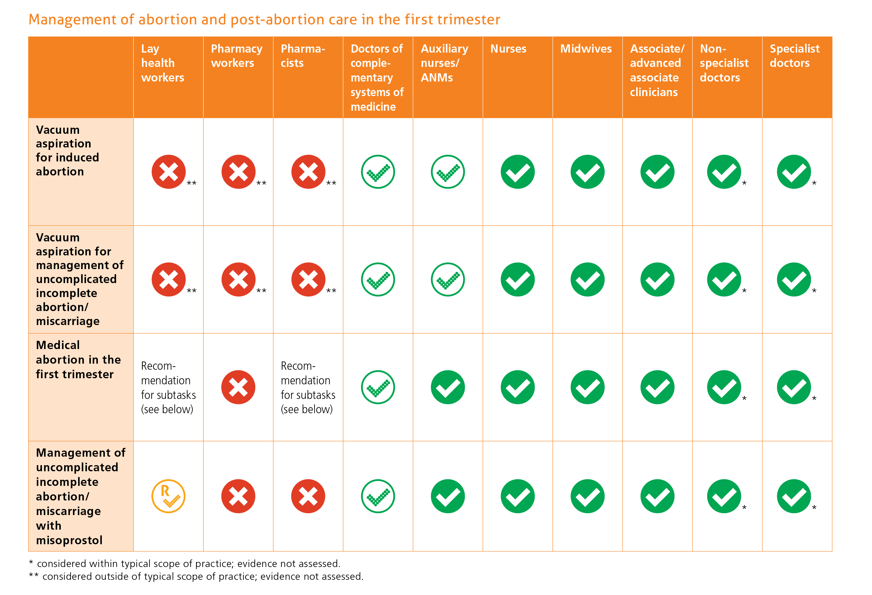
Notes:
Talk through the cadres for which abortion care is recommended by WHO.

Slide 9
Woman-centered, comprehensive abortion care
Accounts for a woman’s individual physical and emotional health needs and circumstances—and her ability to access care
Includes:
  Induced abortion
  Treatment of incomplete, missed or unsafe abortion
  Compassionate counseling
  Contraceptive services
  Related sexual and reproductive health services provided onsite or via referrals
  Community-service provider partnerships
Notes:
Here’s the definition of comprehensive abortion care (sometimes referred to as CAC).
[Read and explain the text on the slide as needed.]

Slide 10
Postabortion care
Woman-centered, comprehensive abortion care includes postabortion care
Postabortion care = a series of medical and related interventions to manage complications of spontaneous and induced abortions, both safe and unsafe
Postabortion care also addresses women’s related health-care needs
Notes:
Here’s the definition of postabortion care, sometimes referred to as PAC.
[Read and explain text on slide as needed.]

Slide 11
MODULE 2: Uterine evacuation methods

Slide 12
Uterine evacuation methods
Uterine evacuation removes contents of the uterus
Recommended methods up to 13 weeks gestation:
  Vacuum aspiration
  Medical methods (abortion with pills)
Both methods can be used for induced abortion and postabortion care
Notes:
[Review slide content]

Slide 13
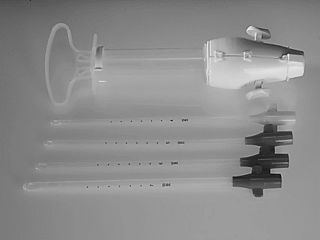
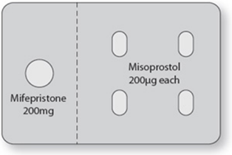
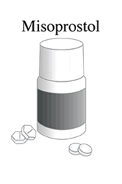
Uterine evacuation methods = Safe and effective procedures
WHO recommends both methods
Require appropriate technology
Can be performed by many provider cadres
Manual vacuum aspirator (MVA) = easy to use, clean and process; requires no electricity
Misoprostol = sometimes less expensive; often available for multiple indications
97-99.5% effective
95-98% effective
83-87% effective
Notes:
Today we have excellent technologies that are affordable, effective, safe and have abundant evidence that they can be offered safely and effectively in low-resource settings at the primary care level.
The WHO recommends manual vacuum aspiration (MVA) and medical abortion with mifepristone + misoprostol as the primary methods in the first trimester.
Where mifepristone is not available, misoprostol can also be used by itself.
[POINT OUT THE EFFICACIES OF THE METHODS LISTED ON THE SLIDE]
All of these methods are appropriate in crisis settings for the reasons you see here.
MVA and medical abortion are not complicated to provide. They do not require running water. They do not require electricity or sophisticated equipment. And they can be done by many provider cadres such as nurses, midwives and clinical officers with no difference in effectiveness and complication rates compared to doctors.
MVA and medical abortion can be provided in a health center, in any facility that provides Basic Emergency Obstetric and Newborn Care or other similar services, and certainly in hospitals.
MVA and misoprostol are currently already available in the Reproductive Health Kit labeled for the management of miscarriage and complications of abortion.
Mifepristone will soon be available to order through the UNFPA RH kit system as an additional commodity where it is approved in country.

Slide 14
Obsolete method: Sharp curettage
“Dilatation and curettage (D&C) is an obsolete method of surgical abortion and should be replaced by vacuum aspiration and/or medical methods.” – World Health Organization
The International Federation of Gynecology and Obstetrics (FIGO) supports vacuum aspiration and medical methods over sharp curettage
Health systems should replace sharp curettage with vacuum aspiration and medical methods
Sharp curettage has increased blood loss, pain and procedure time compared to vacuum aspiration
Notes:
{Review content of slide]

Slide 15
Factors in choosing a uterine evacuation method
Staff skills
Equipment, supplies and drugs available
The woman’s clinical condition
The woman’s personal preference
The woman’s choice of contraceptive method
Notes:
Explain that the uterine evacuation method that a woman uses is determined by availability of vacuum aspiration or medical methods, the woman’s medical eligibility for the methods based on her clinical condition, and her preferences, including her choice of contraceptive method.
The type of contraceptive method the woman desires can determine the type of UE method. For instance, if she wants an IUD, she will need to have an MVA if she wants the IUD placed the same day. If she chooses medical abortion, she will have to come back in a week or so once she is no longer pregnant to get the IUD.
[REVIEW AND DISCUSS SLIDE FURTHER AS NEEDED]

Slide 16
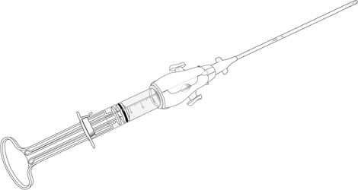
Ipas MVA Plus® with
Ipas EasyGrip® Cannulae
Notes:
The manual vacuum aspirator (MVA) removes the contents of the uterus through a cannula attached to a hand-held device that contains a vacuum that is manually created. The vacuum source is portable and does not need electricity.

Slide 17
Vacuum aspiration
Two types: manual vacuum aspiration (MVA) and electric vacuum aspiration (EVA)
Results in few complications, especially when performed in the first trimester
Most studies show success in 98-100% of cases, including for incomplete abortion
Less costly when performed on outpatient basis with local anesthesia
Notes:
[Review content on slide]

Slide 18
Acceptability of vacuum aspiration
Women find vacuum aspiration acceptable because:
They can remain awake during the procedure
They don’t have to stay overnight at the clinic if the procedure is performed on an outpatient basis
MVA is quiet

Slide 19
Value of MVA in crisis settings
Appropriate for use in primary care facilities
Appropriate technology for low-resource and crisis settings
Easy to use, clean and process
Requires no electricity
Mid-level providers can perform MVA with no difference in complication rates compared to doctors
Notes:
[Review content on slide]

Slide 20
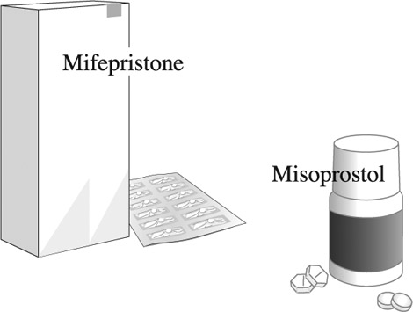
Medical methods
(abortion with pills)
Notes:
There are two medications involved in medical abortion: mifepristone and misoprostol. Using both these medications together is most effective and is the recommended method when both are available. However, misoprostol can be used alone when mifepristone is not available.

Slide 21
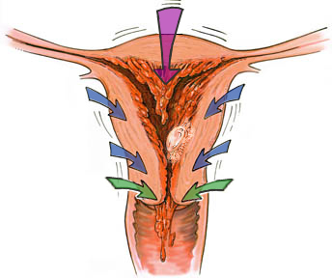
Medical abortion: Mechanism of action
Progesterone blockade
Decidual
necrosis
Rhythmic
uterine
contractions
Cervical
ripening
Detachment
Expulsion
Abortion
National Abortion Federation, 2005
© Lisa Peñalver, penart1@alaska.com
Mifepristone blocks progesterone activity in the uterus, leading to detachment of the pregnancy. Mifepristone also increases uterine sensitivity to misoprostol and softens the cervix.
Misoprostol, a synthetic prostaglandin, stimulates uterine contractions and causes uterine evacuation.
Notes:
Drugs such as mifepristone and misoprostol soften the cervix and stimulate uterine contractions, which causes expulsion of the contents of the uterus. In addition, mifepristone blocks progesterone activity in the uterus, leading to detachment of the pregnancy.
[Review content of slide further as needed]

Slide 22
Medical methods for induced abortion up to 13 weeks
 | Mifepristone + Misoprostol | Misoprostol Only
Effectiveness Rate | >95% | 85%
Ongoing Pregnancy Rate | <2% | 3-10%
Complication Rate | <1-3% | 1-4%
Notes:
Medical abortion with either a combined regimen of mifepristone and misoprostol, or misoprostol used alone, is safe and effective. The rates reported here are for use of medical methods up to 13 weeks gestation. Although these medicines can be used after 13 weeks gestation, we are only discussing their use up to 13 weeks in this training. Because the combined regimen has a higher effectiveness rate and very low complication and ongoing pregnancy rates, it is recommended for medical abortion. However, where mifepristone is not available, misoprostol alone can still be safely used.
Regardless of the method used for medical abortion, a proportion of women who use medical methods will require uterine evacuation with vacuum aspiration, either due to method failure, or incomplete abortion. When using medical methods for uterine evacuation, it is necessary to have vacuum aspiration available, either on-site or by referral.

Slide 23
Misoprostol for postabortion care
Misoprostol can be used to treat incomplete and missed abortion
Effectiveness:
  Incomplete abortion: 91-99%
  Missed abortion: 76-93%
Notes:
Misoprostol can be used to treat uncomplicated incomplete abortion and missed abortion. The effectiveness rates reported here are for uterine size less than 13 weeks gestation. Although misoprostol can be used for uterine size greater than 13 weeks, we are only discussing less than 13 weeks in this training. Not every woman who needs postabortion care will be eligible to use misoprostol for uterine evacuation, and in some cases, medical management will fail. When using misoprostol for postabortion care, it is necessary to have vacuum aspiration available either on-site or by referral.

Slide 24
Cost considerations of medical methods
Costs depend on the regimen used and re-evacuation, if needed
Misoprostol by itself is generally inexpensive
Mifepristone is not available in all settings and may be costly

Slide 25
Acceptability of medical methods
Women find medical abortion acceptable because:
The medications can often be taken at home or another preferred location, and the abortion process completed there
Some women perceive it as more private and natural than other methods
Some women prefer a non-surgical option
Studies indicate women’s and providers’ high satisfaction with medical methods in a variety of settings, including where resources are limited
Notes:
[Review content on slide]

Slide 26
Value of misoprostol in crisis settings
Can be provided on an outpatient basis and at the community level
Can be used by midlevel providers as safely and effectively as doctors
Expands access to uterine evacuation where there are no providers trained in vacuum aspiration
Simple to administer; does not require specialized equipment, facilities or staffing
Inexpensive and widely available
Stable at room temperature
Notes:
[Review content of slide]

Slide 27
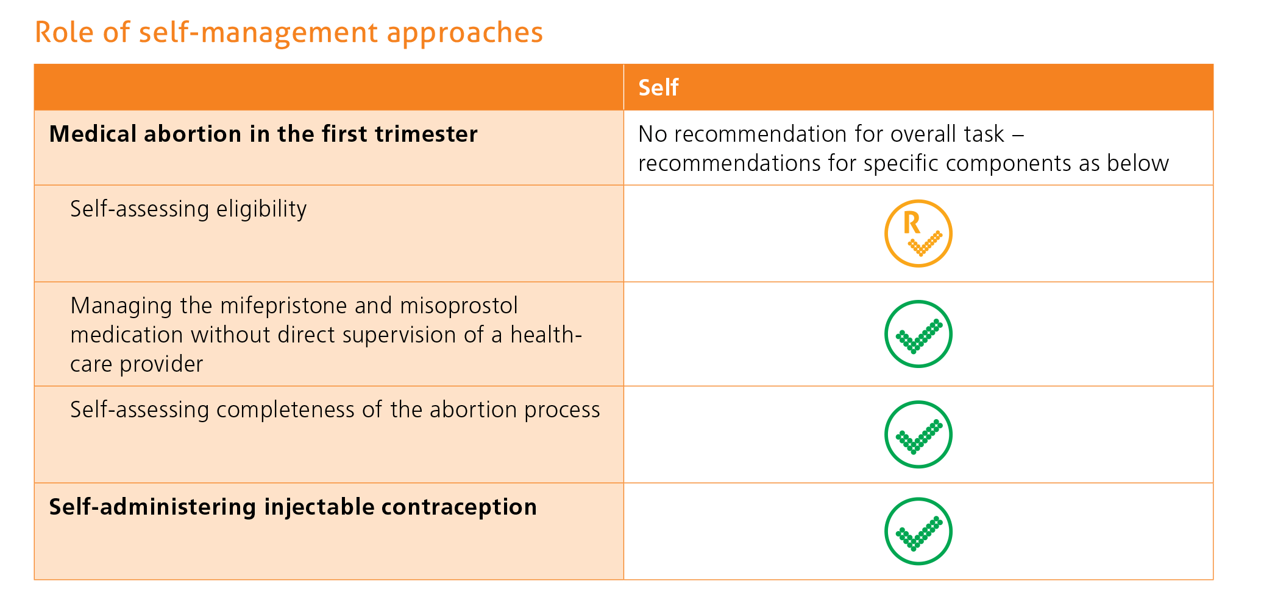
What about women’s role?
Notes:
WHO’s guidance that we discussed earlier—Health worker roles in providing safe abortion care and post-abortion contraception—contains this guidance “Women themselves have a role to play in managing their own health and this constitutes another important component of task sharing within health systems.”
The chart on this slide from the guidance provides recommendations for women’s role in self-assessment and self-management of medical abortion and contraception “in contexts where the woman has access to appropriate information and to health services should she need or want them at any stage of the process.”
REMINDER: The yellow checkmark means “recommended in the context of rigorous research” and the dotted green checkmark means “Recommended in specific circumstances.”
There is growing evidence supporting women’s self-management of medical abortion, although more research is still needed in some areas.

Slide 28
Frequency of adverse events of uterine evacuation methods
Adverse events | Frequency
Failed abortion in first trimester with misoprostol only (needing vacuum aspiration for any reason) | 15%
Failed abortion in first trimester with mifepristone + misoprostol (needing vacuum aspiration for any reason) | 5%
Infection in first trimester with medical abortion | 0.3%
Any adverse event from first-trimester vacuum aspiration abortion | <1%
Serious adverse event from first-trimester vacuum aspiration abortion | <0.1%
Second-trimester medical abortion needing surgical evacuation | 8%
Serious complications from second-trimester medical abortion (transfusion, hemorrhage, laparotomy) | 1%
Serious complications from second-trimester D&E | 2%
Notes:
Complications do occur, but they are rare. These numbers come from large case series in experienced centers, so complication rates may be higher in centers with less experience or lower case volume.
The failed abortion rate in first trimester with misoprostol-only medical abortion is around 15%. (NOTE: Failed abortion is needing vacuum aspiration for any reason including retained products of conception, incomplete abortion, ongoing pregnancy or bleeding.) The ongoing pregnancy rate is around 5%. For first-trimester mifepristone-misoprostol medical abortion using the recommended regimen, failed abortion is 4-5% and ongoing pregnancy rate is <1%
Infection in first-trimester medical abortion is 0.3%
Any adverse event after first-trimester vacuum aspiration <1% (8.46/1000)
Serious adverse event after first-trimester vacuum aspiration <.1% (0.71/1000)
Second-trimester medical abortion needing surgical evacuation (for any indication including retained placenta, bleeding, failure to pass products) is about 8%
Second-trimester medical abortion serious complications (transfusion, hemorrhage, laparotomy) rate is about 1%
Second-trimester D&E serious complications rate is about 2%.

Slide 29
Frequency of death related to uterine evacuation methods
Method | Frequency of death
First-trimester vacuum aspiration abortion | 1/1,000,000 (0.0001%)
First-trimester medical abortion | 1/100,000 (0.001%)
Second-trimester D&E | 3.3/100,000 (0.0033%)
Notes:
In reviewing this slide, please note that the frequency of death is VERY low.

Slide 30
Long-term safety
Safe, induced abortion does NOT cause:
future infertility
breast cancer
severe psychological reactions
Notes:
When we talk with women about how first-trimester uterine evacuation is a safe and effective procedure and complications are very rare, many women will want to know about the long-term effects. Groups that are against abortion have disseminated a lot of misinformation about its long-term effects in an effort to restrict women’s access to abortion.
Here are the facts: [READ SLIDE]

Slide 31
Care after abortion
Following uncomplicated abortion with MVA or mifepristone + misoprostol, there is no need for a follow-up visit. But, women should be given:
Adequate information on complications and care after their abortion
Contraceptive information and a method, if desired
The option of a follow-up visit, if needed or wanted
Follow-up is still recommended after misoprostol-only abortion due to its lower efficacy.
Notes:
Following uncomplicated abortion, there is no medical need for a follow-up visit. However, other important aspects of care after an abortion include:
Before leaving the facility, the woman should be provided with adequate oral and written information on self-care after the abortion and how to recognize complications that need medical treatment. Notify the woman that she can come to the facility at any time if needed or desired.
Women should receive contraceptive information and, for those women who so desire, they should receive either a contraceptive method or a referral before they leave the facility.
Follow-up visit, if the woman experiences any complications or if she desires one for reassurance or for other reproductive health needs.
Providers can also discuss and provide emergency contraception, as well as discuss prevention of sexually transmitted infections (STIs), including HIV.

Slide 32
MODULE 3: Contraceptive services

Slide 33
Return to fertility
How soon after a uterine evacuation
can ovulation occur?
Notes:
[Ask participants if anyone knows the answer to the question on the slide]
ANSWER: Ovulation can take place within 2 weeks after a vacuum aspiration abortion or incomplete abortion, and as early as 8 days after medical abortion with mifepristone and misoprostol. Contraception should be provided immediately to women who want to prevent pregnancy.
A common factor among women receiving abortion-related care is that they are at a critical juncture in their lives and can benefit from compassionate counseling about contraception.

Slide 34
Preferred service delivery model
Offer counseling and method provision in the same unit or clinic, if possible
Have interim methods available for when methods of choice are not in supply
Have different cadres of staff provide contraceptive services
Notes:
[Review content on slide]

Slide 35
Timing of contraceptive counseling
Ideally:
Before or immediately after the uterine evacuation procedure
Otherwise:
At a follow-up visit, if scheduled
Notes:
Providing counseling BEFORE uterine evacuation is the recommended timing, when possible depending on a woman’s condition.

Slide 36
Key messages on postabortion contraception
A woman can become pregnant again almost immediately after an abortion
In general, all contraceptive methods can be used immediately after abortion
Make sure women know where to go for contraceptive services, including emergency contraception
Notes:
Remember, ovulation can occur within 2 weeks after vacuum aspiration, and as early as 8 days after medical abortion with mifepristone and misoprostol.

Slide 37
If a woman comes to a hospital with an incomplete abortion, we’ve already failed once to help her avoid an unwanted or mistimed pregnancy. If she leaves the facility without having any means of preventing another pregnancy in the future that may not be wanted, we’ve failed her twice.
- Cynthia Steele Verme, Postabortion Care Consortium
Notes:
Many women receiving abortion-related services have terminated unwanted pregnancies that resulted from contraceptive failure or from failure to use the method consistently or correctly.
When providing contraceptive counseling with a woman who has just had an abortion or treatment of an incomplete abortion, the first step is to ask her whether and when she wants to become pregnant again and if she desires contraceptive counseling and methods.

Slide 38
Informed choice
This includes:
Choosing a method voluntarily, without coercion or pressure
Choosing from a wide range of methods
Understanding the benefits and risks of each method
Informed consent is:
Obtained prior to method provision
Particularly important for permanent methods such as sterilization
Notes:
[Review content of slide]

Slide 39
Contraception after medical abortion
Method | When to start
Hormonal methods: pills, patch, ring, injectables and implants | With first pill of medical abortion
IUD Female sterilization | When it is reasonably certain the woman is no longer pregnant (within 5-7 days)
Notes:
Long-acting removable contraceptive (LARC) methods have higher continuation rates and lower pregnancy rates compared to short-acting methods.

Slide 40
Contraception after vacuum aspiration
Method | When to start
Hormonal methods: pills, patch, ring, injectables and implants | Immediately following uncomplicated procedure
IUD Female Sterilization | Check products of conception and begin placement of IUD or subdermal implant
Vacuum aspiration with complications: Infection
IUD and sterilization appropriate when infection is resolved
Notes:
Immediate initiation of contraception (hormonal and non-hormonal contraception and male and female sterilization) following aspiration abortion before 13 weeks gestation is safe.
Informed choice regarding the availability of a range of contraceptive methods and the right to refuse contraception or have it removed should be encouraged.
Long-acting contraceptive methods (LARCs) have higher continuation rates and lower pregnancy rates compared to short-acting methods.
Intrauterine device (IUD) placement or female sterilization can be performed immediately following a successful uncomplicated abortion. The 2015 WHO Medical Eligibility Criteria for Contraceptive Use classifies female sterilization as acceptable after an uncomplicated abortion—no specified timeframe.
Male sterilization (vasectomy) is safe and effective and can be performed at any time.

Slide 41
MODULE 4: Ipas MVA instruments

Slide 42
Ipas MVA Plus® Aspirator and Ipas EasyGrip® Cannulae
Woman-centered, appropriate technology
Safe and effective for abortion-related care
Can be used in decentralized health-care settings
Notes:
[Review slide content]

Slide 43
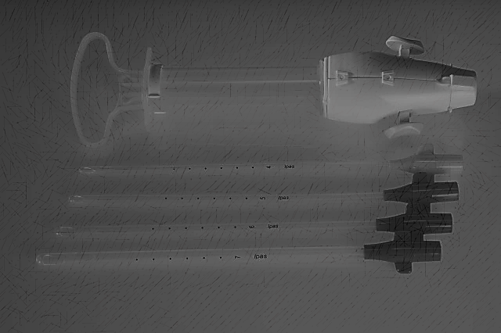
Instrument design features
Clear fluid path—no places for fluids to get trapped
All surfaces can be reached for direct cleaning
Heat tolerant for cleaning
“Lubricious plastics” prevent adhesion to device
Notes:
The Ipas MVA re-design in 2004-2005 was largely driven by infection prevention and incorporated these features:
Clear fluid path without ridges, crevices, etc. where fluids or materials get trapped
All surfaces can be reached for direct cleaning
The plastics are heat tolerant so that they can withstand processing by boiling or steam autoclaving
“Lubricious plastics” prevent the adhesion of fluids or material to the device and components during medical procedures

Slide 44
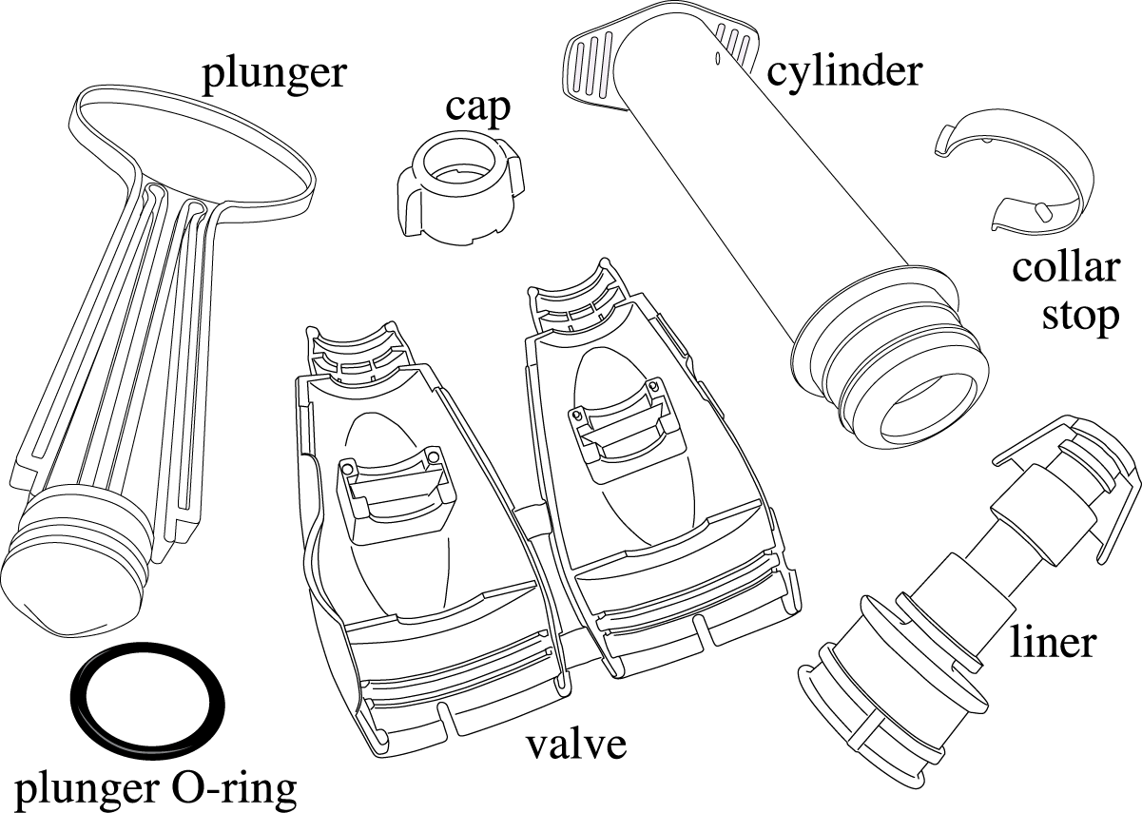
MVA parts disassembled
Notes:
Here you can see the MVA disassembled with all its components labeled. All can be easily cleaned and sterilized or high-level disinfected.

Slide 45
QUESTIONS?

Slide 46
Thank you!

Slide 47
Technical guidance resources
World Health Organization. (2012). Safe abortion: Technical and policy guidance for health systems (2nd ed.). Geneva: WHO. http://www.who.int/reproductivehealth/publications/unsafe_abortion/9789241548434/en/
World Health Organization. (2014). Clinical practice handbook for safe abortion. Geneva: WHO. http://www.who.int/reproductivehealth/publications/unsafe_abortion/clinical-practice-safe-abortion/en/
World Health Organization. (2015). Health worker roles in providing safe abortion care and post-abortion contraception. Geneva: WHO.
http://srhr.org/safeabortion/

Slide 48
Technical guidance resources (continued)
Inter-Agency Working Group (IAWG) on Reproductive Health in Crises. (2018). Inter-agency field manual on reproductive health in humanitarian settings. IAWG. (forthcoming) www.iawg.net
Ipas. (2018). Abortion attitude transformation: A values clarification toolkit for humanitarian audiences. Chapel Hill, NC: Ipas. www.ipas.org/humanitarianVCAT
Ipas. (2018). Clinical updates in reproductive health. Castleman, L. & Kapp, N. (Eds.). Chapel Hill, NC: Ipas. (Updated annually) www.ipas.org/clinicalupdates
Ipas. (2013 & 2014). Woman-centered, comprehensive abortion care: Reference & Trainer’s manuals (2nd ed.) Turner, K. L. & Huber, A. (Eds.). Chapel Hill, NC: Ipas. http://www.ipas.org/en/News/2015/January/The--go-to--training-curriculum-for-abortion-care--Ipas-s-newly-revised-Woman-Centered--Co.aspx

