Slide 1
Fundamentals of abortion self-care

Slide 2

Session objectives
By the end of this session, participants will:
Understand the concept of self-care
Appreciate the role of self-care in improving access to abortion
Describe various approaches to normalizing abortion self-care

Slide 3
Abortion at a glance
Worldwide, approximately 25 million unsafe abortions take place every year.
  97% of these unsafe abortions occur in developing countries.
In Africa and Latin America, 3 out of 4 abortions are categorized as unsafe.
In sub-Saharan Africa, the high rate of population growth means that an unchanging abortion rate still means increasing numbers of abortions each year.
  The annual number of abortions nearly doubled between 1995–1999 and 2015–2019, from 4.3 million to 8.0 million.
Abortion rates in the most populous cities are typically higher than rates in a country as a whole.
Abortion rates are far higher among sexually active adolescents than among all women of reproductive age.
Global data show that restricting abortion makes no difference in how often it occurs: The annual abortion rate, at 40 per 1,000 women, is identical in settings where abortion is restricted and those where it is broadly legal.
The availability of medical abortion, or abortion with pills, has decreased the number of severe complications related to unsafe abortion.
Notes:
Note to facilitator: This slide should be adapted for your audience.

Slide 4
Overview:
Guiding principles of abortion self-care

Slide 5
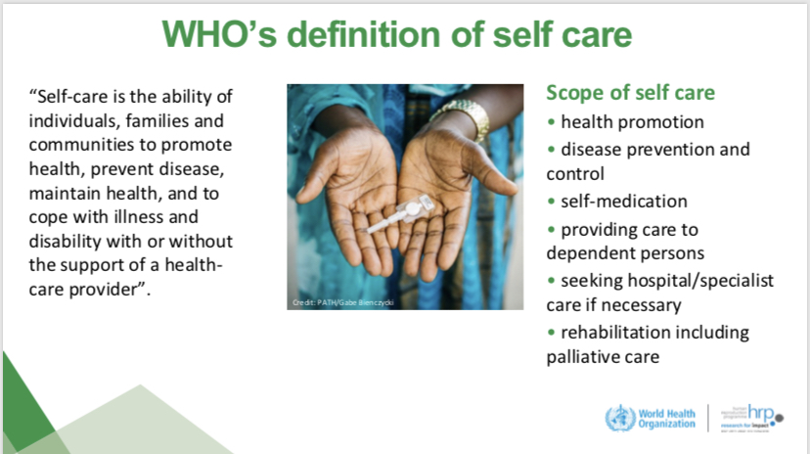

Slide 6
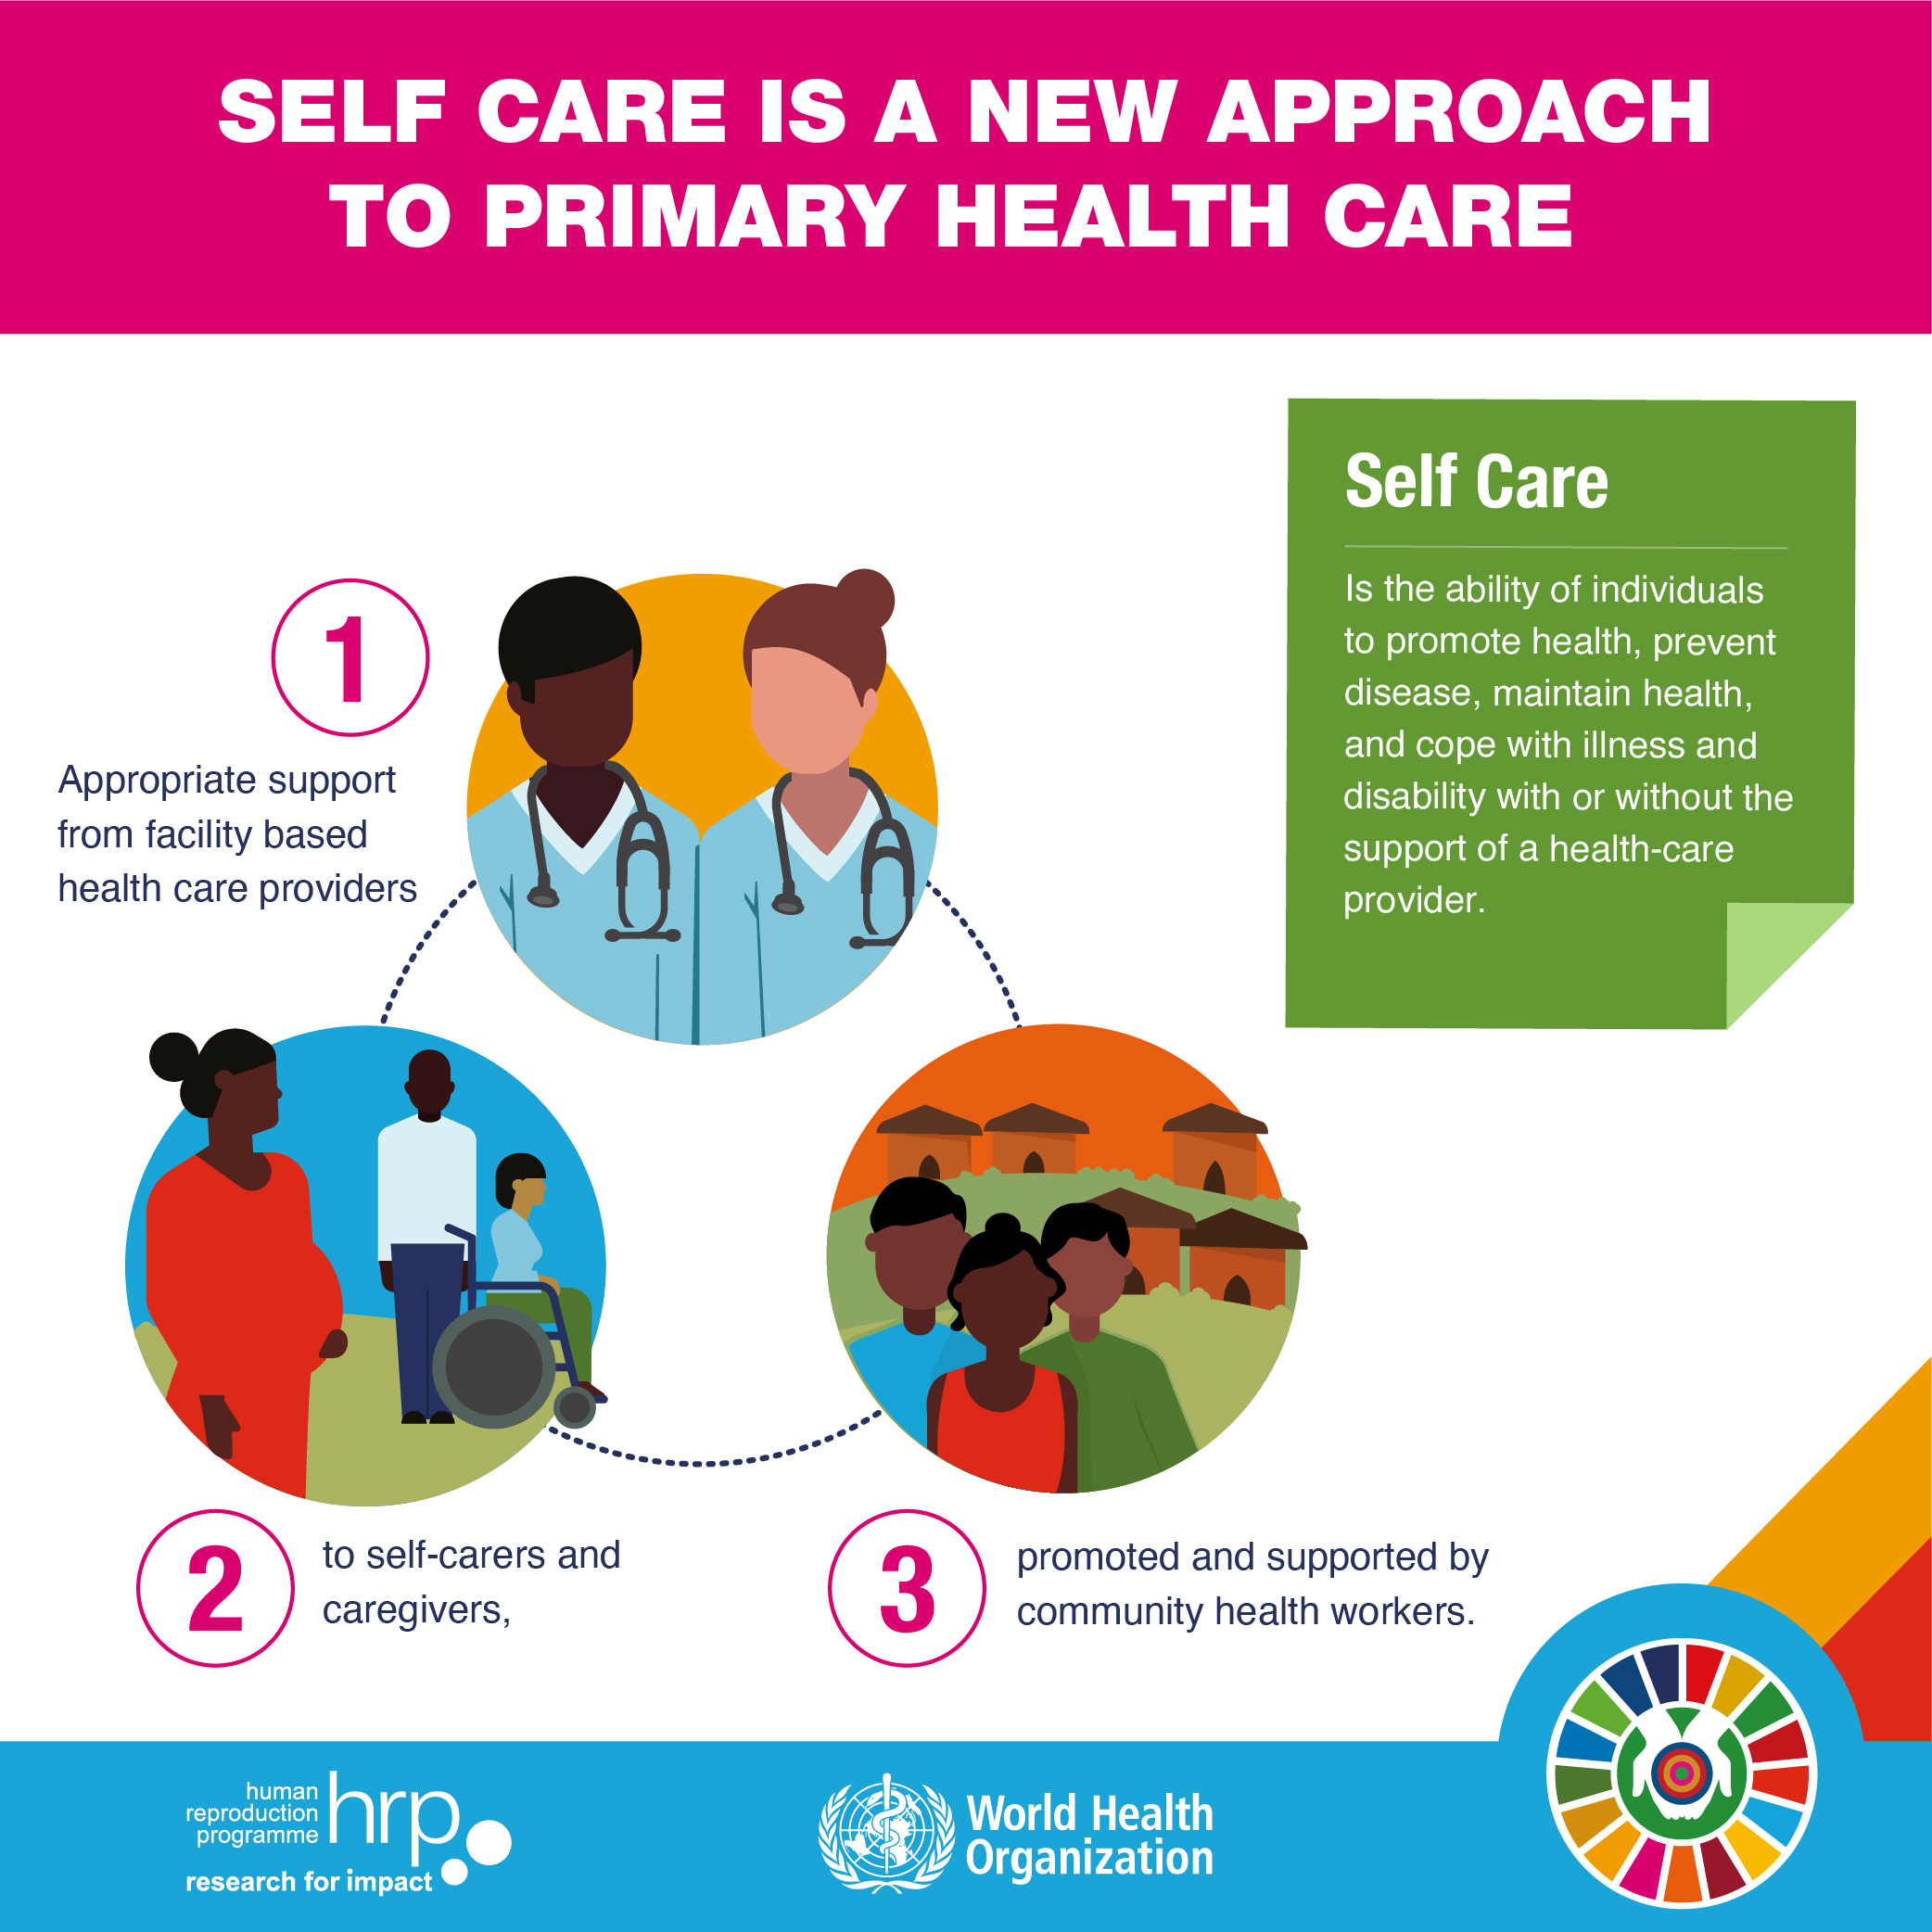
How does self-care intersect with health systems and health professionals?

Slide 7
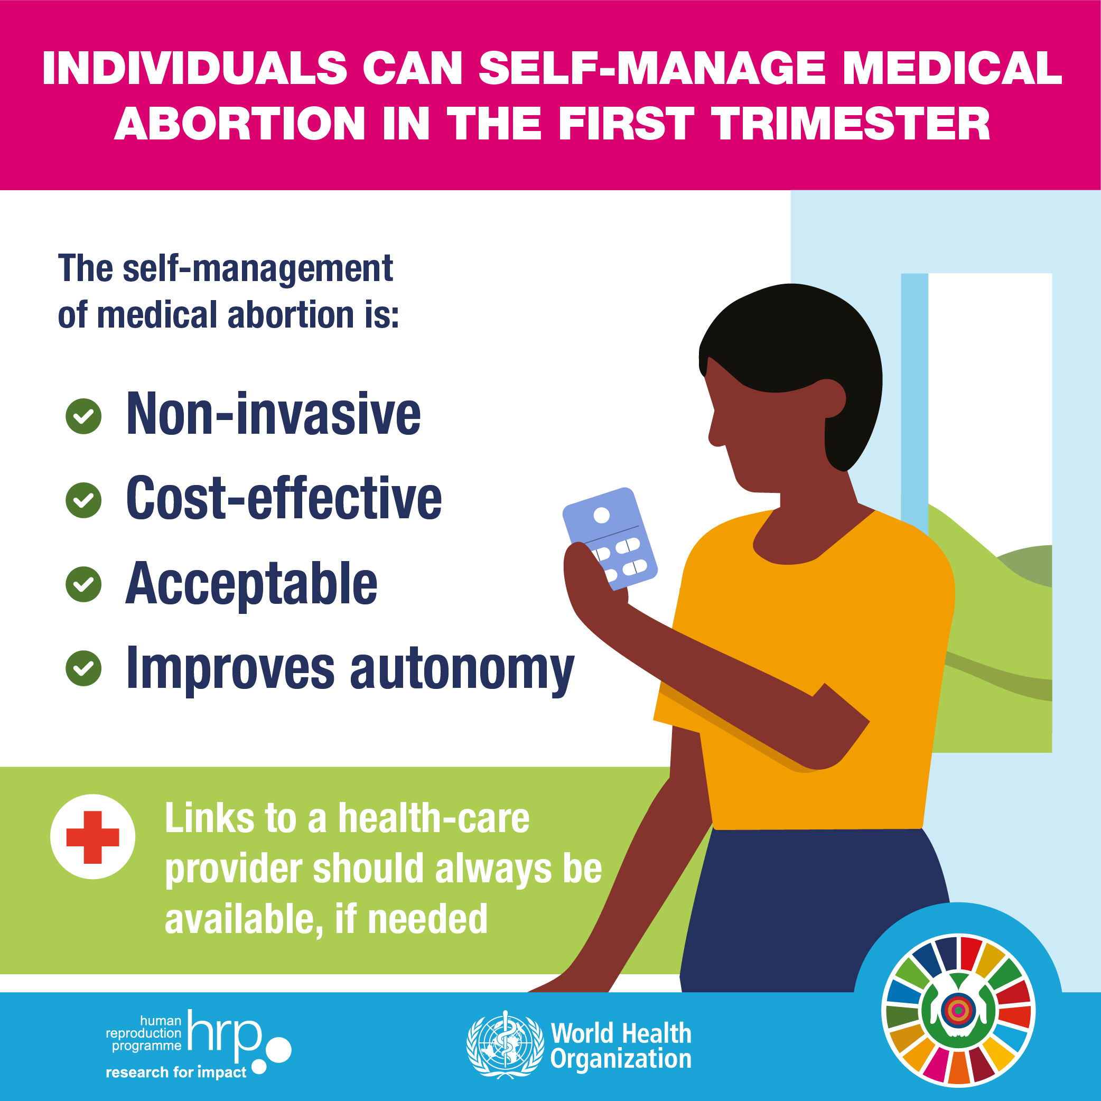
What is abortion self-care?
Abortion self-care (ASC) is an abortion with pills without the necessity of a prescription. The woman manages as much of the process as she wants on her own, with or without the involvement of a health-care provider.

Slide 8

Abortion with pills

Slide 9
Advantages of abortion self-care
Provides a safe and effective “no touch” method
    Mifepristone + misoprostol = highly effective
    Misoprostol alone = slightly less effective
Provides greater autonomy, privacy and control
    Done at home or in another safe space
Is done without direct supervision from a health-care provider
Further demedicalizes abortion
Increases access to services

Slide 10

How do we normalize abortion self-care?
Approaches to and elements of ASC programming

Slide 11
Approaches to ASC programming
Harm reduction
Public health perspective
Human rights perspective
Feminist perspective

Slide 12
Elements of ASC programming
Understanding the existing abortion ecosystem
Understanding the needs and preferences of women and community intermediaries
Reaching women and community intermediaries directly
Engaging with key stakeholders and gatekeepers
Understanding contextual and country-level policies to minimize risks for providers and women

Slide 13
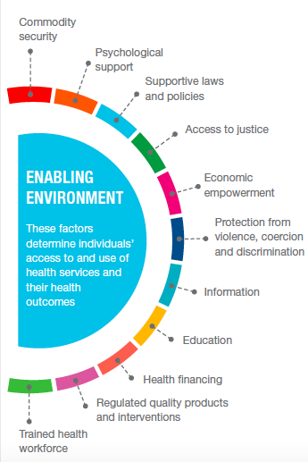
Normalizing abortion self-care means creating an enabling environment . . .
Providing accurate information to support women and girls in managing their abortion process
Ensuring proper supply chain management that guarantees consistent availability of commodities
Creating strong referral systems that support people in the event of an adverse event or complication
Training a variety of “providers” to provide women-centered information and access to drugs

Slide 14
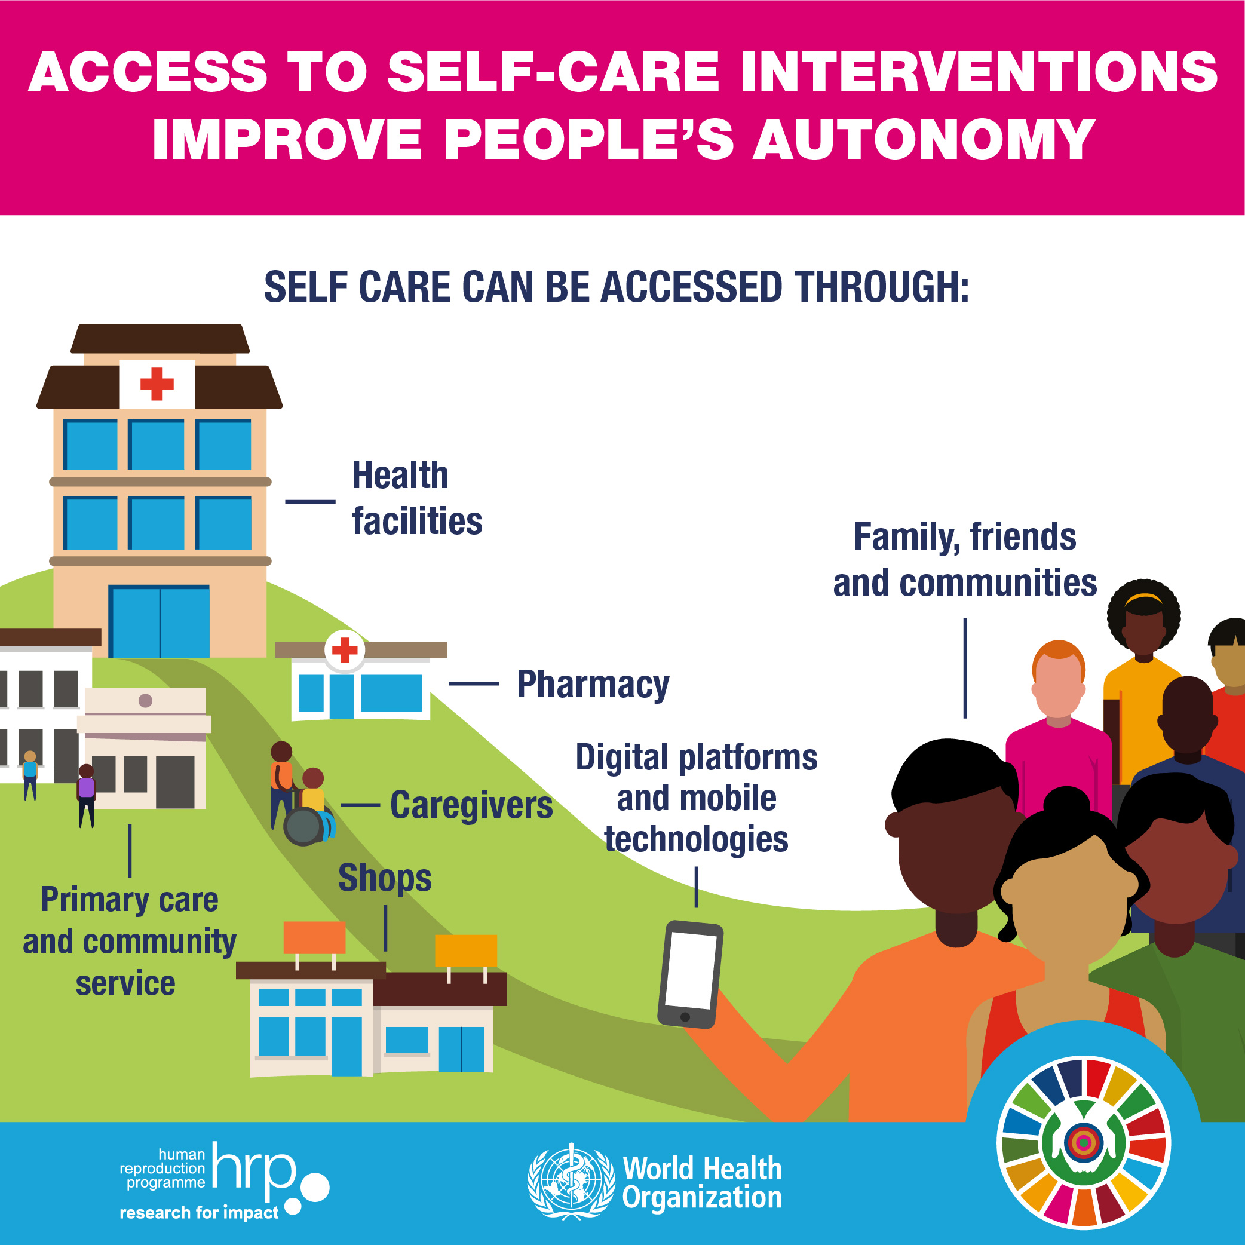
Abortion self-care access points
Telehealth
Pharmacy-based /over-the-counter access
  Phone consultations
  Home delivery
Online and web-based services
Hotlines
Mobile chatbots
Community intermediaries
A mix of all the above

Slide 15
What is needed for abortion self-care to be a safe and effective option for women?
Access to high-quality drugs
Good, simple information on how take the pills
Accurate information on what to expect
Access to help and support in case of complications

Slide 16
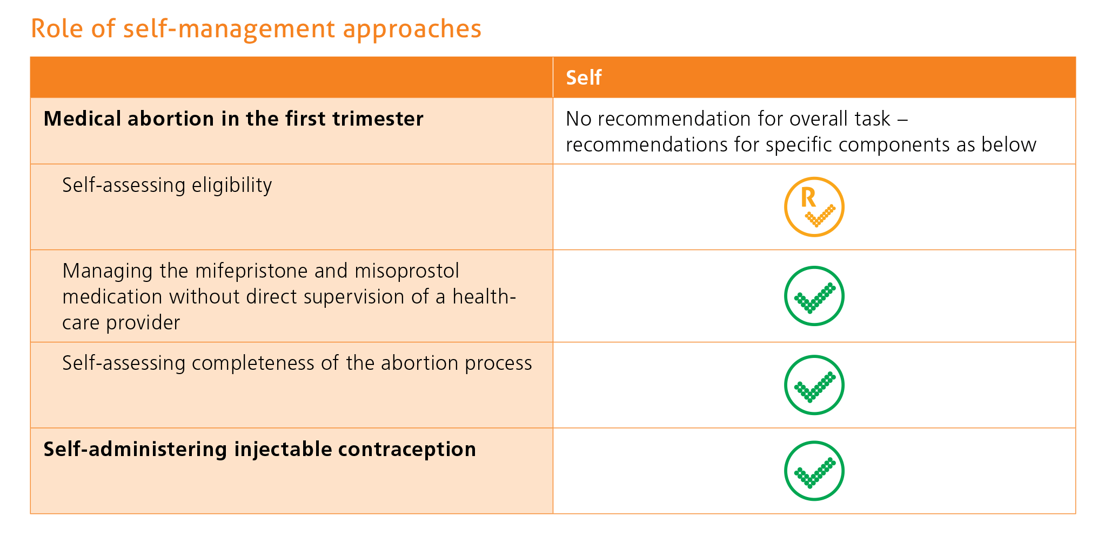
Women can self-manage their abortion

Slide 17
ASC programming: What to avoid
Replication of the health system model/approach
Overemphasis on medical eligibility
Information overload
Additional barriers to care
Insistence on postabortion contraception

Slide 18
ASC programming: Case study 1
Notes:
Note to Facilitators: Include a case study that is relevant to your setting/context/audience. Include information on the context, intervention, results, outcomes, lessons learned.

Slide 19
Abortion self-care key messages
Abortion self-care is about reaching women and girls where they are
There is no standard way of doing ASC programming or interventions
ASC interventions should be linked to a supportive health system
The role of Ipas (and other sexual and reproductive health and rights organizations) is to:
  Amplify women’s voices
  Support women’s choices
  Improve women’s access (to information, drugs and care)
  Normalize women’s experiences across the spectrum of abortion care

Slide 20
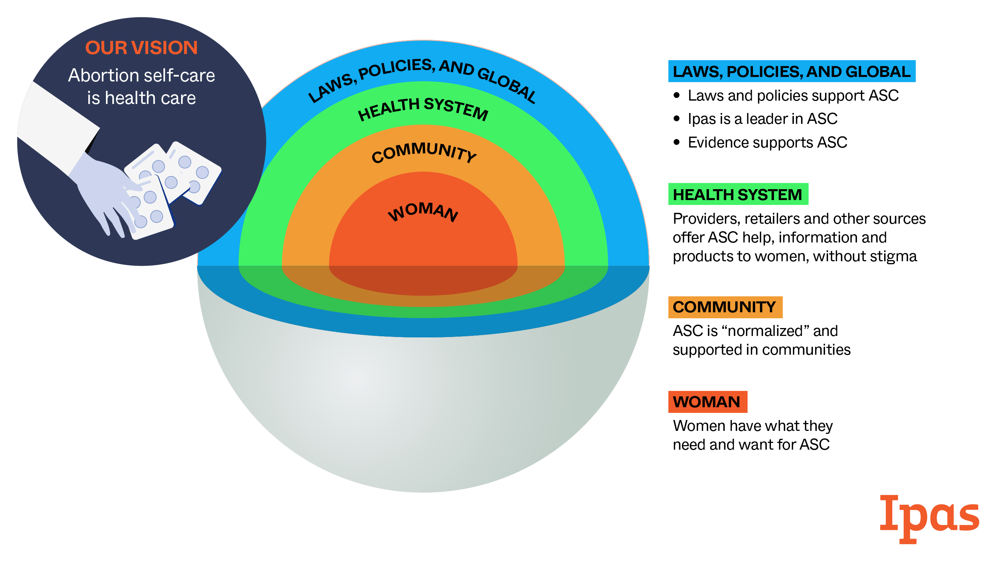

Slide 21
ASC resources at Ipas
Available at www.ipas.org/AbortionWithPills:
  Video: How to have an abortion with pills: Mina’s story
  Guide: How to have an abortion with pills
  FAQ: How to buy abortion pills that are safe and effective
  Guide: Medication abortion self-care: A guide for community accompaniment to support women
  Nurse Nisa (sexual and reproductive health chatbot)
  Abortion Self-Care VCAT Toolkit

Slide 22

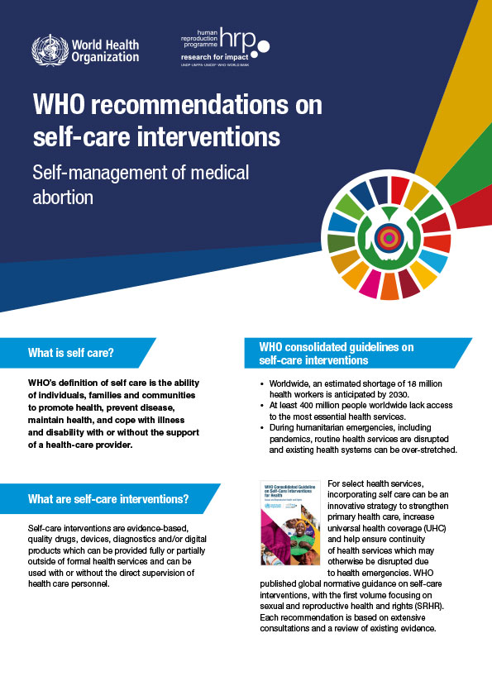
Sexual and reproductive health self-care resources at WHO
World Health Organization. (2019). WHO consolidated guideline on self-care interventions for health: Sexual and reproductive health and rights. https://apps.who.int/iris/bitstream/handle/10665/325480/9789241550550-eng.pdf
World Health Organization. (‎2020)‎. WHO recommendations on self-care interventions: Self-management of medical abortion. https://apps.who.int/iris/handle/10665/332334
World Health Organization. (2022). Sexual and reproductive health: Self-care interventions for health [web page]. https://www.who.int/reproductivehealth/self-care-interventions/en/

Slide 23
Thank you!

