Slide 1
Overview of Unsafe Abortion and Abortion Rights
Notes:
Please note: This PowerPoint presentation gives a high-level overview and includes data at the global level. It is very important to personalize and adapt this to your own context. You might have abortion-related data specific for your country; if you are unable to find country-level data, you can still add data at the sub-regional level, as well as any country-level data that might be relevant (maternal mortality rate, rates of unmet need for contraceptives, etc). The following resources may be helpful as you are developing additional content for this PowerPoint presentation:
Unsafe abortion: global and regional estimates of the incidence of unsafe abortion and associated mortality in 2008 (full text) - WHO publication that includes regional data
Unsafe abortion incidence and mortality: Global and regional levels in 2008 and trends during 1990–2008 (Factsheet)
Facts on Induced Abortion Worldwide – Guttmacher publication
Global Abortion Policies Database – comprehensive database of abortion policy information for each country

Slide 2
Notes:
Note: Use data from your own context if available.
*Click for animation*
56 million abortions occur each year worldwide
Of those, 25 million are classified as unsafe.

Slide 3
Abortion in developing regions
Of the ~25 million women who have unsafe abortions annually:
98% are in the developing world
6.9 million are treated for complications
40% never receive treatment
7 million suffer long-term disability
~44,000 die—91% of those deaths are in Africa and South-Central Asia
Notes:
Note: add your own data if available.
REVIEW SOME OF THE STATS…

Slide 4
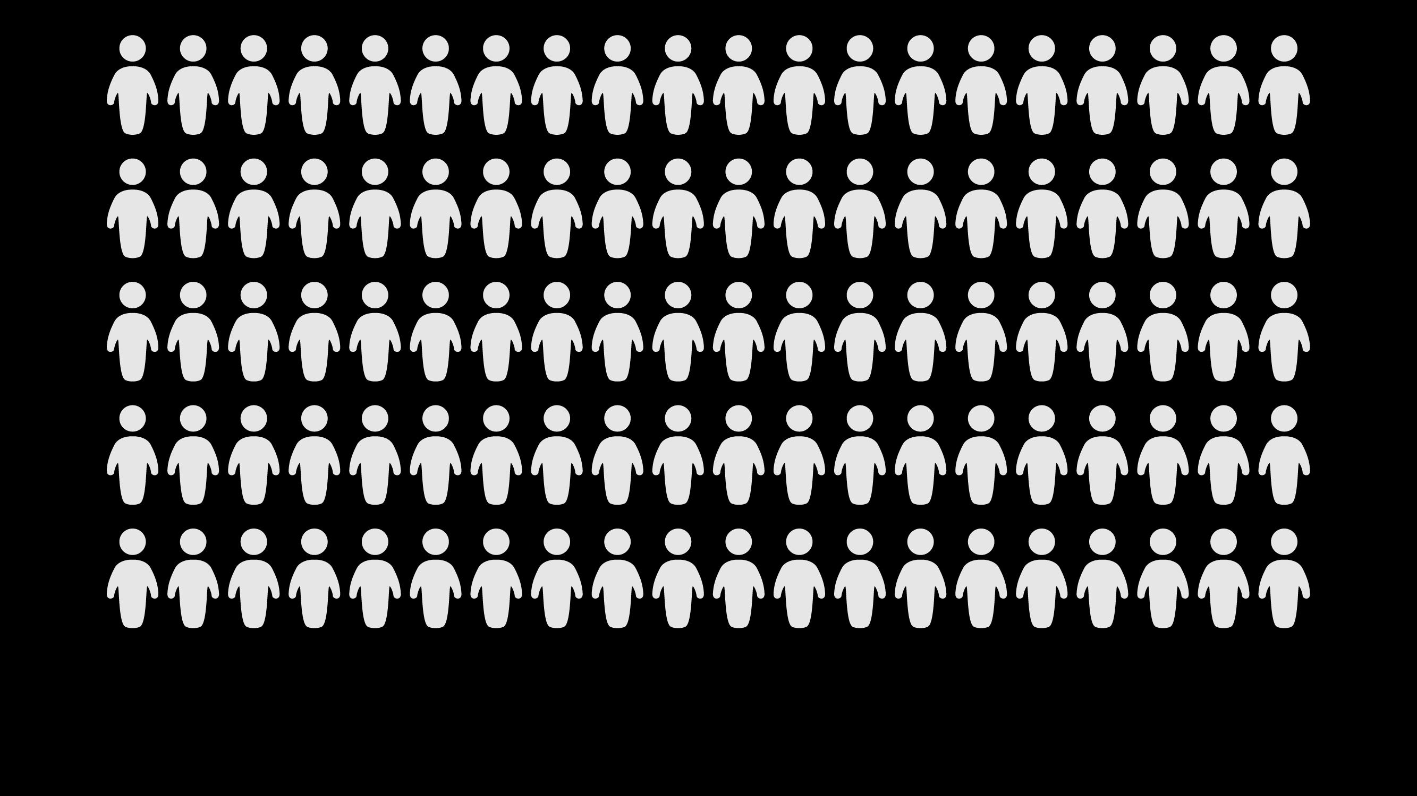
Notes:
*Click for animation*
8-18% of maternal deaths worldwide are due to unsafe abortion

Slide 5
Notes:
Restrictive laws do not stop women and girts from having abortions. In fact, abortion rates tend to be higher in countries with restrictive abortion laws.
Image: Guttmacher Institute. (2018). Infographic: Highly restrictive laws do not eliminate abortion. New York: Guttmacher Institute.

Slide 6
Notes:
Abortion restrictions DO increase the proportion of abortions that are unsafe. Abortion occurs at similar rates in countries where it is highly restricted and where it is broadly legal. Restrictions simply make the abortions that do occur more likely to be unsafe.
Image: Guttmacher Institute. (2018). Infographic: Disparities in safety of abortions across countries with varying legal restrictions. New York: Guttmacher Institute.

Slide 7
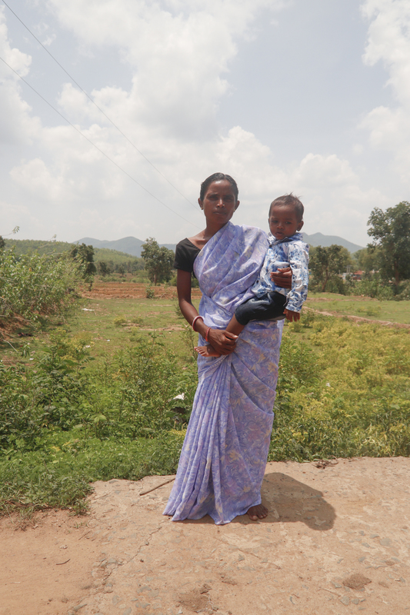
Abortion in developing countries
Women and girls who are poor, young, disabled, and/or living in rural settings or urban slums are most likely to suffer from unsafe abortions
© Sankar Sarkar Photography
Notes:
Barriers to care in developing countries:
Legal and policy barriers such as restrictive or vague laws
Social and cultural barriers such as gender discrimination, poverty, abortion stigma or lack of social support
Health system barriers such as a lack of facilities or trained providers, low-quality care or a high cost of services

Slide 8
Notes:
Women in low-income countries are most likely to have an unsafe abortion and, in turn, particularly likely to experience abortion complications. Furthermore, even within low-income countries, the poorest women have the least access to safe abortion care and are more likely to die from unsafe abortion.
Image: Guttmacher Institute. (2018). Infographic: Variations in safety of abortions across countries by income level. New York: Guttmacher Institute.

Slide 9
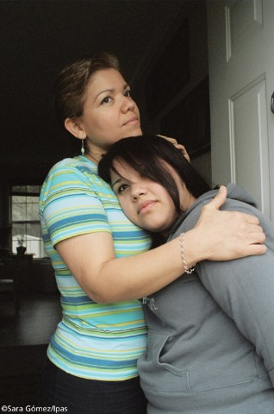
When safe abortion is not available, women:
Face delays in accessing safe services
Resort to seeking high-risk, unsafe abortions
Delay seeking care for complications of unsafe abortion
Are forced to risk their life and health to end a pregnancy
Are forced to become mothers against their will
Notes:
Use this slide to discuss some of the consequences when safe abortion is not accessible.

Slide 10
Public health and human rights
Public health
Unsafe abortion is one of the leading causes of maternal mortality in developing countries worldwide
The resulting deaths and injuries are entirely preventable
Human rights
Criminalization of abortion and high rates of unsafe abortion violate women’s right to health.
Additionally, this violates women’s right to:
life
equality and non-discrimination
self-determination and to determine the number and spacing of children
Notes:
Unsafe abortion is both a public health and a human rights concern. It is important to be familiar with both the public health and the human rights arguments for expanding access to safe abortion care.
The public health rationale is clear… the substantial morbidity and mortality due to unsafe abortion is entirely preventable with access to safe abortion and contraception—and of course the provision of postabortion care services to treat complications of unsafe abortion wherever needed regardless of the abortion laws.
International human rights law is clear that criminalization of abortion and high rates of unsafe abortion violate women’s right to health.
UN committees have also linked abortion to the human rights to life, to equality and non-discrimination, and to self-determination and to determine the number and spacing of children.

Slide 11
International human rights standards related to abortion
Notes:
Governments have an obligation to respect, protect, and fulfill human rights, including the right to health and non-discrimination and other fundamental human rights that support access to safe abortion care.

Slide 12
Abortion as a human right
Human rights treaty monitoring bodies have provided authoritative interpretive guidance on abortion as a human right through general comments and concluding observations. Specifically:
Maternal mortality due to unsafe abortion violates women’s right to life.
Restrictive abortion laws violate the rights to health and life.
Third-party authorization requirements for abortion violate rights to health and life.
Women’s right to health is violated by discriminatory laws and practices that limit access to certain reproductive health services for women, including abortion.
Notes:
Human rights treaty monitoring bodies have provided authoritative interpretive guidance on abortion as a human right. Specifically, we have seen clear guidance on how restrictions and barriers related to abortion, and the harm caused by unsafe abortion, are violations of women’s rights to health and life. Specifically: READ SLIDE.
Treaty monitoring bodies have consistently found that restrictive abortion laws violate human rights and that States have an obligation to, at a minimum, ensure safe, legal, equitable access to safe abortion care in cases of a threat to health or life, when a person has been the victim of rape or incest, or in cases of fetal anomaly.
WHO’s Safe Abortion: technical and policy guidance for health systems, provides for access to complete and accurate information to ensure informed consent, recommends women have access to both surgical and medical abortion, calls on states to ensure that abortion services are legal, and provides guidelines for postabortion care when needed.

Slide 13
Abortion as a human right
International treaties recognize that denying women access to safe, legal abortion also violates other human rights:
Right to be free of cruel, inhuman or degrading treatment
Right to equality and nondiscrimination
Right to privacy and self-determination
Right to determine the number and spacing of children
Notes:
And the international treaties themselves find that denying access to safe, legal abortion also violates other human rights—READ SLIDE.

Slide 14
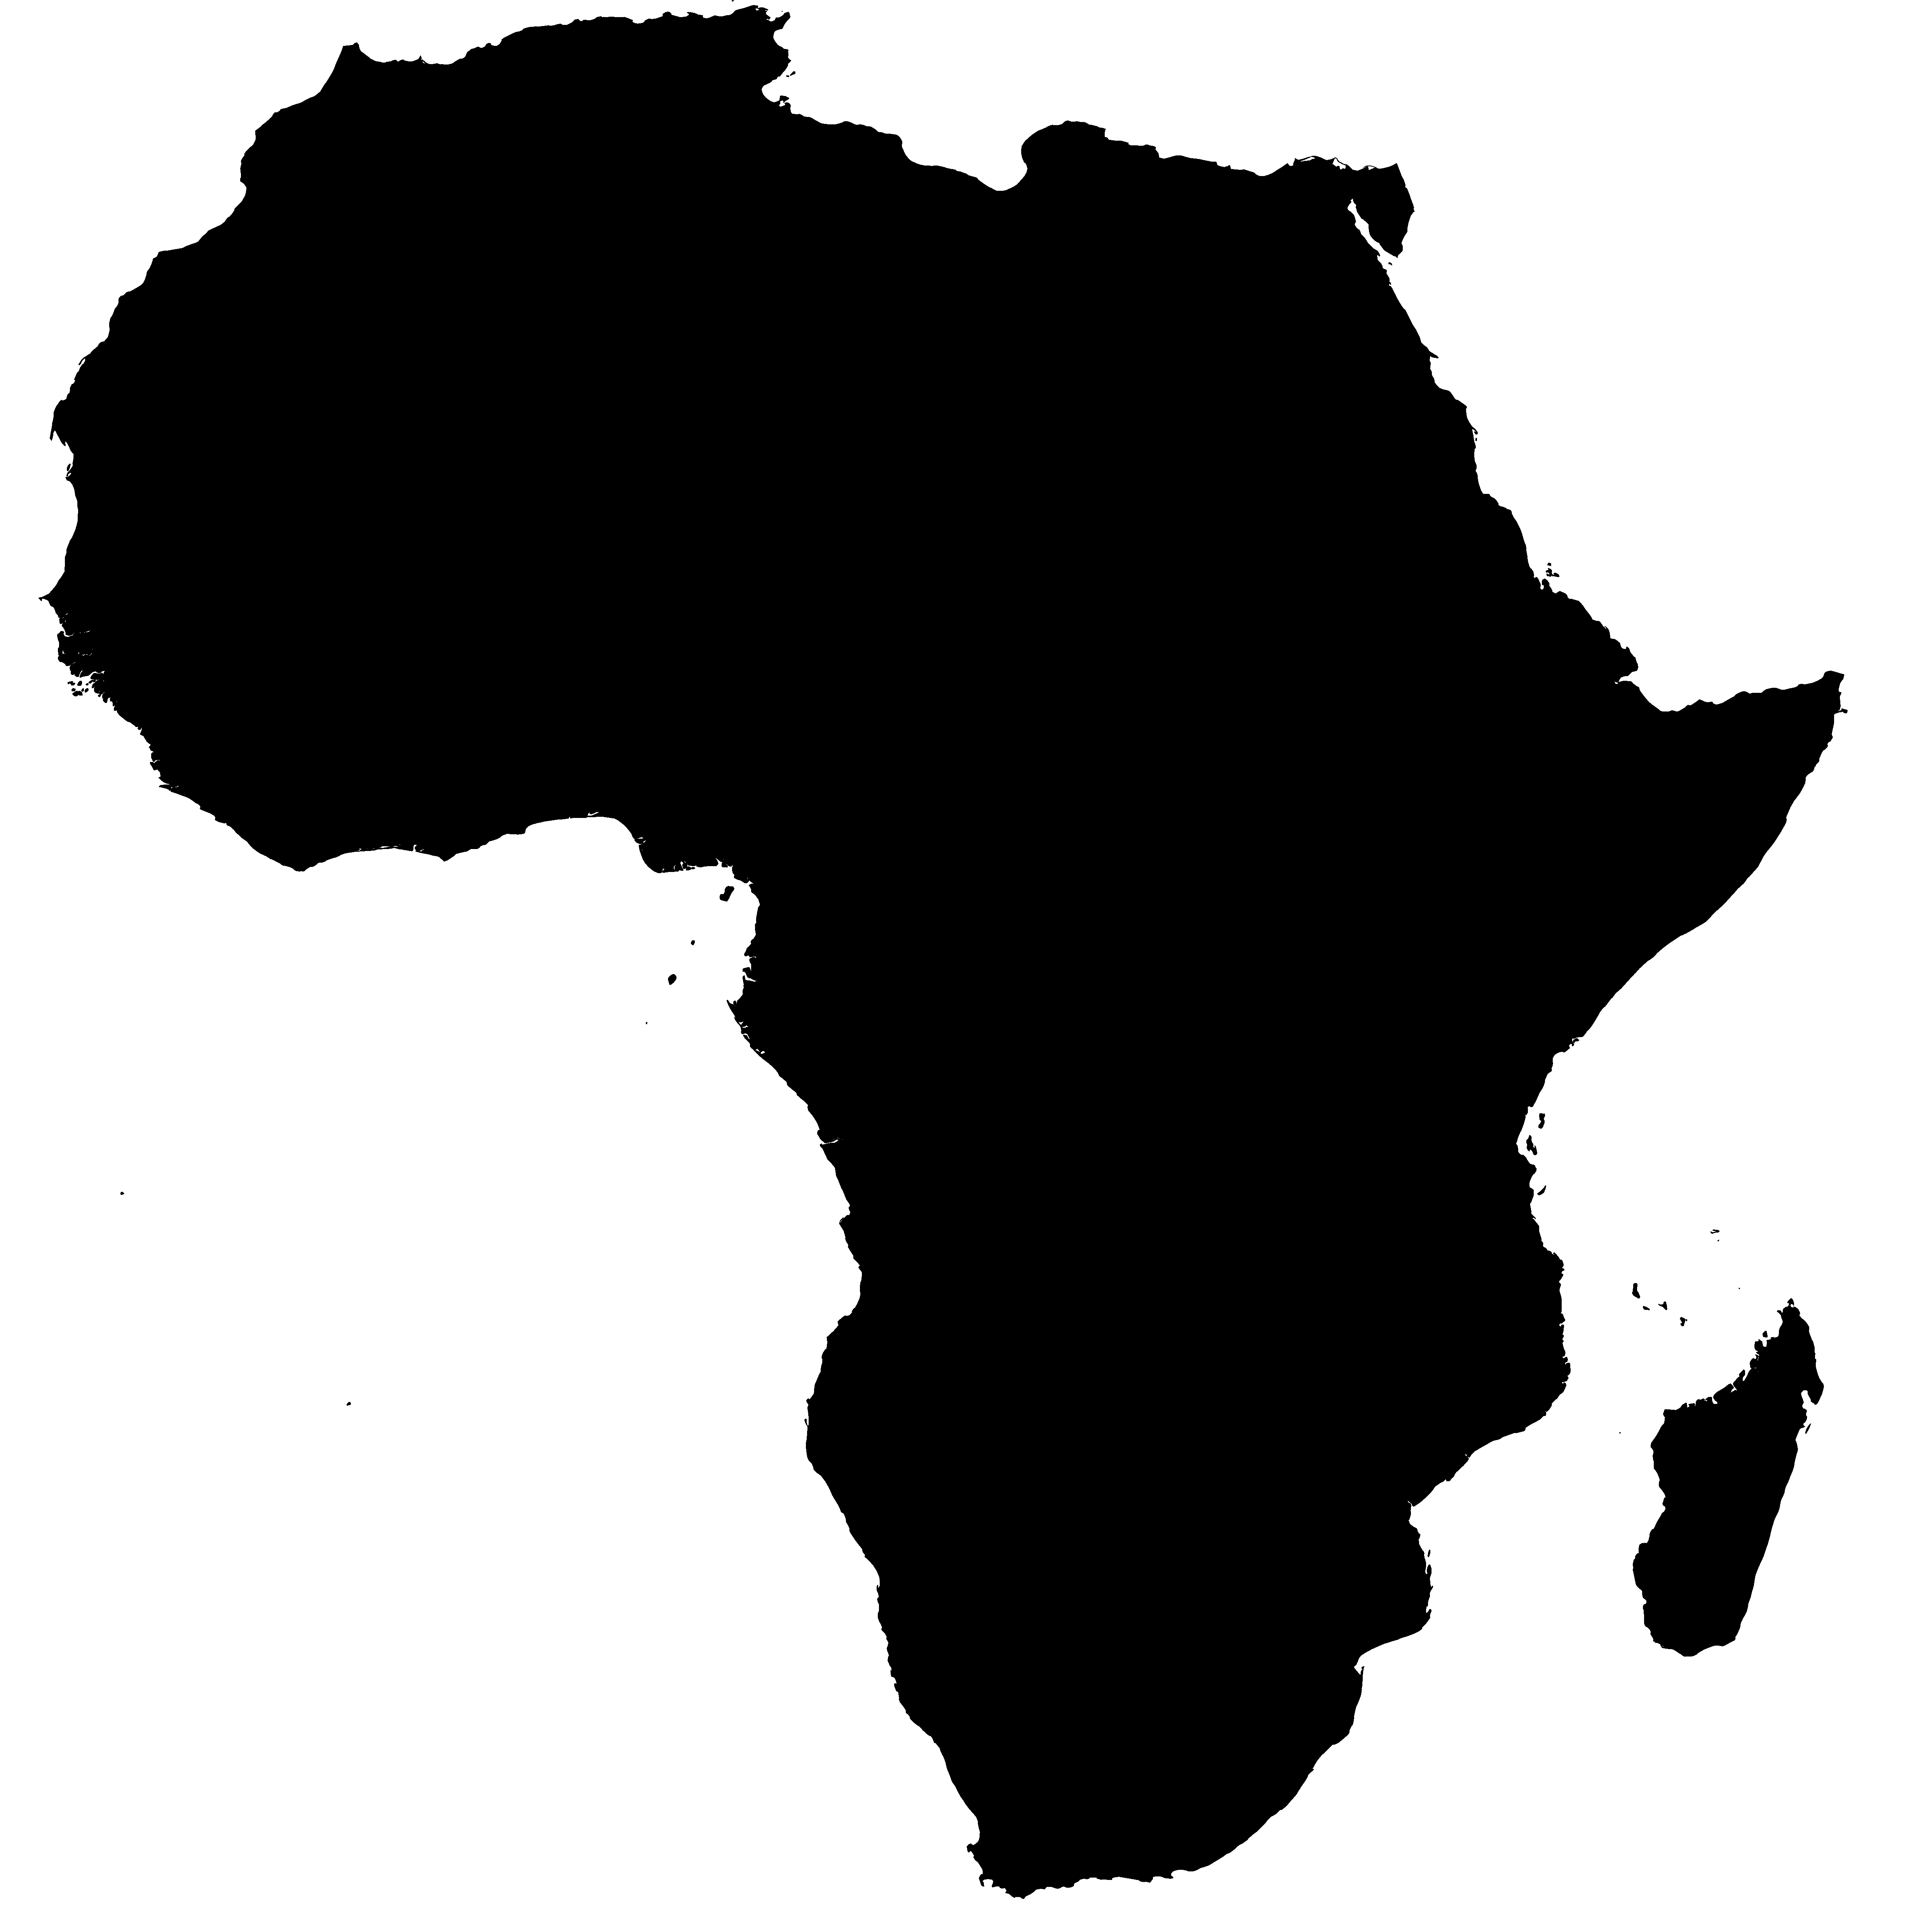
Abortion as a human right: Africa region
Recognized in the Protocol to the Charter on the Rights of Women in Africa (“Maputo Protocol” 2003)
Paradigm shift in African regional recognition of abortion as a human right
Article 14(2)(c) of Women’s Protocol guarantees right to abortion where pregnancy poses a risk to the life or health of the woman or to the life of the fetus, or where pregnancy is a result of sexual assault, rape or incest.
States required to take all appropriate measures to fulfill the rights guaranteed by the Protocol (Art. 26)
Notes:
Note – delete this slide if you are not in the Africa region
The Maputo Protocol is the only human rights treaty that explicitly names abortion as a human right in the text of the treaty itself. For other international treaties, the right to abortion flows from other rights, such as right to health, life, privacy, etc, and the link between abortion and those rights has been made through the guidance from human rights bodies over the decades. In the Maputo Protocol, the right to abortion is clearly and explicitly stated in the text of the treaty, which is a huge progressive step forward for reproductive health and rights. However, despite this paradigm shift and strong language protecting access to abortion as a human right, not all countries have ratified the Maputo Protocol and even among those that have, not all countries recognize abortion as a human right.

Slide 15
Thank you!

