Slide 1
Introduction to Trauma-Informed Care
FOR HEALTH-CARE WORKERS PROVIDING ABORTION CARE TO SEXUAL VIOLENCE SURVIVORS IN HUMANITARIAN SETTINGS
Notes:
Facilitator notes:
Welcome everyone back to the abortion in humanitarian settings training.
Mention that this trauma-informed care session is a new module integrated into abortion trainings for frontline healthcare workers providing abortion services to survivors of sexual violence and other forms of GBV in humanitarian settings.
Inform the participants where and how to access the PPT and resources associated with the trauma-informed care training package.
Say: This toolkit is designed to complement other key training resources focused on care of sexual violence survivors, such as Clinical Management of Sexual Violence Survivors in Crisis Settings | Inter-Agency Working Group on Reproductive Health in Crises (iawg.net) and the WHO curriculum, Caring for women subjected to violence: A WHO curriculum for training health-care providers. These materials expand on the WHO and IAWG materials by applying the concepts of the “LIVES” method and introducing trauma-informed care to abortion care. This toolkit builds on previously published materials with a unique focus on the intersection of trauma-informed care and abortion care for abortion providers who might not have access to the fuller courses, may be at the receiving end of referrals for abortion care, may be receiving abortion care training, or will find application of the content helpful to their abortion services.

Slide 2
Administer pre-test
Notes:
Administer pre-test to your participants.
Please complete this short pre-test. At the end of the session, we will repeat this same test to help us learn whether our training was effective
Small number of questions on your feelings and beliefs about abortion
Should take less than 10 minutes

Slide 3
Workshop objectives
By the end of this session participants will be able to:
Articulate terminologies and definitions related to sexual violence.
Describe the intersection of sexual violence and abortion services.
Integrate trauma-informed counseling techniques into abortion counseling.
Conduct trauma-informed care at the time of providing abortion services.
Describe roles and responsibilities of frontline health-care workers providing abortion services to survivors of sexual violence and other forms of GBV.
Articulate appropriate referral pathways for trauma survivors and provide the clients with an introduction to additional services and referrals, if desired.
Advocate for better integration of sexual and reproductive health (SRH) clinical and protection services.
Name risks of burnout from working with survivors and identify actions that can help maintain well-being in the midst of work-related stress.
Notes:
Facilitator notes:
Read the content on this slide and explain as needed.

Slide 4

Module 1: Introduction to sexual violence
Notes:
Facilitator notes:
Module one delves into the definitions of common terms related to sexual violence and the evidence around sexual violence and other forms GBV globally and in humanitarian settings.

Slide 5
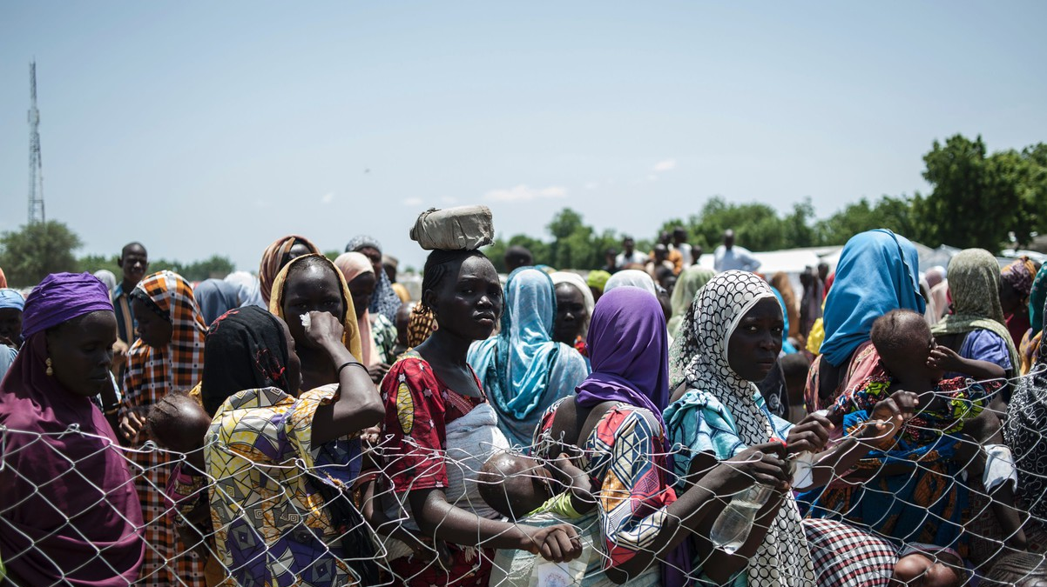
Why are we here?:
The scope of the problem
Notes:
NOTE TO FACILITATOR:
Slides 6-10 provide an overview of the scope of the problem of sexual violence globally. These slides could be deleted or amended to contextualize violence in your country, region and/or target population.
Facilitator notes:
How significant is sexual violence and other forms of GBV? Let’s familiarize ourselves with the data and the real-life implications these human rights violations and health outcomes have on women, their families, and communities.
Image source: STEFAN HEUNIS/AFP/Getty Images. Image copyrighted and not licensed for re-use.
In this photo taken on September 15, 2016, women and children queue to enter one of the Unicef nutrition clinics in Muna informal settlement, in the outskirts of Maiduguri the capital of Borno State, northeastern Nigeria.

Slide 6
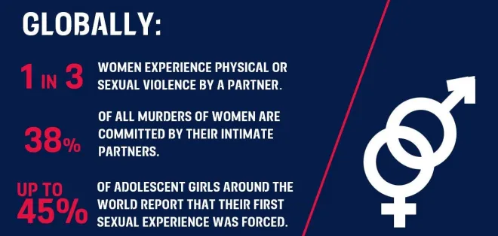
For national data: Global Database on Violence Against Women (unwomen.org)
Notes:
Facilitator notes:
Gender-based violence (GBV) or violence against women and girls (VAWG), is a global pandemic.
Population-level surveys are available in many countries and are based on reports from survivors provide the most accurate estimates of the prevalence of intimate partner violence and sexual violence and could provide a helpful baseline but levels of violence in humanitarian settings are likely to be even higher. UNWomen regularly update their global database on VAWG. You can find it here: Global Database on Violence Against Women (unwomen.org)
A 2018 analysis of prevalence data from 2000-2018 across 161 countries and areas, conducted by WHO on behalf of the UN Interagency working group on violence against women, found that worldwide, nearly 1 in 3, or 30%, of women have been subjected to physical and/or sexual violence by an intimate partner or non-partner sexual violence or both.
Furthermore, 35% of women worldwide have experienced either physical and/or sexual intimate partner violence or non-partner sexual violence and Globally, 7% of women have been sexually assaulted by someone other than a partner.
Source: https://www.who.int/reproductivehealth/publications/violence/VAW_infographic.pdf?ua=1
A UNODC report in 2018 provided a staggering statistic indicating globally 38% of all murders of women are committed by an intimate partner.
Source: https://www.unodc.org/documents/data-and-analysis/GSH2018/GSH18_Gender-related_killing_of_women_and_girls.pdf
A 2014 Gap report by UNAIDS surveying adolescent girls determined, in some settings up to 45% of adolescent girls around the world report that their first sexual experience was forced.
Source: https://www.unaids.org/en/media/unaids/contentassets/documents/unaidspublication/2014/gapreport12pops/02_Adolescentgirlsandyoungwomen.pdf
Approximately 84 million adolescent girls 15–19 years old, or one in every three girls, suffered from one form of physical, sexual, or emotional abuse and controlling behaviors by an intimate partner in 2018. The risks of adolescents experiencing different forms of GBV in crises also becomes more acute and we touched on some of the causes earlier, however additional factors include child marriage, sex-trafficking, being out of school and working. In addition, vulnerabilities during crises are also further heightened for girls with disabilities.
Source: ASRH Toolkit in Humanitarian Settings: 2020 Edition
Image Source: https://rohcof.org/gender-based-violence-gbv/

Slide 7
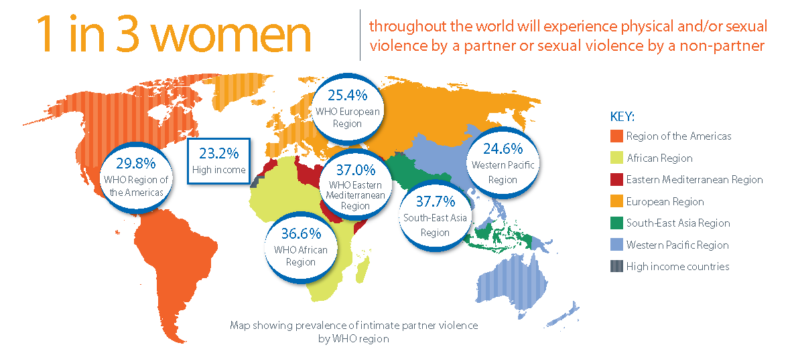
Notes:
Facilitator notes:
This graphic by WHO provides a closer look of the prevalence estimates of lifetime IPV per region.
It ranges from almost 25% in the Western Pacific, 23% in high-income countries and Europe and almost 30% in the WHO Regions of the Americas to 37% in the WHO African region, 37% in the WHO Eastern Mediterranean region, and almost 38% in the WHO South-East Asia region.
Source: https://www.who.int/en/news-room/fact-sheets/detail/violence-against-women
Image source: https://www.who.int/reproductivehealth/publications/violence/VAW_infographic.pdf?ua=1

Slide 8
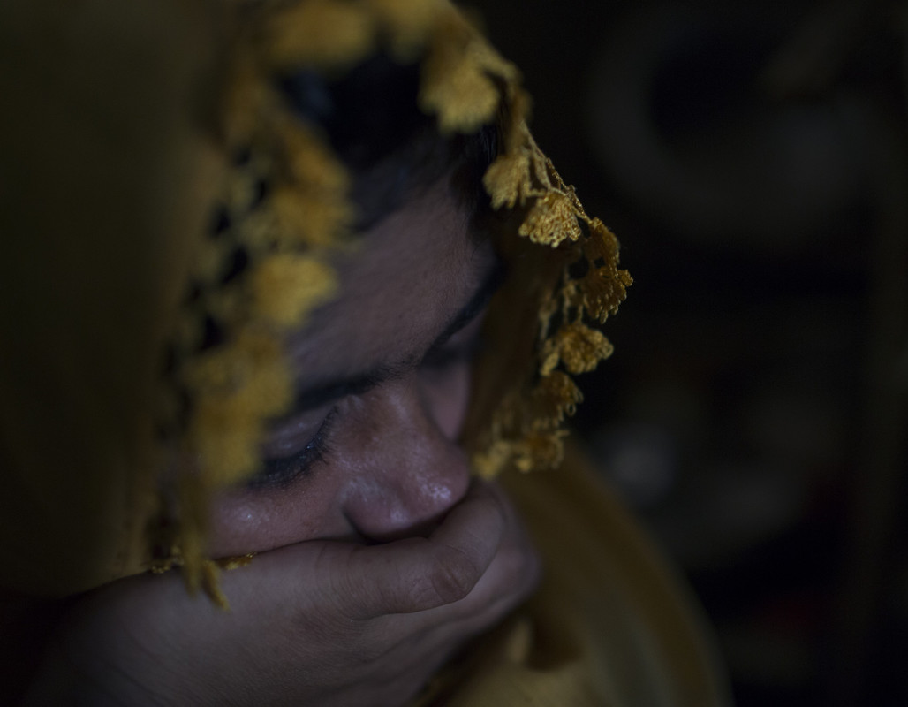
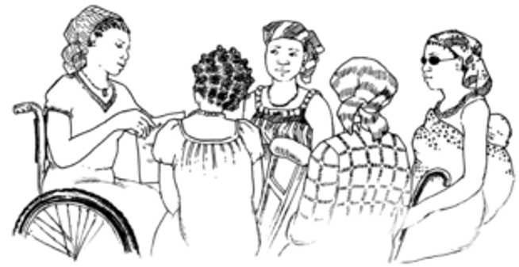
1 IN 5 REFUGEE AND DISPLACED WOMEN EXPERIENCE SEXUAL VIOLENCE IN COMPLEX HUMANITARIAN CRISES
WOMEN WITH DISABILITIES ARE 2-4 TIMES MORE LIKELY TO EXPERIENCE INTIMATE PARTNER VIOLENCE
Notes:
Facilitator notes:
In humanitarian crises, many factors can exacerbate risks of experiencing GBV and grows more acute for women and adolescent girls. These include—but are not limited to—increased militarization, lack of community and State protections and armed actors, displacement, scarcity of essential resources, disruption of community services, changes in cultural and gender norms, disrupted relationships and weakened infrastructure and social and protective networks and lack of services create an environment where women and girls are at acute risks.
Source: SRH Surge Capacity Building Training (UNFPA/NORCAP)
Source: https://www.who.int/health-cluster/about/work/other-collaborations/gender-based-violence/en/
Slide Statistic source: IAWG.(2018). IAFM on Reproductive Health in Emergency Settings
While one in three women experience IPV or non-partner violence, women with disabilities are 2 to 4 times more likely to experience IPV. (UKAID)
Persons with disabilities are among the most vulnerable and socially excluded groups
For women and girls with disabilities:
the intersection of gender inequality and disability makes them especially vulnerable to GBV
social norms often designate women and girls to be caregivers of people with disabilities, which can reinforce their isolation and further limit their access to social economic and material support, increasing their vulnerability to violence and exploitation
Source: Building Capacity for Disability Inclusion in Gender-Based Violence Programming in Humanitarian Settings: A Toolkit for GBV Practitioners. WRC
NOTE TO FACILITTOR
Distribute the handout The Shadow Pandemic – Violence Against Women and Girls and COVID-19 and note how C-19 has affected Violence Against Women
Image source:
Image left: © Farzana Hossen for Ipas. Image copyrighted and not licensed for re-use.
Image right: Hesperian Health Guides: A Health Handbook for Women with Disabilities: https://en.hesperian.org/hhg/A_Health_Handbook_for_Women_with_Disabilities:Chapter_6:_Health_Exams

Slide 9
Terminology
VAW or VAWG
SGBV
SV or SSV
GBV
Violence Against Women or Women and Girls
Gender-Based Violence
Sexual and Gender-Based Violence
Sexual Violence or Survivors of Sexual Violence
=
=
=
=
Notes:
Facilitator notes:
Before we move forward and discuss the intersection of sexual violence and abortion, lets discuss common terminology utilized in crises.
In the humanitarian sector different UN affiliates and other organizations use various and often overlapping terminology
Read the slide and explain further as needed.
Inform the participants that this session will utilize GBV and sexual violence interchangeably and that this will be explored further in the next two slides.
Also inform the participants that although all types of people can be victims of sexual violence, this training will focus on violence against women and all people with uteruses. Because of the nature of the work we do as abortion providers, in this workshop we are primarily focusing on the repercussions of violence against women and girls or people with a uterus.
Below are the definitions for the remaining two terminologies outlined in the slide and only refer to them if participants ask for the other two definitions (VAW and SGBV).
Definitions:
Violence Against Women (VAW): (WHO, UNW ICRC)
UN Declaration of the Elimination of Violence Against Women (1993): “Violence against women is a manifestation of historically unequal power relations between men and women, which have led to domination over and discrimination against women by men and to the prevention of the full advancement of women.”
Sexual and Gender- Based Violence (SGBV):
UNHCR definition for SGBV… gender-based violence is violence that is directed against a person on the basis of gender or sex. It includes acts that inflict physical, mental or sexual harm or suffering, threats of such acts, coercion and other deprivations of liberty.

Slide 10

Definition of Gender-based Violence
An umbrella term for any harmful act that is perpetrated against a person’s will and that is based on socially ascribed (i.e., gender) differences between males and females. It includes acts that inflict physical, sexual or mental harm or suffering, threats of such acts, coercion and other deprivations of liberty.”
Notes:
Facilitator notes:
Read the slide and discuss further if needed
GBV is a term used to focus on a wider range of gendered and sexualized violence directed against women and girls, men and boys, such as sexual violence directed at men in conflict and violence against gay, lesbian, transgendered and intersex people. It encompasses 5 different types and forms of violence: (1) sexual (2) physical; (3) harmful traditional practices; (4) socio-economic; and (5) emotional and psychological .
All five forms of violence occur in humanitarian crises and are often acutely increased and have long-term effects
Source: https://www.elrha.org/wp-content/uploads/2021/02/Elrha_GapAnalysis_GBV_Accessible_PDF_2021.pdf
Source: http://gbvguidelines.org/en/

Slide 11
Definition of Sexual Violence
Any sexual act, attempt to obtain a sexual act, unwanted sexual comments or advances, or acts to traffic, or otherwise directed against, a person’s sexuality, using coercion, threats of harm or physical force, by any person regardless of relationship to the victim, in any setting, including but not limited to home and work.”
Notes:
Facilitator notes:
WHO and IASC have further defined the first form of GBV, sexual violence.
Read the definition on the slide and discuss as needed.
While all forms of GBV are a priority in crises, in the SRH sector and in relation to the MISP there is a specific focus on responding to and preventing sexual violence in humanitarian crises and is considered a life-saving intervention.
Source: World Report on violence and health, WHO, 2002 . Page 8, IASC GBV Guidelines

Slide 12
Definition of Intimate Partner Violence
Intimate partner violence is any behaviour by a current or former partner or spouse that causes physical, sexual or psychological harm. This is one of the more common forms of violence experienced by women globally.”
Notes:
Facilitator notes:
IPV is a form of SV and as noted in the statistics outlined earlier, IPV is prevalent worldwide and the Gap analysis of GBV in Humanitarian Settings, a study conducted by elrha also indicates that GBV, specifically IPV and sexual violence increase in humanitarian crises.
Source: https://www.elrha.org/wp-content/uploads/2021/02/Elrha_GapAnalysis_GBV_Accessible_PDF_2021.pdf
Read the definition and discuss as needed.
Source: UN Women.( 2020).Violence Against Women: https://interactive.unwomen.org/multimedia/infographic/violenceagainstwomen/en/index.html#nav-1
ASK if there are any final questions before moving to the next module.

Slide 13
Module 2: Intersection of trauma, GBV and abortion
Notes:
Facilitator notes:
Now let's turn our attention to the intersections between gender-based violence, trauma and abortion care

Slide 14
What is trauma?
What is your own definition of trauma and why do you think it is an important aspect to consider when providing high-quality reproductive health care?
Notes:
Facilitator notes:
I would like to hear from you now, what is your own definition of trauma and why do you think it is an important aspect to consider when providing high-quality reproductive health care?
Ask participants to describe trauma and traumatic events and consider the reasons why it is an important consideration for the work we do.
U.S. Department of HHS SAMSHA definition of trauma (if helpful):
"Individual trauma results from an event, series of events, or set of circumstances that is experienced by an individual as physically or emotionally harmful or life threatening and that has lasting adverse effects on the individual’s functioning and mental, physical, social, emotional, or spiritual well-being”
Some additional discussion issues and prompts for your group:
Elaborate by saying GBV is a form of trauma, and that refugees and internally displaced people experience multiple forms of trauma and human rights abuses.
Events, even helpful ones, can be retraumatizing. We are trying to minimize the risk that that occurs.
It is likely all women who are seeking abortion care have experienced trauma such as forced displacement and these women are at increased risk to sexual violence and gender-based violence.
In humanitarian settings various forms of trauma may include but are not limited to:
Forced Displacement
War, Terrorism, or Political Violence
Sexual Violence
Physical Violence
Emotional Abuse or Psychological Maltreatment
Source: WHO. ( xx). Chapter 8: Collective Violence: https://www.who.int/violence_injury_prevention/violence/global_campaign/en/chap8.pdf

Slide 15
The intersection of sexual violence and abortion is often “invisible”
Emotional Behavioral Change
Fear
Anxiety
Shame
Depression
Low self-esteem
Post-traumatic stress
Excessive drug and alcohol abuse
Suicidal ideation
High Risk Sex
Multiple partners
Unprotected intercourse
Sex work
Survival sex
Loss of family support
Early or forced marriage
Sexual assault can precede other unhealthy behaviors such as..
Health Outcomes
Unwanted pregnancy
Pregnancy complications
Unsafe abortion practices
Neglected and poor child health
Mortality
Notes:
Facilitator notes:
In humanitarian crises women and girls of reproductive age are at an increased risk of an unwanted pregnancy or pregnancy complications by sexual violence.
This graphic outlines the possible direct and indirect pathways sexual violence and abortion intersect and the adverse health outcomes if abortion services are not provided in crises.
Its important to remember and stay steadfast in our SRHR work that abortion service delivery is not only public health issue it is also a human right.
Training of reproductive health frontline providers in comprehensive abortion care prior to crises and throughout the humanitarian-development nexus is only one of many important steps to ensure the rights of women are upheld and quality services are provided.
Adapted from: https://apps.who.int/iris/bitstream/handle/10665/77431/WHO_RHR_12.43_eng.pdf;jsessionid=104CFF6DCBEC52D46B226E069147E8A2?sequence=1
Adapted from: file:///Users/shadietofigh/Downloads/GBV_humanitarian_settings%20(1).pdf

Slide 16
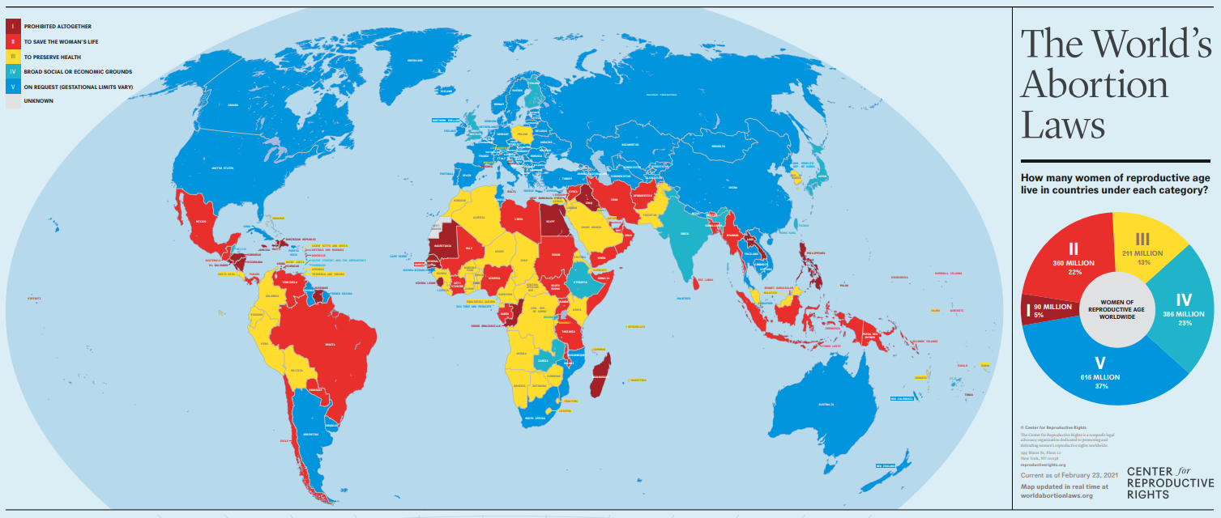
Most women live in countries where abortion is allowed for some indications
Current as of February 23, 2021
http://worldabortionlaws.com/map/
Notes:
Facilitator Notes:
Give an overview of the map, noting that the countries in the darkest red have the most restrictive abortion laws moving toward the countries in blue which have the most permissive laws.
IF time permits and you have a wifi connection, you can go to the map online to demonstrate how you can click on a country of interest and see its abortion laws and indications.
Be sure and cover these key messages:
Most women live in countries where abortion is allowed for some indications.
Evidence shows that laws restricting or criminalizing abortion do not reduce the numbers of abortions that take place, rather they drive them underground and increase death and disability from UNSAFE abortion. Regardless of the legal context, women who want an abortion will find a way to get one and often will risk their lives to do so.
In many countries there are differences between what the law states and how the law is applied in practice.
In some settings, while the law may appear to be restrictive, in practice it may be liberally interpreted and therefore relatively easy for people to access safe abortion services except in situations where mobility and livelihoods are limited, the situation for most refugees. In other countries the law may allow for the provision of abortion under a range of different circumstances, but this may not be a reality for women in practice and especially for people living in displacement or camp conditions.
Source: http://worldabortionlaws.com/map/

Slide 17
FACT: Abortion is legal under some circumstances in most countries
FACT: Many, if not most, sexual violence survivors are likely allowed to request a legal abortion but do not know this and are not encouraged to pursue this option
Indications for legal abortion | To save a woman’s life | To protect a woman’s physical health | To protect a woman’s mental health | Cases of rape or incest | Cases of fetal impairment | Economic or social factors | On request
Number of countries | 190 | 132 | 126 | 99 | 91 | 69 | 58
International agreements support access to safe abortion for survivors of rape. Such agreements include: the Geneva Convention, Article 3; UN Security Resolutions 2106 and 2122; and the Maputo Protocol.
Notes:
Facilitator notes:
While human rights treaties protect SRHR, including abortion, there are still misconceptions that abortion is illegal. In most countries, abortion is not “illegal” but rather “restrictive”
Only a handful of countries ban abortion entirely
95% of the world population lives in a country where safe abortion is permitted under some circumstances.
There are also a number of international and regional agreements, such as those indicated on the slide, that support the imperative to provide safe abortion in crisis settings.
While some refugees may have better access to health care than residents of their host country, politics and regulations make them unlikely to have widespread access to safe abortion care.
(Note for facilitators: This table is additive. This means that all countries listed “to protect a woman’s physical health” also permit abortion to save the life of the woman, etc.)
Source: Ipas’s VCAT for humanitarian audiences
Source: CCR abortion law map: https://maps.reproductiverights.org/worldabortionlaws

Slide 18
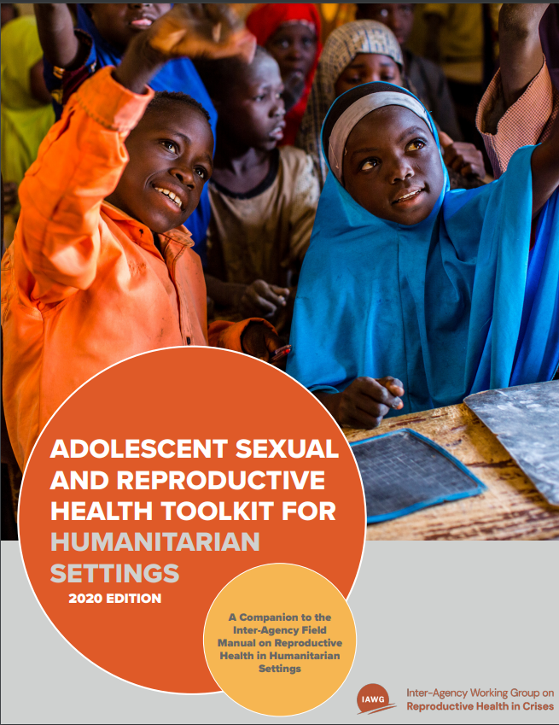
SRH of Adolescents: Principle of Adolescent Capability
Adolescents who request SRH services can be considered capable of receiving reproductive health counseling and services without parental oversight.”
ASRH Toolkit for Humanitarian settings: 2020 Edition
Notes:
Facilitator notes:
Read the slide and elaborate as needed.
Note the many forms of violence and risks adolescents face in crises are: forced prostitution, trafficking, forced early marriage , psychological abuse and rape, all compounded further with additional forms of violence throughout reproductive age.
It is important to remember that adolescents are at increased risk to sexual violence during crises and have the capability and the rights to access abortion and other SRH services to the extent of local laws.
According to the principle of adolescent capability, an adolescent's ability to determine her own reproductive desires and needs, such as the need for an abortion, is sufficiently demonstrated by their own pursuit of the care they need. Even in the case of minors, if they are deemed "capable", consent from partners, parents, guardians or relatives should not be sought, as this could endanger the adolescent.
Source: https://www.who.int/health-cluster/about/work/task-teams/GBV-webinar.pdf?ua=1
Affirm that there is almost never a need for others' consent
Source: Inter-Agency Working Group (IAWG) on Reproductive Health in Crises, Sub-Working Group on Adolescent Sexual and Reproductive Health (ASRH). ASRH Toolkit for Humanitarian Settings: 2020 Edition. New York City, 2020.

Slide 19

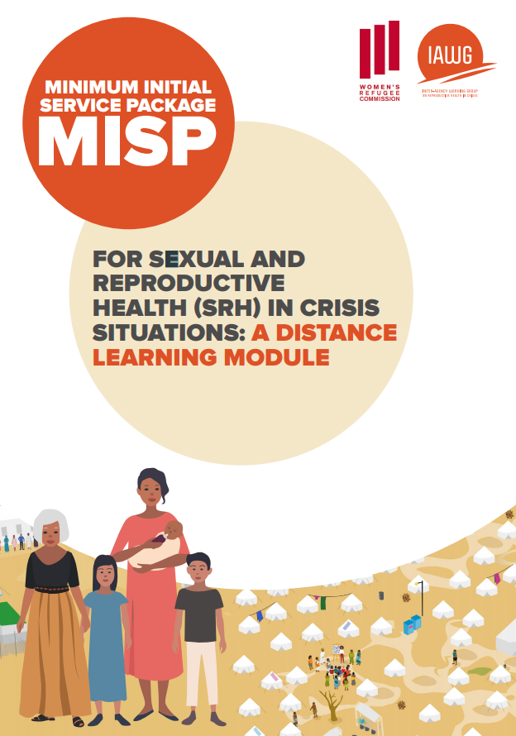
IAWG Minimum Initial Service Package (MISP) Resources
MISP Quick Reference
MISP Distance Learning Module
Notes:
NOTES TO FACILITATOR:
If you are in a humanitarian setting, distribute the handout of the “MISP Quick Reference Sheet” to the participants; no need to go read over all parts of the slide
If you are not in a humanitarian setting, you may delete this and the next 2 slides.
Facilitator notes:
Describe the Inter-Agency Working Group and where to find further resources on the IAWG webpages.
The IAWG is a broad-based, highly collaborative coalition representing UN, government, non-governmental, research, and donor organizations. Formed in 1995, and currently a network of over 2,500 individual members from 450 agencies. This international coalition of organizations and individuals works collectively to advance sexual and reproductive health and rights in humanitarian settings. (https://iawg.net/)
As abortion frontline providers you will likely be working in facilities that provide some or all of the SRH healthcare services associated with each of the objectives of the MISP and the Inter-Agency Field Manual (IAFM) which provides detailed SRH clinical and programmatic guidance for emergency response and provides justification for the provision of safe abortion care in emergencies.
Explain briefly the goal of the MISP and each of the objectives
Source: IAWG.(2018). Minimal Initial Service Package (MISP) for Sexual and Reproductive Health:
MISP Quick Reference: https://iawg.net/resources/misp-reference
MISP Distance Learning Module: https://iawg.net/resources/minimum-initial-service-package-distance-learning-module
https://iawg.net/resources/minimum-initial-service-package-misp-resources

Slide 20


Safe abortion care and the MISP
…to respond to the needs of sexual assault survivors
…to the full extent of the law as “another SRH health priority”
Survivors are entitled to:
Pregnancy testing
Pregnancy options counseling
Safe abortion care to the full extent of the law
When capacity exists, abortion care should be facilitated from the onset of an emergency
When capacity does not exist, abortion care should be available as soon as MISP priority activities are underway
Safe Abortion Care Sub-Working Group: https://iawg.net/about/sub-working-groups/safe-abortion-care
Notes:
Facilitator notes:
The 2018 MISP and accompanying field manual have expanded access to comprehensive abortion care in emergency settings as a priority service to the full extent of the law, but also integrated abortion services as a critical component of responding to the needs of sexual assault survivors.
Your role as trained reproductive frontline providers is to ensure safe abortion care is implemented in humanitarian settings.
Read slide and elaborate as needed.
Source: IAWG Abortion Sub-Working Group: https://iawg.net/about/sub-working-groups/safe-abortion-care

Slide 21
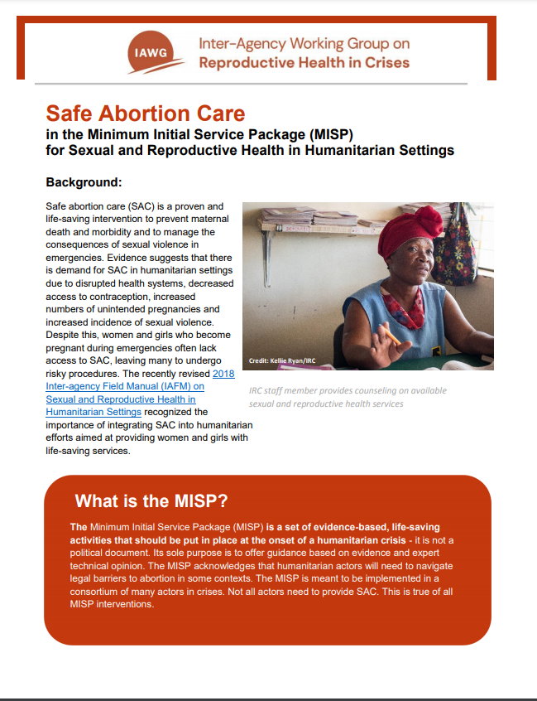
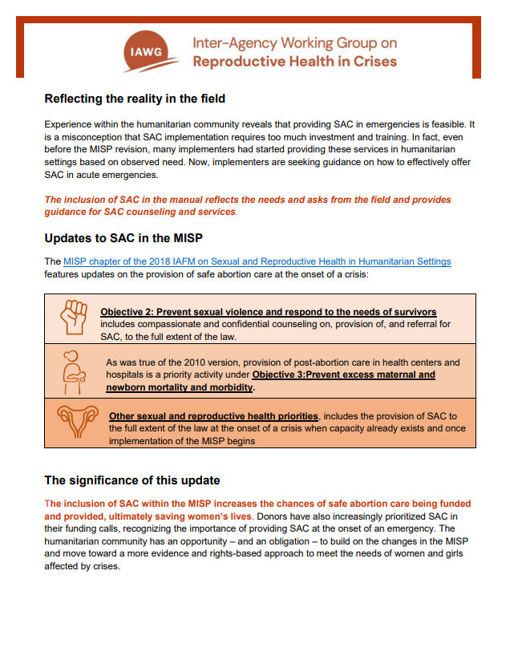
Resources for introducing abortion care as a part of minimum initial services
Notes:
NOTE TO FACILITATOR:
Distribute the “IAWG SAC in the MISP brief” to the participants.
Facilitator notes:
The IAWG SAC sub-working group created this “SAC in the MISP” brief which explains the changes to SAC in the Minimum Initial Service Package (MISP) on sexual and reproductive health (SRH) and its impact in the field which can be a useful resource for advocacy to expand abortion services in your settings.
Source: IAWG Abortion Sub-Working Group: https://iawg.net/resources/safe-abortion-care-in-the-minimum-initial-service-package-misp-for-sexual-and-reproductive-health-in-humanitarian-settings
ASK if there are any final questions before moving to the next module.

Slide 22
Module 3: Trauma-informed care and abortion clinical services
Notes:
Facilitator notes:
GBV in all its forms has tremendous physical, emotional and social consequences for the person victimized by it, who is often referred to as a ‘survivor.’ Survivors of GBV have the right to receive quality, compassionate care and support that addresses the harmful consequences of violence in order to help them heal and recover.
This module aims to set standards for quality, compassionate care for GBV survivors in humanitarian settings, with particular focus on trauma-informed care for the provision of abortion. While the focus of this session is on the intersection of trauma and abortion, the information on trauma-informed care and pelvic care is not only applicable for abortion services, but also contraception, prenatal care and labor and delivery.

Slide 23
Trauma-informed services = survivor-centered care
Trauma
Retraumatization
Trauma Response
Trauma-informed services are informed about and sensitive to past trauma in survivors.
A trauma-informed approach integrates an understanding of the survivor’s history and the entire context of their experience.
A survivor-centered approach creates a supportive environment where a survivor’s rights are respected and ensures she is treated with dignity and respect.
Re-traumatization includes triggers, response to disclosure, contact with perpetrator, victimization or lack of control, empowerment, agency or a safe environment.
Notes:
Facilitator notes:
At the core of these practices, we believe that survivor-centered care = trauma-informed care.
A survivor-centred approach aims to create a supportive environment in which a survivor’s rights are respected and in which s/he is treated with dignity and respect. The approach helps to promote a survivor’s recovery and his/her ability to identify and express needs and wishes, as well as to reinforce his/her capacity to make decisions about possible interventions.
It is important as abortion providers to be informed about trauma- related issues in survivors and integrate approaches that do not cause triggers and retraumatization.
Contributing factors of retraumatization include: triggers, response to disclosure, contact with perpetrator, victimization, lack of control, empowerment, agency or safe environment.
Further, invasive medical procedures such as a pelvic exam, bimanual exam, MVA procedure, IUD or vaginal ultrasound on someone who has or is currently in the mist of processing their trauma can re-induce traumatic reactions.
Source: NSVRC.(2017). Building cultures of care: A guide for sexual assault services programs: https://www.nsvrc.org/sites/default/files/publications_nsvrc_building-cultures-of-care.pdf

Slide 24
Do no harm
The WHO encourages health workers to raise the topic of sexual violence and intimate partner violence only with women who have injuries or conditions that they suspect are related to violence.
Provide women-centered care by applying the four core principles of safety, respect, confidentiality and nondiscrimination.
Ensure information is confidential and referrals aligned with local GBV protocols and guidelines.
Apply the highest standard of care. In recent research, abortion clients identified kindness, non-judgmental treatment, individualized information and interactive counseling as the most important aspects in counseling. *
*Sarah E Baum, Rebecca Wilkins, Muthoni Wachira, Deepesh Gupta, Shamala Dupte, Peter Ngugi, Shelly Makleff, Abortion quality of care from the client perspective: a qualitative study in India and Kenya, Health Policy and Planning, 2021; czab065, https://doi.org/10.1093/heapol/czab065
Notes:
Facilitator notes:
Do No Harm:
Remember women in humanitarian crises have experienced some form of trauma, and we know that 1 in 5 women experience sexual violence. As a result, there is a high probability of women who are requesting abortion and contraceptive care have experienced multiple forms of trauma.
Many women have different needs from most other health-care clients in these settings
A woman who has been subject to violence, IPV and other forms of GBV trauma may have different needs from most other clients.
She may have various emotional needs that require attention
She may be frightened and need reassurance
Her safety may be an ongoing concern
She may need referrals or other resources
She needs help to make her feel more in control and able to make her own decisions
Reinforce that their role as providers is to ‘support, not diagnose’, therefore “Do no harm!”
Health-care providers should, at a minimum, offer first-line support when women disclose violence and apply all four principles: safety, respect, confidentiality, and nondiscrimination. Skills required are empathetic listening, non-judgmental attitude, privacy, confidentiality, link to other services).
Highlight the study findings included on the slide noting that women prioritized kindness, non-judgmental treatment, individualized information and interactive counseling as key aspects of the client-provider relationship.
As frontline providers your role is to ensure referrals and service delivery protocols are aligned with the humanitarian guidelines.
Work with your colleagues and supervisors to ensure you have these resources and guidelines available to you, should you need them.
Source: WHO clinical Handbook for providers on Sexual Violence(2013) http://www.who.int/reproductivehealth/publications/violence/9789241548595/en/
Source: IAFM 2018 Edition
Source: UNFPA Surge Capacity Training

Slide 25
The provider's role
Include visible information on women’s rights to SRH services, including GBV, abortion, and contraception
Ensure front line providers have information, education and communication materials and job aids
Ensure training (to designated abortion providers) and whole site orientation sessions on survivor-centered care for staff
Ensure that all staff know reporting to the police by frontline providers is NOT mandatory unless specified by national laws. In some countries mandatory reporting on the sexual abuse of minors is required. If so, conversations should be held in advance about compliance and legal and personal risks to providers and clients.
Ensure that all staff know the four principles of safety, respect, confidentiality, and nondiscrimination
Notes:
Facilitator notes:
Read slide and elaborate as needed.
Ask if there are other responsibilities that should be included?
Note that No additional medical equipment for integrating trauma-informed care and abortion services is required.
These are both personal and whole site responsibilities.
Source: IAWF.2018. IAFM on Reprodictive Health in Humanitarian Settings: https://iawgfieldmanual.com/manual
Source: Guidelines for integrating Gender-Based Violence Intervention in Humanitarian Action. Module 4: responding to a GBV disclosure as a non GBV specialist.
Source: https://www.who.int/reproductivehealth/publications/violence/VAW_infographic.pdf?ua=1

Slide 26
Mandatory reporting is NOT recommended
“Prompt, safe abortion services should be provided on the basis of a woman’s complaint rather than requiring forensic evidence or police examination. Administrative requirements should be minimized and clear protocols established for both police and health-care providers as this will facilitate referral and access to care.”
WHO (2012). Safe abortion: technical and policy guidance for health systems, pp. 92-93.
Also see - Law and Policy Guide: Rape and Incest Exceptions, Center for Reproductive Rights
https://maps.reproductiverights.org/law-and-policy-guide-rape-and-incest
Notes:
Facilitator notes:
Use this slide to add emphasis to the recommendations from WHO on no mandatory reporting
Have someone read the quote and discuss
Can link to the CRR resource for their thorough summary of global law and policy on this
Mention that some countries require mandatory reporting for sexual abuse of minors

Slide 27

Serious Health Outcomes of Violence
Mental
Depression, suicidal thoughts or attempts, anxiety, post-traumatic stress disorder, insomnia, panic attacks, mental disorders
Behavioral
alcohol and drug abuse, self injury, risky sexual behavior, homicide, suicide
Acute Physical
Injury, shock, disease, infection
Reproductive
Pelvic inflammatory disease, sexually transmitted diseases, unwanted pregnancy, pregnancy complications, low birth weight, urinary tract infections, sexual disorders, unsafe abortion
Chronic Physical
Disability, chronic infections, chronic pain, gastrointestinal disorders, eating disorders, sleep disorders
SIGNS OF VIOLENCE ARE OFTEN INVISIBLE
Ipas ARCHES toolkit
Notes:
Facilitator notes:
To respond to GBV trauma you need to understand the possible consequences of sexual violence
Traumatic events are common in complex emergency settings. Sexual violence, and especially rape, have a huge impact on people’s health. Social consequences include but not limited to :
root causes: abuse of power, gender inequality and inequality of human rights
Contributing factors: alcohol/drug abuse, poverty, conflict, availability of food/fuel/wood/income generation, collapse of traditional society and family support system, lack of police protection, impunity, loss of male power dynamics and perceived gender roles, retaliation, strategy/tool of war.
Per WHO the health impact of women exposed to IPV includes: (Source: https://www.who.int/reproductivehealth/publications/violence/VAW_infographic.pdf?ua=1)
Sexual and Reproductive Health:
16% more likely to have low birthweight baby.
1.5x more likely to have HIV + 1.5x more likely to get syphilis infection, chlamydia or gonorrhea.
Death and Injury:
42% of women who have experienced physical or sexual violence at the hands of a partner have experienced injuries as a result.
38%of all murders of women globally were reported as being committed by their intimate partners
Mental health:
twice likely to experience depression and
almost twice as likely to have alcohol use disorders
Source: http://gbvguidelines.org/en/capacity-building/module-2-defining-gbv/
Source: graphic adapted from: file:///Users/shadietofigh/Downloads/GBV_humanitarian_settings.pdf
Source; https://apps.who.int/iris/bitstream/handle/10665/77431/WHO_RHR_12.43_eng.pdf?sequence=1

Slide 28
Asking about violence: Role playing
Important! Never raise the issue of violence unless a woman is alone. Even if she is with another woman.
Some statements you can make to raise the subject of violence before you ask direct questions
“Many women experience problems with their husbands, partners or someone else they live with.”
“I have seen women with problems like yours who have experienced trouble.”
Direct questions to start with that show you want to hear about her problems
“Are you afraid of your husband (or partner)?”
“Has someone at your home ever threatened to hurt you or physically harm you?”
“Has anyone forced you into sex or sexual contact you did not want?”
“Has anyone threatened to kill you?”
Notes:
Facilitator notes:
To gradually establish trust on this private and sensitive issue:
Never raise the issue of partner violence unless a woman is alone.
Even if she is with another woman, that woman could be the mother or sister of an abuser.
If you do ask her about violence, do it in an empathic, nonjudgmental manner.
Use language that is appropriate and relevant to the culture and community you are working in.
Some women may not like the words “violence” and “abuse”. Cultures and communities have ways of referring to the problem with other words. It is important to use the words that women themselves use.
10-minute rapid exercise:
Ask participants to pair up with a participant near them and practice both direct and indirect methods of questions about violence.
After each participant has practiced both types of questions take 5 minutes and ask how the exercise felt to them and if anyone in the group had new thoughts or suggestions for others that they think are helpful.
Source: WHO.(2013). Responding to intimate partner violence and sexual violence against women: WHO clinical and policy guidelines: http://www.who.int/reproductivehealth/publications/violence/9789241548595/en

Slide 29
What to do if you suspect violence but she does not disclose it?
Remember: This may be your only opportunity to help this woman!
Do no harm!
Do not pressure her; give her time to disclose what she wants to tell you
Tell her about services that are available if she chooses to use them
Offer her referrals to other services
Offer her a follow-up visit for any health needs
Notes:
Facilitator notes:
read the slide and elaborate as needed.
Remember women and adolescents accessing abortion services experience compounding barriers to access care in crises and while many may not disclose their violence, their visit may be the only opportunity for you as a provider to share information on available SRH, health, mental health, protection etc services and referrals available.
Source: WHO.(2013). Responding to intimate partner violence and sexual violence against women: WHO clinical and policy guidelines: http://www.who.int/reproductivehealth/publications/violence/9789241548595/en

Slide 30
In summary: Abortion health-care worker response
Providers should be trained to provide survivor-centered care and trauma-informed care
Make sure standard operating procedures are in place in your facility
Ensure consultation spaces are private
Ensure referral to additional services are identified and known by all
Health-care facilities should be equipped to provide a comprehensive SRH response, addressing both physical and mental consequences
Mandatory reporting to the police by the health-care provider is NOT recommended. Abortion providers should offer to report the incident if the woman chooses, preferably to protection services.
Notes:
Facilitator notes:
Read slide and elaborate as needed
Mention that privacy is visual and auditory
Source: WHO.(xx). Violence Against Women: Global Picture Health responsehttps://www.who.int/reproductivehealth/publications/violence/VAW_infographic.pdf?ua=1
Source: IAWG. (2018). IAFM on Reproductive Health in Humanitarian Settings: https://iawgfieldmanual.com/manual
Source: Source. WHO.(2013). Responding to intimate partner violence and sexual violence against women: WHO clinical and policy guidelines: http://www.who.int/reproductivehealth/publications/violence/9789241548595/en

Slide 31
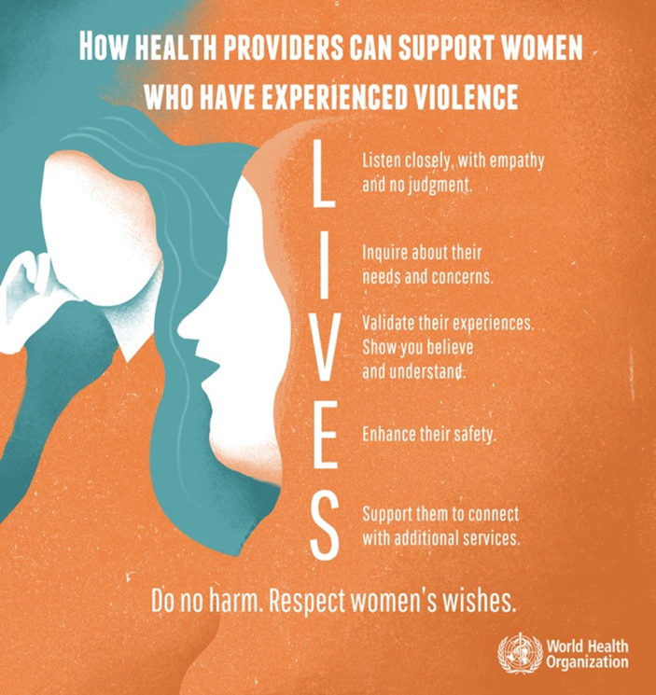
WHO “LIVES” method for supporting survivors of sexual assault
Listen
Listen to the woman closely, with empathy and without judging.
Inquire about needs
Assess and respond to her various needs and concerns-emotional, physical (including reproductive health) and social.
Validate
Show her that you understand and believe her. Assure her that she is not to blame.
Enhance Safety
Support
Discuss a plan to protect herself from further harm if needed.
Support her by helping her connect to information, services and social support.
Notes:
Facilitator notes:
WHO “LIVES” framework is an important tool for non-GBV provider specialists.
Read the slide and elaborate as needed
Remember that informed consent for services and release of information is required as it ensures that survivors’ rights and needs are first and foremost.
Source: WHO.(2013). Responding to intimate partner violence and sexual violence against women: WHO clinical and policy guidelines: http://www.who.int/reproductivehealth/publications/violence/9789241548595/en
Source: WHO.(2020). Clinical management of rape and intimate partner violence survivors: developing protocols for use in humanitarian setting: https://apps.who.int/iris/bitstream/handle/10665/331535/9789240001411-eng.pdf?ua=1

Slide 32
Clinical Care
ASSESSING THE PATIENT’S HEALTH
PHYSICAL EXAM AND MANAGEMENT
General medical history
Obstetric and gynecological history including last menstrual period (LMP)
Information about the assault
Mental health assessment
Done at survivor’s own pace
Trauma-informed care
This workshop focuses on integrating trauma-informed care into the pelvic exam and vacuum aspiration procedure
For other exam and management details, see the resources on the next slide.
Notes:
Facilitators Notes
The primary purpose of the history and examination is to determine the clinical care that is needed. History-taking and the examination are to be done at the survivor’s own pace.
The main purpose of the physical examination is to provide medical care. Note the survivor's mental state. It is important to ask permission to do the physical exam and obtain informed consent for each step. Document everything thoroughly and objectively
EXPLAIN that the additional exam components that might be done for a survivor just after an assault, such as injury assessment and forensic exam, are beyond the scope of this workshop.
REFER participants to the WHO/UNFPA/UNHCR and IAWG resources on the next slide for further detail.

Slide 33
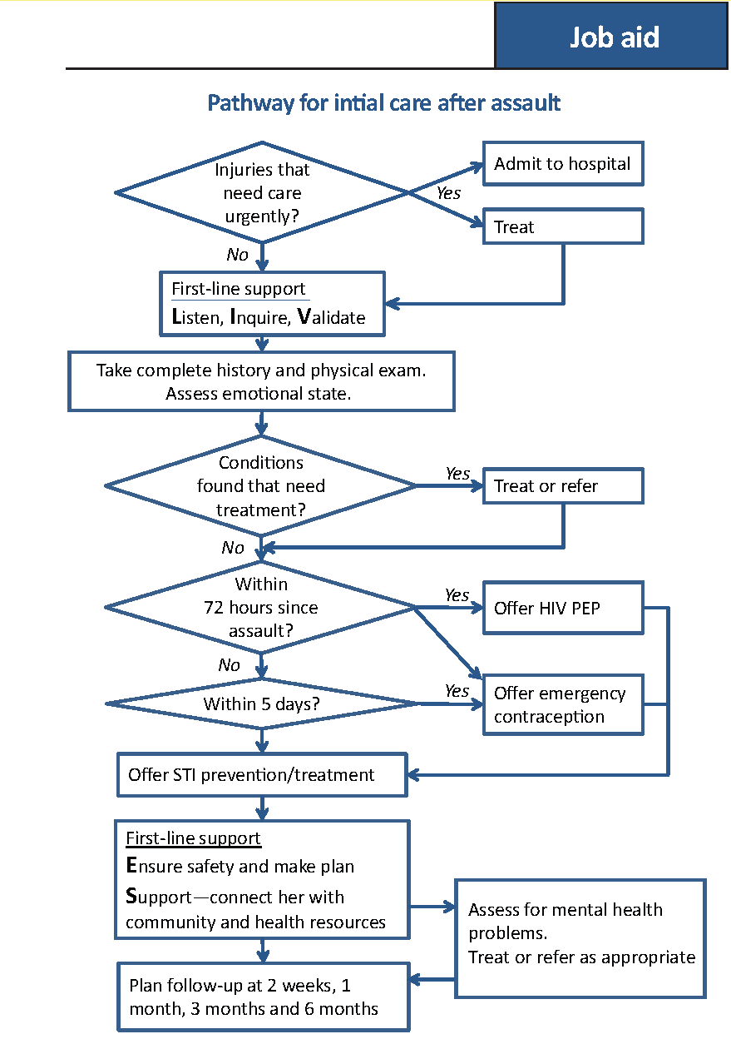
Clinical Care
Time-sensitive issues to be addressed with survivors:
Treat life-threatening complications first
Prevent HIV transmission if incident <72 hours
STI presumptive treatment at first visit
Injury care as needed
Prevent pregnancy, offer or refer for safe abortion care
REFER TO CLINICAL MGMT MATERIALS FOR MORE DETAIL
Notes:
Facilitator Notes:
REFER TO Clinical Management of Sexual Violence Survivors in Crisis Settings created by the Inter-Agency Working Group on Reproductive Health in Crises (iawg.net) and Clinical Management of Rape and Intimate Partner Violence Survivors: Developing protocols for use in humanitarian services by WHO, UNFPA and UNHCR for detailed clinical guidance on all the above topics.
Let’s talk about some of the time-sensitive clinical issues that should be addressed with survivors.
WHO has provided job aids for frontline providers treating clients who disclose the sexual violence or clients they suspect has experienced sexual violence.
DISTRIBUTE copies of the WHO diagram “Pathway for initial care after assault” to each participant. TELL them that they will use this handout later in an activity.
REVIEW the following points:
Treat life-threatening complications first and refer to higher-level health facilities, if appropriate.
Post-exposure prophylaxis (PEP) for HIV infection should be started as soon as possible and up to 72 hours after possible exposure to HIV. There is a risk of HIV transmission if there was exposure to blood or semen through vaginal, anal, or oral intercourse, or through wounds and/or mucus membranes.
Survivors of sexual violence should be given antibiotics to prevent and treat sexually transmitted infections (STIs)—chlamydia, gonorrhea, trichomonas, and syphilis—the first visit whenever that is.
There is no reason to test for STIs before offering treatment. The incubation time for STIs is often several weeks and there are no rapid point-of-care diagnostic tests available for most STIs.
Survivors presenting without severe injuries can often be treated on site. Clean any tears, cuts, and abrasions and suture clean wounds within 24 hours. Do not suture dirty wounds or wounds older than 24 hours. Consider giving appropriate antibiotics and pain relief if there are large unclean wounds.
Give tetanus prophylaxis according to national protocol if there are any breaks in skin or mucosa and the patient is not vaccinated against tetanus, or the vaccination status is uncertain.
REFER participants to the WHO/UNFPA/UNHCR and IAWG resources on the slide for further detail.
Prevention of pregnancy is also covered in the job aid through offering emergency contraception. Let’s talk about the time-sensitive issues specifically related to the prevention and/or management of unwanted pregnancy after sexual assault that must be discussed with survivors. GO TO NEXT SLIDE
Image Source: World Health Organization (WHO). Health care for women subjected to intimate partner violence or sexual violence: A clinical handbook. Geneva: WHO; 2014
https://www.who.int/reproductivehealth/publications/violence/vaw-clinical-handbook/en/

Slide 34
Prevention and management of unwanted pregnancy after sexual assault
Time-sensitive issues to be addressed with survivors:
Survivors may seek post-rape care any time after the assault.
Offer emergency contraception to all survivors who have been raped within 5 days of assault.
No need to screen for health conditions or test for pregnancy
Provide pregnancy testing at the 2-week and 1-month follow-up visits after assault.
Provide pregnancy testing at any time if the survivor’s menstrual period is a week or more late.
Those who present with a pregnancy at any gestational age due to sexual violence should receive information about all available options, including safe abortion care or a referral for that care.
Notes:
Facilitator Notes:
Remember that survivors may seek post-rape care at any time after an assault; people make decisions about when and where to seek care in all different ways
Some will come in within hours or a few days after an assault while others may not come in for weeks or months.
Appropriate care and prevention and/or treatment options for survivors will differ depending on when they present
For those who present weeks or months after the assault, always remember to ask if they sought care or received any treatments at the time of the rape and manage clinical interventions appropriately.
For the prevention and/or management of unwanted pregnancy…
The first critical time period is up to the 5th day, or 120 hours, since the rape. During that time, all survivors should be offered emergency contraception without any screening or pregnancy testing required.
Pregnancy testing should be offered at the 2-week and 1-month follow-up visits and at any time a survivor’s menstrual period is a week or more late.
Those who present with a pregnancy at any gestational age due to sexual violence should receive information about all available options, including safe abortion care or a referral for that care.

Slide 35
Prevention and management of unwanted pregnancy after sexual assault (cont.)
Time-sensitive issues to be discussed with survivors:
WHO-recommended methods for termination of pregnancy by when they can be used
 | <12 weeks gestation | >12 weeks gestation
*Medical abortion | Mifepristone + Misoprostol | Mifepristone + Misoprostol
 | Misoprostol-only | Misoprostol-only
Surgical abortion | **Vacuum Aspiration (VA) | Dilatation and Evacuation (D&E)
*The regimens for medical abortion change significantly for <12 weeks and >12 weeks **VA can be used up to 14 weeks with appropriate training and resources
See Ipas’s Clinical Updates in Reproductive Health for regularly updated clinical guidance including medical abortion regimens:
https://www.ipas.org/resource/clinical-updates-in-reproductive-health-2/
Notes:
Facilitator Notes:
Per the WHO, these are the methods for induced abortion (termination of pregnancy) according to when they can be used
REVIEW the slide content and answer any questions.
NOTE that local standards and guidelines may differ from the WHO guidance, but it is important to understand the global evidence and guidance.
NOTE that Ipas’s Clinical Updates in Reproductive Health is specially designed to provide concise, easy-to-read information about a wide spectrum of topics related to abortion care. including the various regimens for medical abortion. The Clinical Updates are updated annually and are available online in English, French, Spanish and Portuguese.
GO to <https://www.ipas.org/resource/clinical-updates-in-reproductive-health-2/> and review the resources there if an internet connection is available and time allows.

Slide 36
Ten Steps: Trauma-informed Care
1
Establish rapport before the exam.
2
3
Allow one support person to accompany the client during the exam, if desired by the client.
4
Invite the client to suggest measures that will make them more comfortable with the exam and procedure.
Allow the client to choose the gender of the provider, if they have a preference.
Notes:
Facilitator notes:
The stress and stigma associated with the abortion seeking experience coupled with trauma from sexual violence trauma for women and adolescents in crises require frontline abortion providers to adopt a survivor-centered approach that includes a trauma-informed lens when providing services.
Source:Gretchen E. Ely, Rebecca S. Rouland Polmanteer & Jenni Kotting (2018) A trauma-informed social work framework for the abortion seeking experience, Social Work in Mental Health, 16:2, 172-200, DOI: 10.1080/15332985.2017.1369485
The ten practical steps to trauma-informed care includes guidance on how providers can improve care for clients who have experienced trauma from sexual violence. The implementation of the ten-step trauma-informed care approach in conjunction with the LIVES method ‘accommodates and centers the care on the survivor’s needs and empowers the survivor to know she has agency and authority in decision making about her health and needs throughout the visit. Trauma-informed care creates resilience and decreases the negative impact of trauma triggers and thereby decreases negative health outcomes.
Source. WHO.2013. Clinical handbook for providers on Sexual Violence: http://www.who.int/reproductivehealth/publications/violence/9789241548595/en/
Source: Miller, Kathleen K.; Brown, Calla R.; Shramko, Maura; Svetaz, Maria V. 2019. "Applying Trauma-Informed Practices to the Care of Refugee and Immigrant Youth: 10 Clinical Pearls" Children 6, no. 8: 94. https://doi.org/10.3390/children6080094
Read through the slide and elaborate as needed.
Adapted from:
Source: Reproductive Health Access Project. (2015). Contraceptive Pearl: Trauma-Informed Pelvic exams: https://www.reproductiveaccess.org/resource/trauma-informed-pelvic-exams/#:~:text=For%20patients%20with%20a%20history,patient%20is%20clothed%20and%20seated).

Slide 37
Ten Steps: Trauma-informed Care (cont.)
5
Before starting, inform the client that you will stop the exam and/or the procedure if they feel uncomfortable. Assure the client that they have control over the pace of the exam and/or procedure.
6
Tell the client about each step of the exam and/or the procedure right before it happens.
7
Keep the client's body covered, exposing only the areas being examined.
Notes:
Facilitator notes:
Continue reading steps on the slide and elaborate as needed.

Slide 38
Ten Steps: Trauma-informed Care (cont.)
8
9
10
Encourage the client to use abdominal breathing in order to relax the pelvic floor muscles.
Rest the hands for bimanual exam and the unopened speculum against the client’s vagina so that they get used to the sensation before the hand or speculum are inserted and opened.
If the client does not want to continue the exam or procedure, the provider should stop, inquire about the client’s needs and proceed if and when the client is ready.
Notes:
Facilitator notes:
Read content on the slide.
Also state that where available, use lubricant and/or the smallest possible speculum
Answer any final questions about the 10 Steps of trauma-informed care before moving to the Activity

Slide 39


Activity 1 – Role play with clinical case studies
Notes:
Note for facilitators: These case studies are for small group work and discussions and are meant to help the participants review and practice the steps of the LIVES method and of trauma-informed care.
Use the Clinical Case Studies for this activity.
Divide participants into groups of three. Each group will perform simulated practice of the LIVES method and trauma-informed care process.
Distribute the Trauma-Informed Care Direct Observation Feedback Form to each participant.
Distribute the Clinical Case Studies – Participant Version to each participant.
Ask one trainee to be the provider while another participant plays the observer. The third trainee plays the role of the patient. At the end of each roll play, the provider and the patient should give feedback describing their feelings about the experience.
The observer should then give the provider feedback about skills that were performed well and areas for improvement. While your group is practicing, be sure to observe, listen, and make notes of issues and suggestions that arise, offer feedback to your colleagues as needed, and ensure that all the steps of the LIVES method and trauma-informed care form are being followed.
Switch roles until all trainees have had the opportunity to practice performing the trauma-informed care, using the checklist to observe, and acting as the patient.
The small group leaders or the facilitator can use the bullet points to generate more discussion about the case. The bulleted points for the cases are not meant to be shared with participants before the discussion.
Note Ipas, IAWG, WHO and other resources that may be useful for abortion services.
Activity Closing:
Make sure all the bullet points in the Clinical Case Studies – Facilitator Version are covered for each case
Ask for any additional points that participants/groups have added
Answer any questions
Encourage participants to make notes about what they need in their facilities to provide trauma-informed abortion care
Image source: Noun project, Alice Design

Slide 40
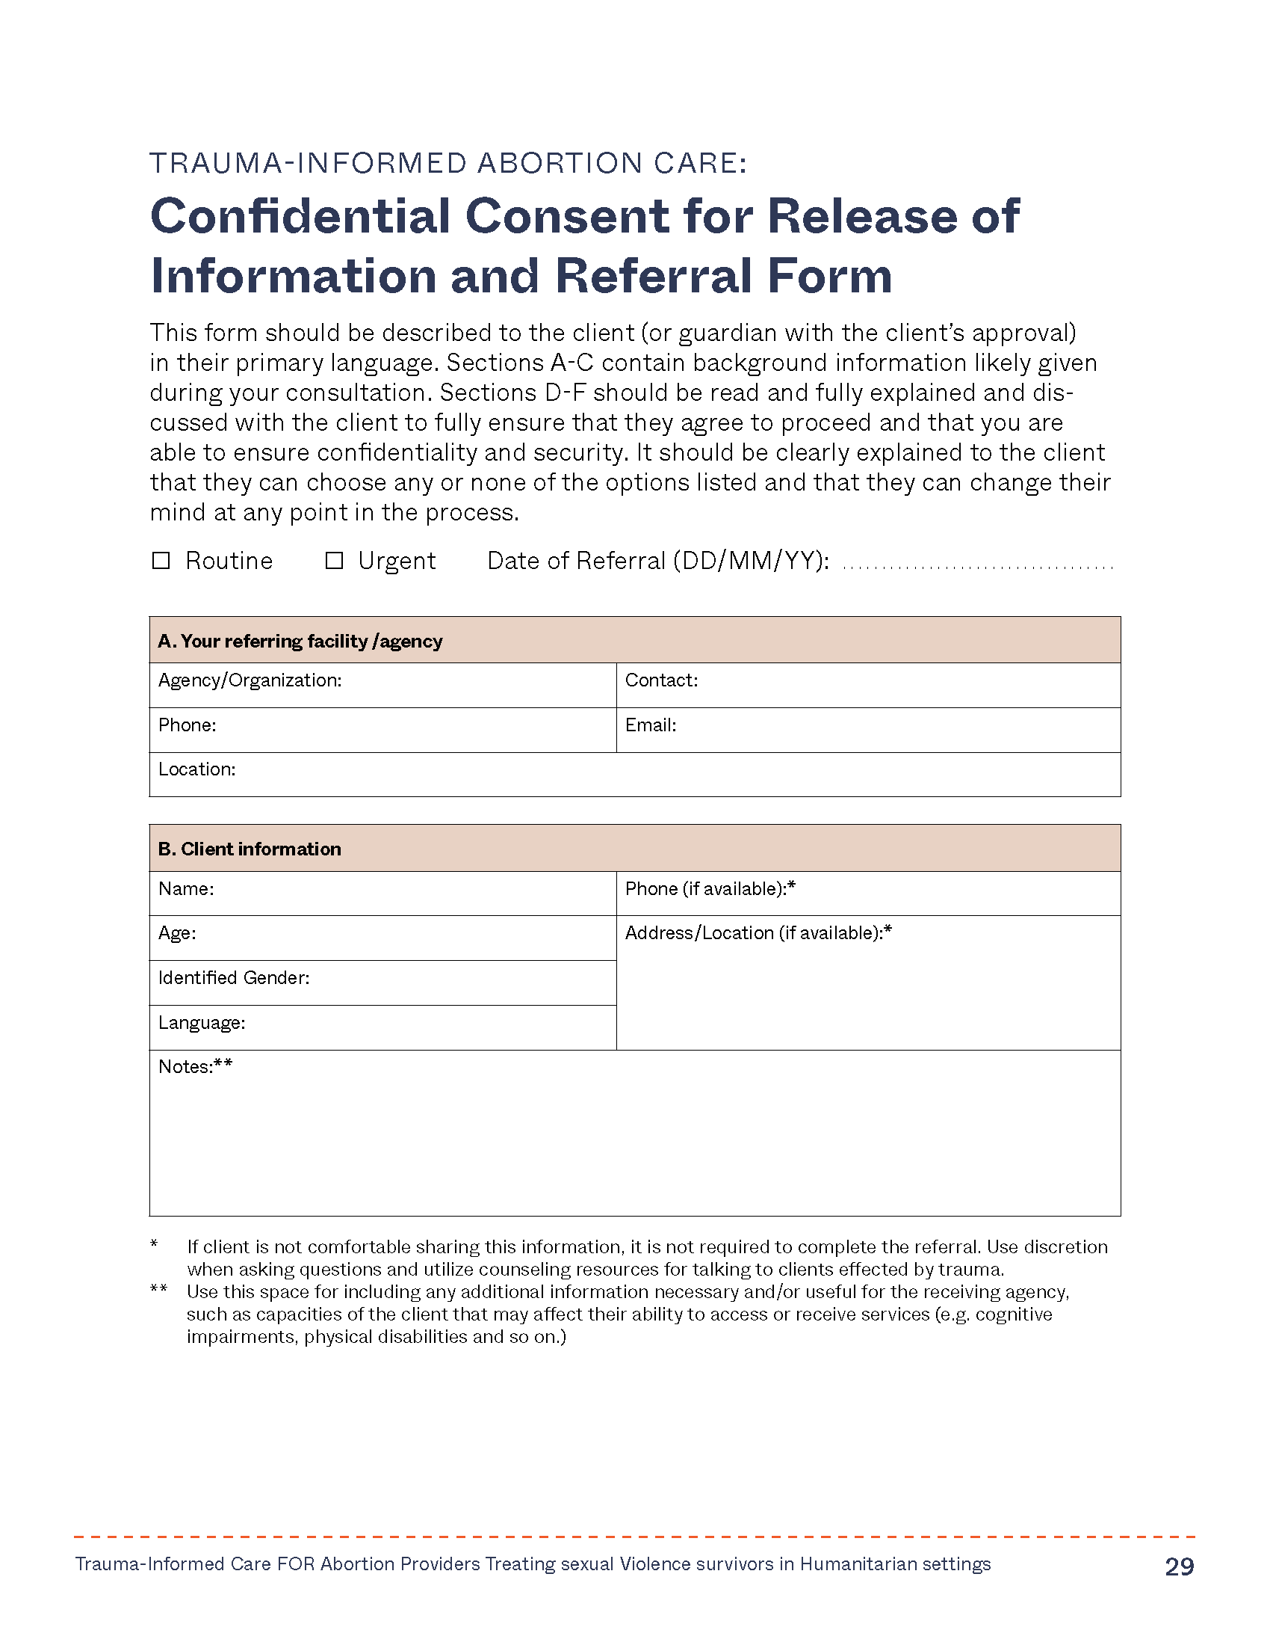
Module 4: Referral pathways and service integration
Notes:
Facilitator notes:
This module describes the humanitarian cluster and coordination system, the minimal standards for service delivery and the importance of establishing robust referral pathways, specifically for abortion providers who are treating sexual violence survivors.
Through cases, we will also work on steps for integrating GBV treatment and SRH services.
We have included an example in this workshop of a referral form. But many health systems have their own required formats to support referrals of survivors of sexual violence.

Slide 41
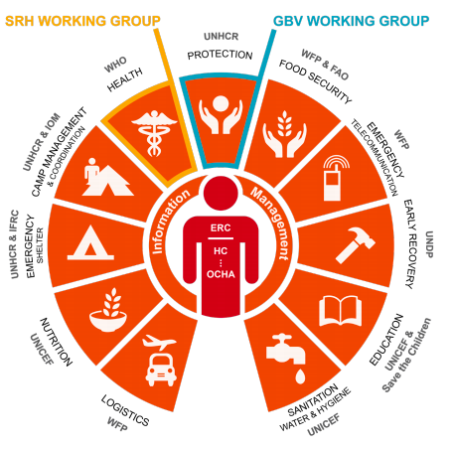
Why are multisector referrals needed?
Survivors have multiple needs that require a comprehensive set of services.
A coordinated multi-sector response ensures the client’s comprehensive needs are met.
One provider and/or one facility cannot provide all of the services.
Referrals work both ways: If your protection service providers are not referring to you, explore the reasons for this and encourage collaboration.
Source: “What is the Cluster Approach?” Humanitarian Response, accessed April 8, 2019
https://www.humanitarianresponse.info/en/about-clusters/what-is-the-cluster-approach
Notes:
Facilitator notes:
As a frontline abortion provider, you are working among a multi-sector approach that is designed to respond to the needs of refugees and internally displaced people in complex humanitarian settings.
This graphic shows the various sectors involved in a complex-humanitarian response and illustrates that SRH interventions are an integral component of the Health cluster and GBV interventions of the Protection cluster. Both sectors have their own sub-working groups/committees that are in constant communication and coordination with one another.
In humanitarian settings coordination and communication among clusters and organizations breaks barriers and silos and ensuring the complex and comprehensive needs of the target population are met.
It’s imperative as abortion/SRH providers that we breakdown barriers and silos. How do we do that?
establishing relationships with other providers at SRH facilities, health facilities, shelters, social services that abortion services are life-saving and available
adhering to the GBV referral protocol that is created in each and every humanitarian setting. Your designated SRH manager of your facility will provide this information to you, if not, don’t hesitate to ask for it. Let’s take a closer look at what some of your core roles and responsibilities are as abortion providers.
Image source: IAWG.(2018). MISP Distant Learning Package: https://cdn.iawg.rygn.io/documents/IAWG-MISP-DLM-EN-Unit-2.pdf?mtime=20200218174035&focal=none
Source: IAWG.(2018).IAFM For Reproductive Health in Humanitarian settings:
Source: Guidelines for integrating Gender-Based Violence Intervention in Humanitarian Action. Module 4: responding to a GBV disclosure as a non GBV specialist

Slide 42
Roles and responsibilities of abortion providers
Health
Mental health
Protection/ Security
Help the survivor assess her present risk for harm before leaving the clinic:
“Are you or your children in immediate danger?”
“Do you feel safe to go home?”
“Would you like some help?”
Offer information on referrals for health, protection, legal advice or other services. Help the client to identify support with family, friends, local women’s groups, shelters and so on.
Survivor
Notes:
Facilitator notes:
As mentioned previously your goal as an abortion frontline provider is NOT to diagnose but to detect if there is ongoing sexual violence, or other forms of GBV or any previous incidences. Again, if there is no self-disclosure and you suspect sexual violence, IPV or other forms of GBV utilize WHO’s LIVES method, and in conjunction with the GBV referral protocol, utilize the informed consent form for referrals to mental health and psychosocial support, health and security/protection, etc.
As an abortion provider it is important to know WHERE to connect women for all three approaches above. The GBV referral protocol will have clear instructions and critical information. If it makes sense for you and other providers, develop a referral list and outline the type of services available, organization name and contact information.
No matter when a survivor of sexual assault or physical assault arrives at the clinic, they’ve experienced a severe emotional trauma. If the client agrees she should be referred to mental health care services for psychological counseling and care. Many organizations have women’s shelters that provide protection.
Read and explain as needed further on what's on the slide and reinforce that WHO advises against healthcare providers directly reporting cases to legal services.
Show a copy of the referral and informed consent form and summarize what it includes and what the providers need to do with it.
Source: IAFM 2018: https://iawgfieldmanual.com/manual/gbv
Source: WHO: https://www.who.int/reproductivehealth/publications/violence/VAW_infographic.pdf?ua=1
Source; https://www.humanitarianresponse.info/sites/www.humanitarianresponse.info/files/documents/files/5._gbv_reporting_for_non_gbv_actors.pdf
Source: GBV guidelines for reporting cases for non-GBV specialized actors ROLES AND RESPONSIBILITIES OF THE DIFFERENT ACTORS IN GBV RESPONSE
Source: https://www.gbvguidelines/module-4-responding-to-a-gbv-disclosure-as-a-nongbv-specialist

Slide 43
Roles and responsibilities of abortion providers
Health
Mental health
Protection/ Security
Refer her for post-rape services or other medical treatment as needed.
Refer her to psychosocial support and mental health support.
Mandatory reporting of sexual violence cases to legal services by a health-care worker is NOT recommended.
Remember: allow the client to make an informed decision about which services she wishes to access.
Utilize the referral and informed consent form.
Survivor
Notes:
Facilitator notes:
Read and explain what's on the slide further as needed
Show a copy of the referral and informed consent form and summarize what it includes and what the providers need to do with it.
Informed consent and release of information form allows the client to have agency in selecting the care she wants and permitting information for referrals to be released. This is an important document for frontline providers and should be readily available in the facility.
Source: IAFM 2018: https://iawgfieldmanual.com/manual/gbv
Source: WHO: https://www.who.int/reproductivehealth/publications/violence/VAW_infographic.pdf?ua=1
Source; https://www.humanitarianresponse.info/sites/www.humanitarianresponse.info/files/documents/files/5._gbv_reporting_for_non_gbv_actors.pdf
Source: GBV guidelines for reporting cases for non-GBV specialized actors ROLES AND RESPONSIBILITIES OF THE DIFFERENT ACTORS IN GBV RESPONSE
Source: https://www.gbvguidelines/module-4-responding-to-a-gbv-disclosure-as-a-nongbv-specialist

Slide 44
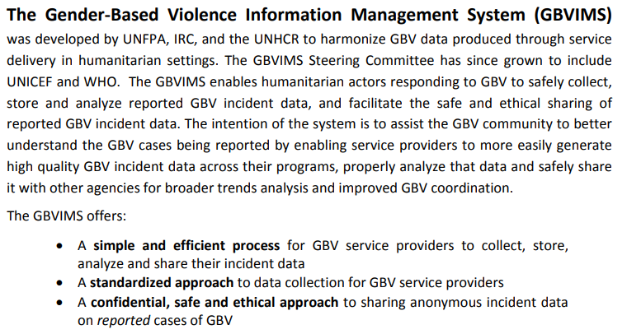

Gender-Based Violence Information Management System (GBVIMS)
https://www.gbvims.com/
Notes:
Note for facilitators:
Be sure all participants are aware of the GBVIMS for monitoring SGBV cases globally
Review content on the slide as necessary and/or go to <https://www.gbvims.com/> and review the resources there if time allows.

Slide 45
Activity 2 – Care and referral pathways

Slide 46
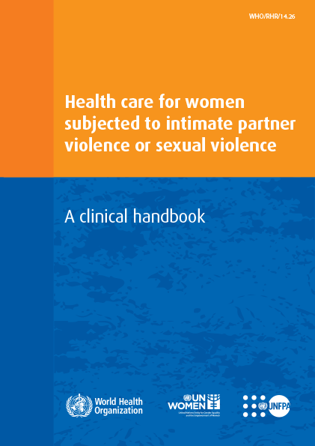
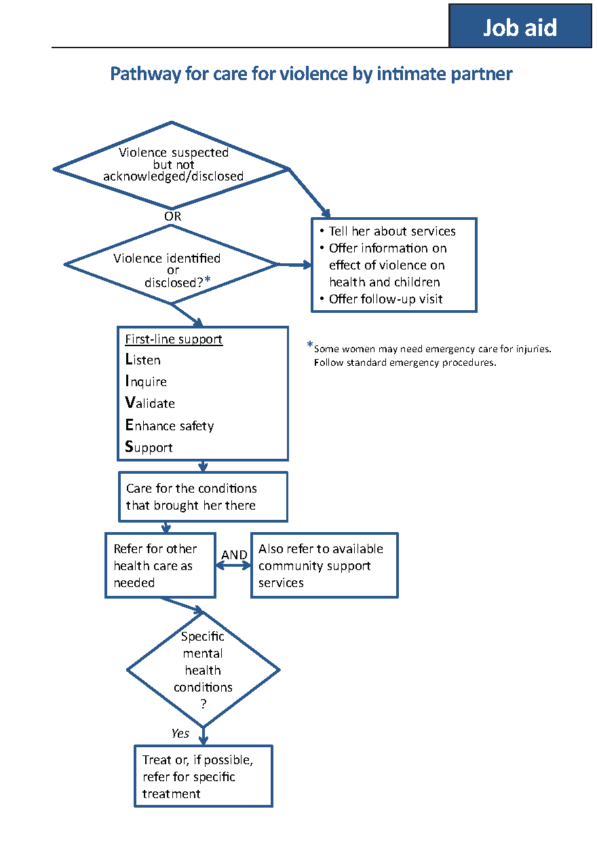
Care and Referral Pathways*
Pathway for care for violence by intimate partner, page 38
Pathway for initial care after assault, page 65
*Source: World Health Organization (WHO). Health care for women subjected to intimate partner violence or sexual violence: A clinical handbook. Geneva: WHO; 2014.
Notes:
Facilitator notes:
WHO has provided job aids for frontline providers treating clients who disclose the sexual violence or clients they suspect has experienced sexual violence.
Distribute copies of the diagrams to each participant.
In small groups, ask the participants to brainstorm resources available and support needed for the various care tasks in the pathways.
Encourage participants to make a referral resource list.
Then ask the groups to consider where and how abortion care and/or referral fits into these pathways and add that to the diagram.
Ask the participants to brainstorm resources available and support needed for the abortion care and/or referrals
Image Source: World Health Organization (WHO). Health care for women subjected to intimate partner violence or sexual violence: A clinical handbook. Geneva: WHO; 2014
https://www.who.int/reproductivehealth/publications/violence/vaw-clinical-handbook/en/

Slide 47
Holistic Care and Treatment is Crucial for Healing and Safety
Where would you send someone who needed these services?
General health services
Clinical/SRH services
GBV/women’s protection services
Mental health and psychosocial support
Food and livelihoods services
Legal assistance services
Safe house/shelter services
Safe spaces
Notes:
Say:
We have looked at the resources available and needed to provide the clinical care needed by women seeking immediate care or later abortion care after sexual assault.
Now also consider these other services that the survivor may need for overall healing and safety.
Where would you send someone who needed these services?
Continuing in small groups, ask the participants to brainstorm resources available and support needed for the services listed on the slide.
Are there other services that are not listed here that may be needed?
Activity Closing:
Answer any questions
Discuss and brainstorm around any challenges identified by participants for their settings
Encourage participants to make a referral resource list.

Slide 48

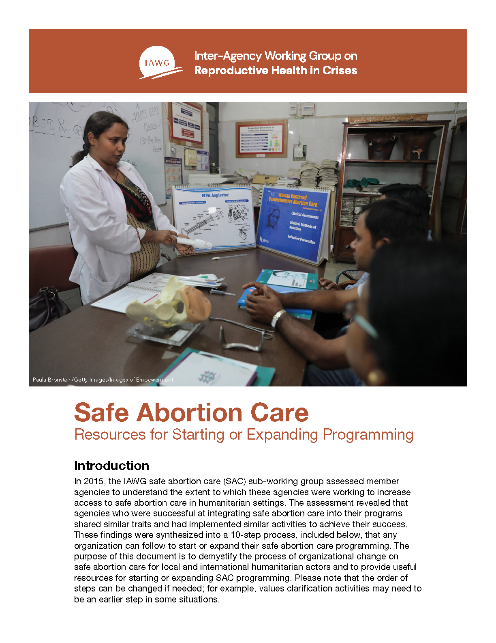
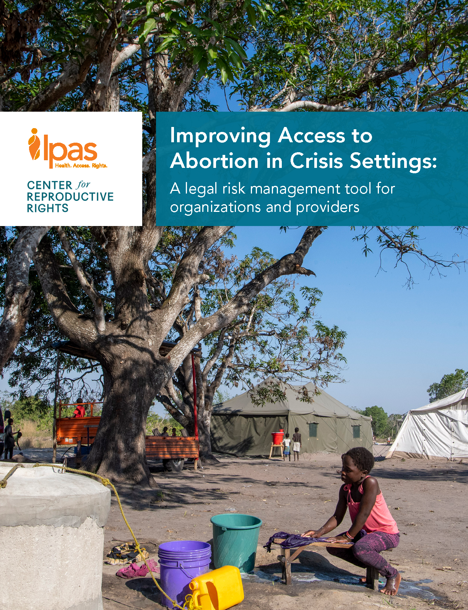
Activity 3 – Service delivery/integration case studies
Notes:
Note for facilitators: These case studies are for small group work and discussions and are meant to help the participants consider trauma-informed care service integration into a facility, across a camp, and improving coordination and referral systems.
Use the Service Delivery/Integration Case Studies for this activity.
Divide participants into small groups.
Distribute the Service Delivery/Integration Case Studies – Participant Version to each participant.
The small group leaders or the facilitator can use the bullet points to generate more discussion about the case. The bulleted points for the cases are not meant to be shared with participants before the discussion.
Note Ipas, IAWG, WHO and other resources that may be useful for service integration.
Activity Closing:
Make sure all the bullet points in the Service Delivery/Integration Case Studies – Facilitator Version are covered for each case
Ask for any additional points that participants/groups have added
Answer any questions
Encourage participants to make notes about what they can do to integrate services into their facility services and/or advocate for better coordination and referral systems across the camp.

Slide 49
Module 5: Care for Caregivers
This section content used and adapted with permission from the Inter-Agency Working Group (IAWG) on Reproductive Health in Crisis.
Adapted from: Inter-Agency Working Group (IAWG) on Reproductive Health in Crises and Jhpiego. Clinical Management of Sexual Violence Survivors in Crisis Settings: A Training Course for Health Care Providers. New York: 2021. https://iawg.net/resources/clinical-management-of-sexual-violence-survivors-in-crisis-settings
Notes:
Note to Facilitators:
Introduce the topic by explaining that your needs are as important as those of the survivors you are caring for.
You may have strong reactions or emotions when listening to or talking about violence with your patients.
This is especially true if you have experienced violence yourself.
Health care providers can develop stress-related conditions, such as burnout, compassion fatigue, or vicarious trauma.
If you are working with survivors, be aware of these risks and take action to maintain your well-being in the face of work-related stress.

Slide 50
What is “burnout”
Burn out is a special type of stress–a state of physical or emotional exhaustion that also involves a sense of reduced accomplishment and loss of personal identity. This can affect providers at the facility or community level, as well as family members.
Manifestations of burnout
Feeling like crying
Difficulty sleeping
Poor concentration
Feeling of anger directed against oneself or others (patients, colleagues, family)
Use of alcohol and drugs
Lack of general interest in life
Inability to feel pleasure
Voluntary isolation
Lack of pleasure at work
Grief or fear stemming from work
Notes:
Note to Facilitators:
Begin by asking participants:
What is burnout?
Have you ever felt ‘burnt out’ or worked with someone else who was ‘burnt out’?
How did you know? How was this different from ‘just a bad day’? How did you feel in your body?
How did your/your colleague’s behavior change?
After a few volunteers share their ideas, advance to the animation and explain the bullets on the slide.

Slide 51
STATISTICS ON BURNOUT
50% of providers who are dealing with traumatized people say they feel affected and 30% said that this even interferes with their life.
These effects are exacerbated in 30% of professionals who have already suffered trauma in childhood (Adverse Effects Trauma in Childhood).
(Brady et al. 1999;Figley 1995; Kohlenberg et al 2006)
Notes:
Note to Facilitators:
Explain that burn out is very common, particularly among providers who care for patients with histories of trauma.
Furthermore, the effects of burnout are exacerbated among those providers who have already suffered trauma in children.

Slide 52
How to avoid burnout: Suggested strategies at work
Discuss cases with peers and/or supervisors for inputs and reassurance about decisions, skills, and roles, thus reducing self-doubt
Be aware that you cannot do everything yourself and ask for help when you need it
Accept that not every patient can be helped and reminding yourself of the good job you are doing
Accept your professional limitations and consistently try to expand your skills and knowledge
Remember you are making a difference in patients’ lives
*Crivatu IM, Horvath MAH, Massey K. The Impacts of Working With Victims of Sexual Violence: A Rapid Evidence Assessment. Trauma, Violence, & Abuse. May 2021. https://doi.org/10.1177/15248380211016024
Notes:
Facilitator Notes:
Explain that there are work strategies we can take to help mitigate burn out. Then review the bullets presented on the slide.
Next, ask: What are other strategies you use at work, or have used in the past, to take care of yourselves and avoid burn out? Invite participants to share their own strategies.

Slide 53
How to avoid burnout: Positive personal actions
Make time to do activities that bring you joy and relaxation outside of work (hobbies, time with friends/family, resting, spending time in nature etc.)
Take care of your own physical health by exercising or using relaxation and breathing techniques
Create social support at work by sharing your problems with colleagues, supervisors
Organize social activities with loved ones such a friends and family
Take regular leave when possible
Ask for help when needed
Notes:
Facilitator Notes:
Explain that there are positive personal actions we can take to avoid burn out. Then review the bullets presented on the slide.
Next, ask: What are other strategies you use, or have used in the past, to take care of yourselves and avoid burn out? Invite participants to share their own strategies.

Slide 54
What organizations can do: Implications for practice*
Normalize negative impacts of the work
Provide staff with space and time to be heard and supported
Increase quantity and quality of formal supervision which meets the needs of the individual and the team
Increase quantity and quality of training in clinical service provision and trauma-informed care
Train staff and supervisors/managers in knowledge, skills, and ability to cope with the psychological and emotional demands of the work
Promote staff’s well-being, improve team cohesiveness and support for burnout
*Crivatu IM, Horvath MAH, Massey K. The Impacts of Working With Victims of Sexual Violence: A Rapid Evidence Assessment. Trauma, Violence, & Abuse. May 2021. https://doi.org/10.1177/15248380211016024
Notes:
Note to Providers:
If your participants include managers or others responsible for provider support, review the various steps on the slide that organizations can take to provide this support.
IF your participants include only providers, you may skip or drop this slide.

Slide 55

Activity 4 – Care for Caregivers
Notes:
Note for facilitators:
Use this 15-minute space for a group activity to practice some self-care to avoid burn out
This could take the form of either small group discussions, a discussion circle, or teaching of breathing techniques… choose one of these or combine them as time allows.
Suggestions for a discussion circle
Either in pairs or as a group invite participants to discuss a difficult experience they encountered during their work as providers.
If in pairs, after 10 minutes, bring the participants back to plenary and invite participants to share their own responses, if they feel comfortable.
Ask:
What was it that made this experience particularly challenging?
What might have helped ease the challenge?
Facilitate the discussion
Suggestions for deep breathing practice
Instruct participants to sit with their feet flat on the floor. Tell them to start with their hands in their laps.
Explain that after they learn how to do the exercises, they can do them with eyes closed.
Read the instructions below slowly and calmly, giving participants time to do the exercise.
First, relax your body. Shake your arms and legs and let them go loose. Roll your shoulders back and move your head from side to side.
Put your hands on your belly. Think about your breath.
Slowly breathe out all the air through your mouth, and feel your belly flatten. Now breathe in slowly and deeply through your nose, and feel your belly fill up like a balloon.
Breathe deeply and slowly. You can count 1–2–3 on each breath in and 1–2–3 on each breath out.
Keep breathing like this for about 2 minutes. As you breathe, feel the tension leave your body.
Image source: Noun project, Gan Khoon Lay

Slide 56
Module 6: Closing
Notes:
Facilitator notes:
Welcome the participants to the workshop closing.
SAY, let’s take a few minutes to review the key messages together

Slide 57

Key messages
Survivor-centered interventions prioritize the rights, needs and wishes of the survivor.
Abortion care needs are often overlooked.
Two core survivor-centered approaches for abortion providers to implement in complex humanitarian settings are:
The LIVES method
Trauma-informed care 10 steps to prioritize the rights needs and wishes of the survivor
Notes:
Facilitator notes:
Ask a participant to read the content on the slide.
Before going to the next side ask if there are any questions related to the points outlined on this slide.
Source: refer to previous module slides and content for exact sources

Slide 58

Key messages
The most important role of an abortion provider is to provide survivor-centered care by:
Supporting, not diagnosing.
Doing no harm; do not pressure the client to disclose information they are not ready to share.
Utilizing the LIVES method and the trauma-informed care approach from the beginning to the end of the visit.
Coordinating confidential and informed consent referrals.
Notes:
Facilitator notes:
Ask a participant to read the content on the slide.
Before going to the next side ask if there are any questions related to the points outlined on this slide.
Source: refer to previous module slides and content for exact sources.

Slide 59
Key messages
Providers themselves can experience the effects of secondary trauma in the form of burnout:
Burnout can lead to a number of negative physical and emotional outcomes that can impact providers at the facility or community level, as well as family members.
Providers are encouraged to be alert to signs of burnout in themselves and colleagues and ask for help as needed.
Organizations can help by creating time/space to deal with burnout and improve training on staff well-being.
Notes:
Facilitator notes:
Ask a participant to read the content on the slide.
Before going to the next side ask if there are any questions related to the points outlined on this slide or any other final questions or clarifications needed.
Source: refer to previous module slides and content for exact sources.

Slide 60
Closing Reflections
Think about and write down three things you plan to do after the workshop related to the provision of trauma-informed abortion care.
Think about one way you can support yourself in avoiding burnout.
Notes:
Facilitator Notes:
Ask participants to write down at least 3 specific things they will do after this workshop related to the provision of trauma-informed abortion care, and one way they can support themselves to avoid burnout.
After a couple of minutes, ask each participant to share one thing they wrote down that they plan to do after this workshop. Participants may decline if they do not feel comfortable sharing any of their completed statements with the group.
Thank the group for their participation.

Slide 61
Administer Post-test and Workshop Evaluation
Notes:
Facilitator Notes:
We would like to see how we have done today in sharing knowledge with you.
Can you please help us by repeating this post-test so that we may be sure that we have accomplished our objective and passed on knowledge?
There are a small number of questions on your feelings and beliefs about abortion
It should take less than 10 minutes to complete.
We also ask that you complete a very short workshop evaluation, which should take less than 5 minutes to complete.
Together, these show whether our training was effective and what we can do to make it better.

Slide 62
Thank you!

