Slide 1
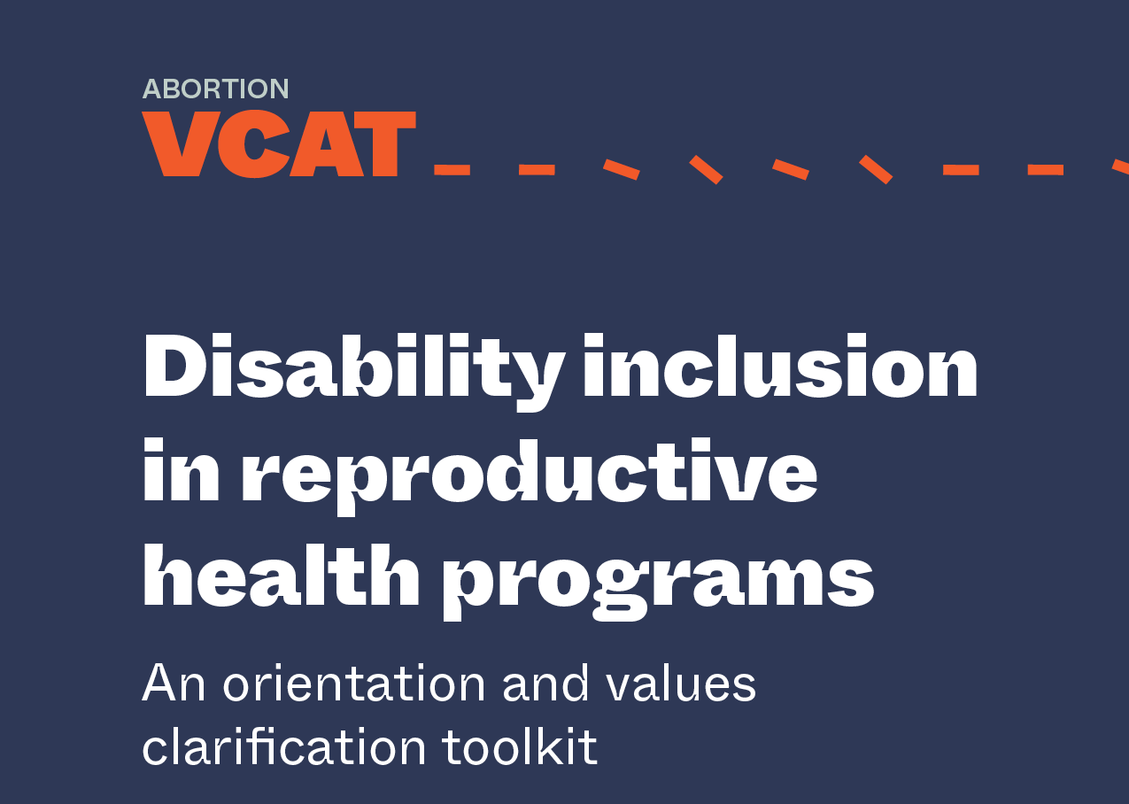
PowerPoint slides to support facilitation of selected activities

Slide 2
Contents
Disability inclusion 101
Activity: Cross the Line
Activity: The Wall
Activity: Language and Terminology (Part 1)
Activity: Language and Terminology (Part 2)
Activity: Reasons Why
Activity: Why Did She Die?
Activity: The Last Abortion

Slide 3
Disability Inclusion 101
Disability is not inability

Slide 4
Overview
Models of disability
UN Convention on the Rights of Persons with Disabilities
Nothing about us, without us

Slide 5
The charity and medical models of disability
Problem = Individual
Brave
Bitter and twisted
Patient
Care
Pity
Cannot walk or see
Sad or tragic
Problem = Individual
Care/cure
Medical rehabilitation
Segregated institutions
Sheltered employment
Social workers
Charity model
Medical model
Notes:
These diagrams demonstrate different conceptions of disability.
The circle in the middle represents the central problem, from which the surrounding attitudes and points of view are founded.
These models of disability shape the way in which individuals and organization's respond to people with disabilities.
Elements of all models discussed exist in all societies today.
Medical
focuses on person’s impairment as the problem;
seeks to ‘cure’ or ‘improve’ individuals to ‘fit’ them into society;
leads to segregated services resulting in exclusion from the mainstream with the rationale that this means better specialised services can be provided;
decision making in the hands of specialists or professionals;
expensive, benefitting very few;
disabled people play passive role in development.
Charity
regarded as "unfortunate", "dependent" or" helpless";
seen as people who need pity and charity, often with roots in traditional understandings that impairments result from sin, ill-favour or curse;
assumes disabled people cannot contribute to society or support themselves;
mostly provides money or gifts, such as food or clothing;
disabled people become long-term recipients of welfare and support;
aid provided by specialist organisations not mainstream development.

Slide 6
Consequences of the charity and medical models of disability
The emphasis is on the individual and their impairment
The goal is to “cure” or “improve” individuals to better “fit” into society
People with disabilities are seen as being “ill” and needing treatment and to be looked after
People with disabilities are seen as “unfortunate,” “dependent” or “helpless” and needing pity and charity
The individual is isolated, segregated, disempowered, and dehumanized

Slide 7
The social or human rights-based model of disability
Problem = Disabling society
Rights
Discrimination
Exclusion
Poverty
Inadequate services
Inaccessible buildings & transportation
Notes:
disability is the social consequence of impairment;
people are disabled by society denying their rights and opportunities;
disabled people’s needs and rights are the same as non-disabled people’s;
leads to inclusive approaches to education, employment and other services by encouraging the participation of disabled people in mainstream programming;
activities focus on identifying and removing attitudinal, environmental and institutional barriers to inclusion.
underpinned by national and international legislation including the UN Convention on the Rights of Persons with Disabilities.

Slide 8
Consequences of the social/rights-based model of disability
The emphasis shifts from the individual to society
People with disabilities are seen as disabled by society because of geographical, attitudinal, linguistic, technological and institutional barriers
It is society, by creating barriers to full inclusion, that restricts opportunities and prevents people from participating fully
People with disabilities are not expected to change or for their impairments to be cured or fixed in order to fit into society
Everyone is seen as equal

Slide 9
Inclusion
Exclusion
Segregation
Integration
Notes:
These diagrams express the different approaches that are deployed when working with people with disabilities.
The circle represents society. People with disability are often excluded from “normal society” and excluded from mainstream development programmes.
Medical/Charitable models which focus on the individual as the problem that needs to be fixed – requiring specialist interventions result in segregated approaches.
An integrated approach is where people with disability are recognises the right to inclusion, whilst still treating people with disabilities as a separate group.
Whereas an inclusive model recognises the equal rights of people with disability to people without a disability. Barriers are removed to ensure full and equal access.

Slide 10
United Nations Convention on the Rights of Persons with Disabilities (CRPD)
The UN CRPD is the most important international instrument in the field of disability and international development
It is the first legally binding international instrument that promotes and protects the rights of disabled people globally
The UN CRPD does not explicitly define disability. It says:
  “that disability is an evolving concept and that disability results from the interaction between persons with impairments and attitudinal and environmental barriers that hinders their full participation in society on an equal basis with others.”
Notes:
The UNCRPD is a rights based framework. People with disabilities have the same rights as everyone in society, and these rights must be upheld. Society must become more inclusive of people with disabilities.

Slide 11
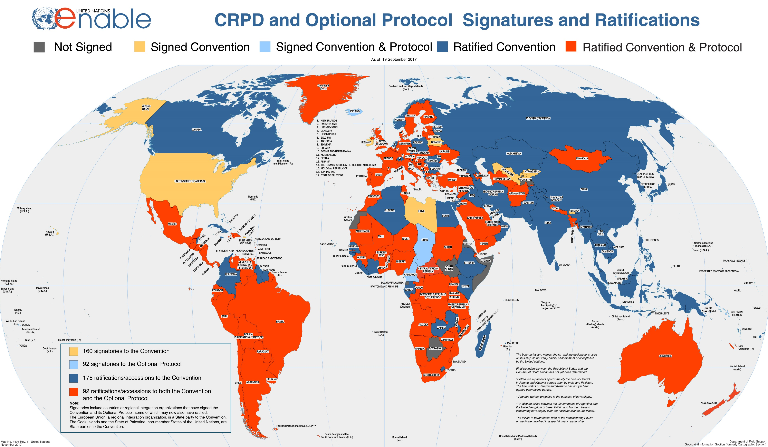
Notes:
Has your country signed up to the UNCRPD?
As of December 2017, 175 Member States on the United Nations had ratified the Convention. https://www.un.org/development/desa/disabilities/news/dspd/suriname-ratifies-crpd-on-29-march-2017-total-173.html#

Slide 12
UN CRPD Article 6: Women with disabilities
States Parties recognize that women and girls with disabilities are subject to multiple discrimination, and in this regard shall take measures to ensure the full and equal enjoyment by them of all human rights and fundamental freedoms.
States Parties shall take all appropriate measures to ensure the full development, advancement and empowerment of women, for the purpose of guaranteeing them the exercise and enjoyment of the human rights and fundamental freedoms set out in the present Convention.
Notes:
Key articles which relate to SRHR are Article 6 and Article 25

Slide 13
UN CRPD Article 25: Health
States Parties recognize that persons with disabilities have the right to the enjoyment of the highest attainable standard of health without discrimination on the basis of disability. States Parties shall take all appropriate measures to ensure access for persons with disabilities to health services that are gender-sensitive, including health-related rehabilitation. In particular, States Parties shall:
Provide persons with disabilities with the same range, quality and standard of free or affordable health care and programmes as provided to other persons, including in the area of sexual and reproductive health and population-based public health programmes;
Provide those health services needed by persons with disabilities specifically because of their disabilities, including early identification and intervention as appropriate, and services designed to minimize and prevent further disabilities, including among children and older persons;
Provide these health services as close as possible to people’s own communities, including in rural areas;
Require health professionals to provide care of the same quality to persons with disabilities as to others, including on the basis of free and informed consent by, inter alia, raising awareness of the human rights, dignity, autonomy and needs of persons with disabilities through training and the promulgation of ethical standards for public and private health care;

Slide 14
All activities must include the participation of persons with disabilities:
“
Nothing about us without us.”
Notes:
Crucially the UNCRPD calls the active participation of people with disability within development. Coining the slogan ‘Nothing about us without us’
People with disabilities must be involved in all aspects of development and in decisions which affect their lives.

Slide 15
The past
Throughout history, persons with disabilities, particularly women and girls with disabilities, have been targeted by harmful policies which continue to inform law and policy in many countries, particularly to force or coerce them not to reproduce.
The way forward
Women with disabilities from diverse constituencies must be actively involved in conversations about sexual and reproductive health—not only within disability-specific debates but within all areas of sexual and reproductive health and rights.

Slide 16
Thank you.
Developed with support from Leonard Cheshire
www.leonardcheshire.org

Slide 17
Cross the Line
Notes:
Introduction
This activity is often used early in an abortion VCAT workshop to help participants begin to reflect on their personal views and to start to get a sense of the range of views on and experiences with abortion. This activity also starts to draw out some of the messages that fuel abortion stigma. For facilitators, this activity can help assess the range of views on abortion among participants in the room in order to better tailor the activities to follow and represent viewpoints that may not be present.
Objectives:
By the end of this activity, participants will be able to:
· Articulate some of their feelings and views on abortion and how they were formed;
· Identify diverse views among participants; and
· Describe how stigma might affect individual and societal views of abortion.

Slide 18
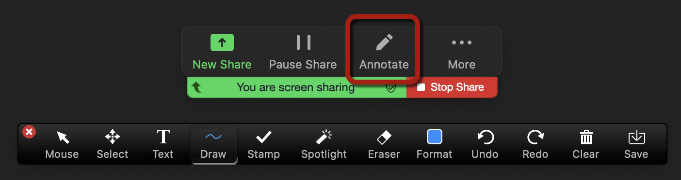
Virtual participation tools
We will use the annotation text tool for this exercise.
For each Cross the Line statement, you will write your name:
  under the line if the statement does not apply to you
  above the line if the statement does apply to you
Between each statement, the facilitator will clear all text.

Slide 19

Cross the line if…

Slide 20
Cross the line if…
you have ever attended a work meeting in your pajamas.

Slide 21
Thank you—let’s go back to the other side.

Slide 22
Cross the line if…
you have a friend or a family member who has difficulty walking, seeing, hearing, remembering or concentrating in a way that affects their day-to-day life.

Slide 23
Thank you—let’s go back to the other side.

Slide 24
Cross the line if…
you have heard friends or family talking in a negative way about people with disabilities.

Slide 25
Thank you—let’s go back to the other side.

Slide 26
you have not known what to do or say when meeting someone with a physical disability.
Cross the line if…

Slide 27
Thank you—let’s go back to the other side.

Slide 28
Cross the line if…
you have heard someone talking in a negative way about people with disabilities accessing sexual and reproductive health services, carrying a pregnancy, or raising children.

Slide 29
Thank you—let’s go back to the other side.

Slide 30
you or someone you know has provided sexual and reproductive health services to someone with a disability.
Cross the line if…

Slide 31
Thank you—let’s go back to the other side.

Slide 32


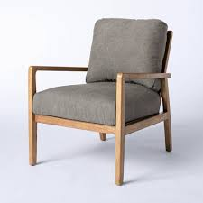
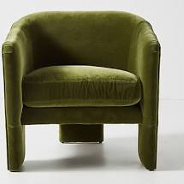
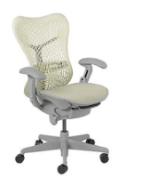



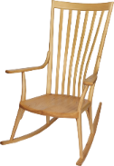


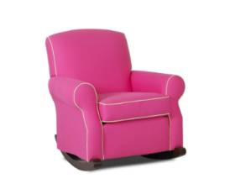


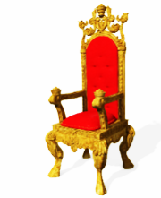


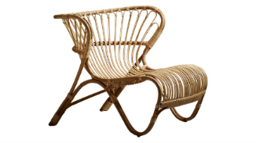






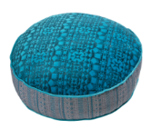

Thank you!
Notes:
How did it feel to participate in this activity?
What did you learn about your own and others’ experiences with abortion?
Were there times where you felt pressure to move with most of the group? How did you handle that pressure?
What does this activity teach us about the stigma surrounding abortion?

Slide 33
Key messages
People living with disabilities have the same rights and needs related to sexual and reproductive health as people living without disabilities.
There is often a gap in our capacity or confidence to deliver services to people with disabilities.
We need to think about people with disabilities when we think about sexual and reproductive health information and care in order to increase accessibility.
Unfortunately, living with a disability is stigmatized in nearly every culture around the world.
Because of isolation and separation, many people’s experience with disability inclusion doesn’t reflect the prevalence of people with disabilities in the world.
Our experiences of disability within the culture we live in can influence how we think about serving clients with disabilities and meeting their sexual and reproductive health needs.
Disability inclusion is relevant to all of our lives and professional roles.

Slide 34
The Wall

Slide 35
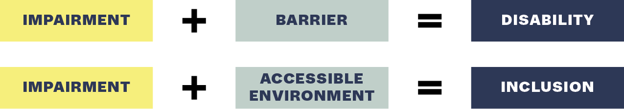
The building blocks of disability and inclusion
Notes:
DIAPOSITIVE ANIMÉE :
Lorsqu'on utilise un modèle social du handicap, cela ne veut pas dire que les personnes handicapées n'ont pas de besoins médicaux supplémentaires, ou qu'elles ne souffrent pas en faisant des choses au jour le jour. Bien sur que si.
Il s'agit d'une facon de voir les choses. Utilisation d'un modèle social du handicap. Une personne n'est pas handicapée parce qu'elle est sourde. Une personne n'est pas handicapée parce qu'elle est en fauteuil roulant.
Elle est handicapée parce que le monde dans lequel elle vit n'est pas conçu en fonction de ses besoins ou de ses droits.
En tant que prestataires de services, nous pouvons donc nous concentrer sur les personnes handicapées. Une préoccupation constante est qu'il y a tant de types de handicap différents - comment savoir quoi faire quand quelqu'un vient avec une incapacité que je ne connais pas.
Cependant, notre rôle en tant que prestataires de services de santé sexuelle et reproductive et de planning familial ne nous oblige pas à être des experts de chaque type de handicap. Nous devons simplement comprendre quels sont les obstacles auxquels un client peut être confronté, et ce que nous pouvons faire pour les surmonter. Il faut poser des questions!
Nous pouvons utiliser cette simple équation pour réfléchir au handicap.
Incapacite + Obstacle = Handicap
CLIQUEZ SUR L'ANIMATION
Incapacite + Environnement accessible = Inclusion

Slide 36

Barriers to inclusion
Notes:
An inclusion approach focuses on what can be done to remove the barriers that women with disabilities face to accessing services.
These barriers can be considered across the following four areas.
Individual – the different compounding barriers linked with different parts of their identity – gender/age. As well as the pain that their impairment causes.
Environment – what we think of most often when we think about disability – inaccessible buildings – the need for ramps. Environmental barriers can also be – how information is displayed or shared.
Institutional – policies don’t recognise people with disabilities as a client group,
Attitudinal – these barriers underpin the others. Our attitude towards disability affects the way in which we respond to disability as an individual or as an organisation.
We will talk about Environmental, Institutional and Attitudinal barriers in detail now.

Slide 37
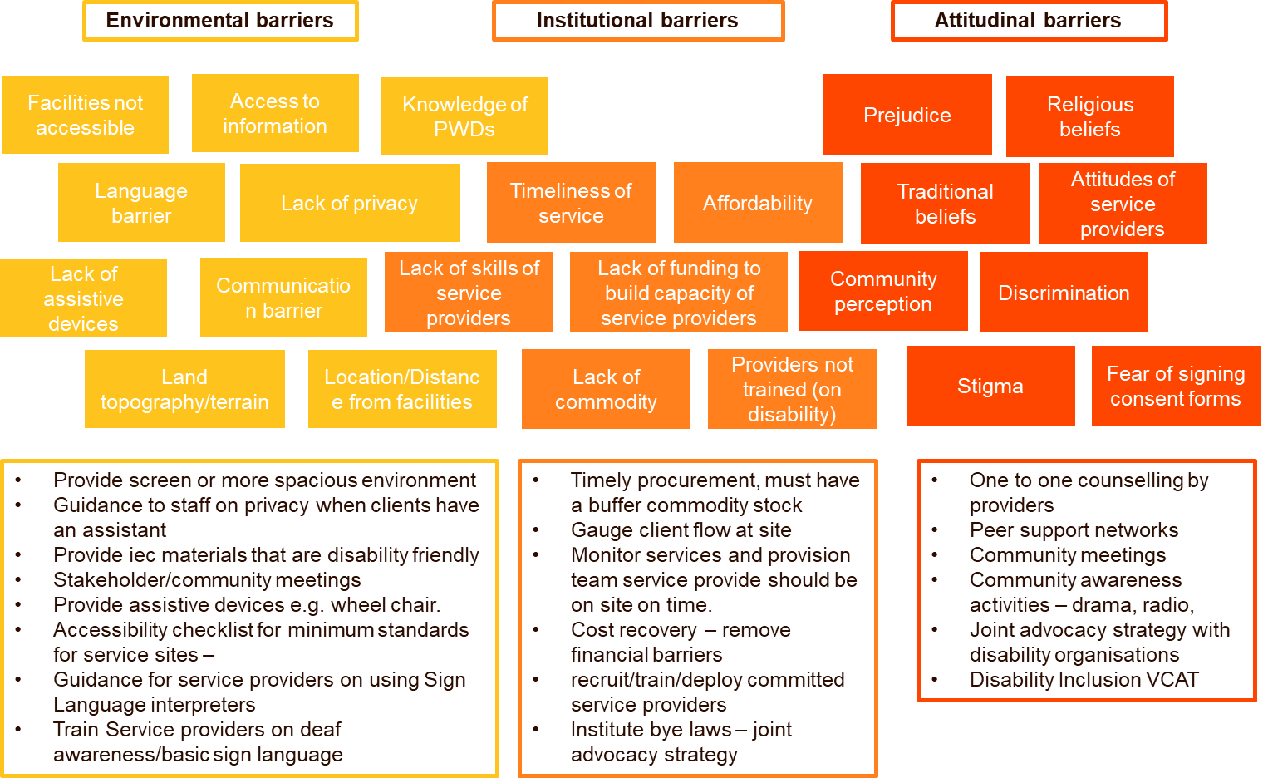
Barriers to inclusion

Slide 38
Optional extras

Slide 39
UN CRPD Article 6: Women with disabilities
States Parties recognize that women and girls with disabilities are subject to multiple discrimination, and in this regard shall take measures to ensure the full and equal enjoyment by them of all human rights and fundamental freedoms.
States Parties shall take all appropriate measures to ensure the full development, advancement and empowerment of women, for the purpose of guaranteeing them the exercise and enjoyment of the human rights and fundamental freedoms set out in the present Convention.
Notes:
Key articles which relate to SRHR are Article 6 and Article 25

Slide 40
UN CRPD Article 25: Health
States Parties recognize that persons with disabilities have the right to the enjoyment of the highest attainable standard of health without discrimination on the basis of disability. States Parties shall take all appropriate measures to ensure access for persons with disabilities to health services that are gender-sensitive, including health-related rehabilitation. In particular, States Parties shall:
Provide persons with disabilities with the same range, quality and standard of free or affordable health care and programmes as provided to other persons, including in the area of sexual and reproductive health and population-based public health programmes;
Provide those health services needed by persons with disabilities specifically because of their disabilities, including early identification and intervention as appropriate, and services designed to minimize and prevent further disabilities, including among children and older persons;
Provide these health services as close as possible to people’s own communities, including in rural areas;
Require health professionals to provide care of the same quality to persons with disabilities as to others, including on the basis of free and informed consent by, inter alia, raising awareness of the human rights, dignity, autonomy and needs of persons with disabilities through training and the promulgation of ethical standards for public and private health care;

Slide 41
Exclusion
Segregation
Integration
Inclusion
Notes:
ANIMATED SLIDE:
The models showed in the previous slides have implications for how we approach disability inclusion in our work.
These diagrams express the different approaches that are deployed when working with people with disabilities.
The circle represents society. The red dots represent persons without disabilities, and the other colours represent persons with disabilities.
The first circle represents Exclusion. People with disability are often excluded from “normal society” and excluded from mainstream development programmes.
A medical or charitable model approach to disability may lead to the following 2 approaches.
A segregated approach is where a special service is provided for persons with disabilities. Separate from service provision for non-disabled persons. This may be at a separate location. Focus is on “Us” and “Them”.
3. An integrated model is where persons with disabilities are recognised within society, but specialist services are provided. Potentially a special clinic focusing on persons with disabilities.
4. The final model is an inclusion model. An inclusive model recognises the equal rights of people with disability to people without a disability. Barriers are removed to ensure full and equal access.
Inclusion is a constant process and a way of thinking. It isn’t about treating everyone as the same, but that we all have equal rights.
Ultimately, all models are exist in all societies today in different ways. It is possible to have an inclusive approach which includes an element of integrated services.
E.g Deaf people – are welcome to attend a service at any time – but if they come on Thursdays there will be additional resource provided e.g sign language interp.
At the same time we can support deaf organisations to advocate for the training of more sign language interpreters, and ensure that this is recognised in national policies.
The most important point is that persons with disabilities must be given choice, and a say in the way services are provided. It shouldn’t be impose.

Slide 42


1 billion people with disabilities live in the world today
19.2% of all women are living with a disability
20% of all people living in poverty have a disability
Up to 220 million young people are living with a disability
Notes:
First we’re going to discuss some of the stats, about disability and the intersection with the priority areas that we focus on under WISH. the WHO estimates that globally 1 billion people live with a disability. Amongst women this is estimated to be 19.2% of the population.
So when we are thinking about our youth reach, or our poverty reach – persons with disabilities are included within them. And in many cases are likely to be the poorest of the poor.

Slide 43
Language and Terminology, Part 1

Slide 44
Internationally, there is no one universally agreed definition of disability. The concept of disability is complex, multifaceted and evolving.
Notes:
Internationally there is no one universally agreed definition of disability,
The next few slides I will take you through some of the dominant models of disability and how they affect our definition.

Slide 45
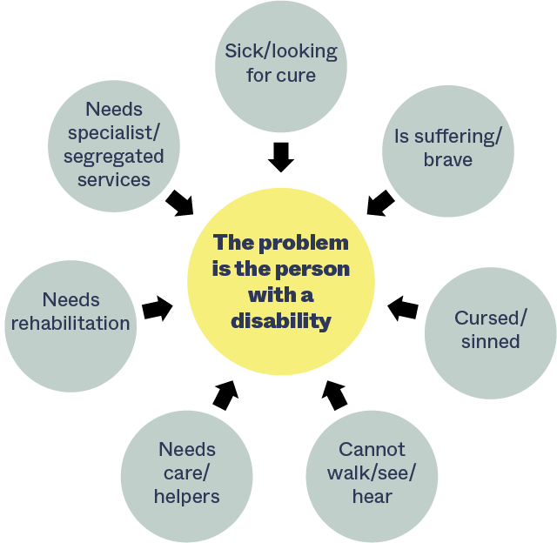
The charity or medical model of disability
Notes:
This diagram demonstrates how we can think about disability from what is called a medical or charitable model.
Both models of disability represent the problem, or challenge to overcome sits with the person with a disability.
As a result of focusing on the individual it results in the responses in the red circles.
The circle in the middle represents the central focus of disabilities, from which the surrounding attitudes and points of view are founded.
When we think about the problem to be solved being sited with the person with a disability.
We may think of this in relation to someone being sick, and looking for a cure for their disability.
Their disability is something that they “suffer” and we therefore see them as being brave for struggling on in life with this disability.
In many cultures today, disability is still seen as a result of being curse, or having sinned.
We make comparisons between persons with disabilities and people without disabilities and focus on what a person with disabilities cannot do. The impairment that the person has is the problem that needs to be fixed.
This framing of disability leads us to respond by focusing on:
Their need for care of helpers
For gifts and basic needs support
From a medical perspective this leads us to seek a cure or to improve individuals to be better able to fit into society
Segregated services resulting in exclusion from the mainstream with the rationale that this means better specialised services can be provided;
Decision making in the hands of specialists or professionals; with disabled people play passive role in development.
expensive, benefitting very few;
NEXT SLIDE
Charity
regarded as "unfortunate", in need of help and support – paternalistic – people with disabilities often comment on people saying sorry for their disability, reflecting their perception of what it must be like to have a disability and how difficult it must be. The words in this diagram may feel quite strong, when in reality how this is experience in life may be more subtle.
seen as people who need pity and charity, often with roots in traditional understandings that impairments result from sin, ill-favour or curse;
assumes disabled people cannot contribute to society or support themselves;
mostly provides money or gifts, such as food or clothing;
disabled people become long-term recipients of welfare and support;
aid provided by specialist organisations not mainstream development.
Medical
focuses on person’s from the perspective of their physical impairment
seeks to ‘cure’ or ‘improve’ individuals to be better able to fit into society.

Slide 46
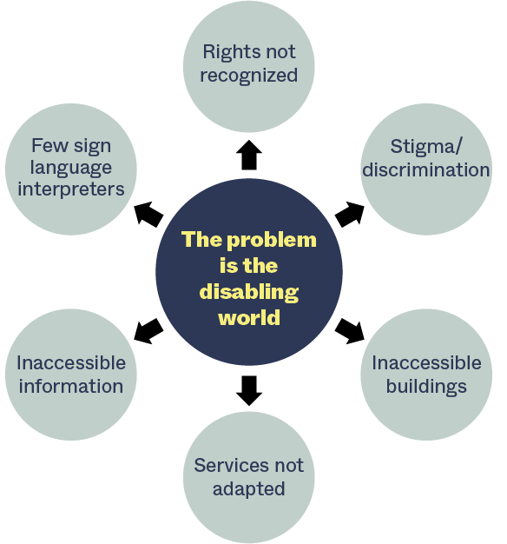
The social/rights-based model of disability
Notes:
This diagram is based on the social model of disability leading to a human rights approach.
You will notice that in this diagram the arrows are pointing out from the centre. The problem in this model does not sit with the individual that has a disability. The problem is the disability world that a person lives in. Disability is the social consequence of impairment
Therefore a person is disabled because
their rights are not recognised on an equal basis to non-disabled persons
They experience stigma and discrimination based on their impairment
We do not focus on the fact that the person cannot walk, rather that buildings are inaccessible
We focus on the barriers that people with disabilities face and how to overcome them
In our setting this may include
Services not adapted
Information not accessible.
Few Sign Language interpreters
Overcoming these barriers is therefore where we focus our efforts.
Not about making specialist services, but about developing an approach which is inclusive of persons with disabilities.
It is this model that is the basis of the UN Convention on the Rights of Persons with Disabilities

Slide 47
United Nations Convention on the Rights of Persons with Disabilities (UN CRPD)
Persons living with disabilities include those who have long-term physical, mental, intellectual or sensory impairments which in interaction with various barriers may hinder their full and effective participation in society on an equal basis with others.

Slide 48
Language and Terminology, Part 2

Slide 49
SCENARIO:
A client requesting services has a mobility impairment…
STATEMENT 1:
STATEMENT 2:
“The client cannot get on the examination bed.”
“Our examination bed is not suitable or accessible for this client.”
Notes:
Here is the set up:
Imagine you all are in the fictional country called “Zoomland” where there can only be one more safe, legal abortion performed.
There are 7 women who have expressed their desire to terminate their pregnancy and have applied to be granted this last abortion.
Your small groups represent the policy makers who are reviewing the applications and have to decide who should receive the last abortion.
Your group must choose one… if you can’t agree on only one, then no one will receive an abortion.

Slide 50
Put yourself in the client’s shoes…
What type of language is this, stigmatizing or rights-based?
What is the impact of the language used? What kind of conversation and possible solution does each statement lead to?
Whose responsibility is it to find a solution in each case?

Slide 51
A deaf client who uses sign language is seeking services…
Stigmatizing statement: | Rights-based statement:
“She is deaf and doesn’t understand what we are saying.”
Notes:
Here is the set up:
Imagine you all are in the fictional country called “Zoomland” where there can only be one more safe, legal abortion performed.
There are 7 women who have expressed their desire to terminate their pregnancy and have applied to be granted this last abortion.
Your small groups represent the policy makers who are reviewing the applications and have to decide who should receive the last abortion.
Your group must choose one… if you can’t agree on only one, then no one will receive an abortion.

Slide 52
A client with an intellectual impairment needs to give informed consent…
Stigmatizing statement: | Rights-based statement:
“She can’t give her consent.”
Notes:
Here is the set up:
Imagine you all are in the fictional country called “Zoomland” where there can only be one more safe, legal abortion performed.
There are 7 women who have expressed their desire to terminate their pregnancy and have applied to be granted this last abortion.
Your small groups represent the policy makers who are reviewing the applications and have to decide who should receive the last abortion.
Your group must choose one… if you can’t agree on only one, then no one will receive an abortion.

Slide 53
A client with sight impairment is seeking services…
Stigmatizing statement: | Rights-based statement:
“They can’t read the form.”
Notes:
Here is the set up:
Imagine you all are in the fictional country called “Zoomland” where there can only be one more safe, legal abortion performed.
There are 7 women who have expressed their desire to terminate their pregnancy and have applied to be granted this last abortion.
Your small groups represent the policy makers who are reviewing the applications and have to decide who should receive the last abortion.
Your group must choose one… if you can’t agree on only one, then no one will receive an abortion.

Slide 54
A person who uses a wheelchair is applying for a new job…
Stigmatizing statement: | Rights-based statement:
“They can’t even get in the building for the interview.”
Notes:
Here is the set up:
Imagine you all are in the fictional country called “Zoomland” where there can only be one more safe, legal abortion performed.
There are 7 women who have expressed their desire to terminate their pregnancy and have applied to be granted this last abortion.
Your small groups represent the policy makers who are reviewing the applications and have to decide who should receive the last abortion.
Your group must choose one… if you can’t agree on only one, then no one will receive an abortion.

Slide 55
Key messages
It is useful to practice using new language, so that we become more confident with the terminology and the subject we’re talking about. Feeling confident talking about disability in the context of sexual and reproductive health and abortion makes it more likely that we will consider the needs of people with disabilities in our programming and approach inclusive programming in a respectful and rights-based way: “Changing the language we use can change the way we think.”
Referring back to the social model of disability, it is not our responsibility to fix someone’s impairment, but we can devise solutions for clients with disabilities by applying a rights-based lens.
We need to consider that some actions to ensure disability inclusion in sexual and reproductive health can be addressed immediately, while others will need to be planned for and actualized in due course.
The questions we ask will reveal whether we are prepared to operate from a rights-based and inclusive approach or from the charity/medicalization approach that blames and penalizes people living with disabilities.

Slide 56
Reasons Why

Slide 57
Reasons Why
Breakout room instructions
Meet your note-taker!
Within the time allotted, brainstorm as many reasons as possible for the question you are provided.
Designate one person in your room to summarize your list for the full group in 3 minutes or less.
Notes:
JAMBOARD: FRAME 1

Slide 58
What are all the reasons why…
Breakout Room 1: | …people living with disabilities have sex?
Breakout Room 2: | …people living with disabilities get pregnant?
Breakout Room 3: | …people living with a disability have an abortion?
Breakout Room 4: | …people living with a disability make decisions about their pregnancy that they don’t want to make?
Notes:
Optional slide – more for facilitators to have an overview

Slide 59
Breakout Room 1: What are all the reasons why people living with disabilities have sex?
Notes:
JAMBOARD: FRAME 2

Slide 60
Breakout Room 2: What are all the reasons why people living with disabilities become pregnant?
Notes:
JAMBOARD: FRAME 3

Slide 61
Breakout Room 3: What are all the reasons why people living with a disability have an abortion?
Notes:
JAMBOARD: FRAME 4

Slide 62
Breakout Room 4: What are all the reasons why people living with a disability make decisions about their pregnancy that they don’t want to make?
Notes:
JAMBOARD: FRAME 5

Slide 63
Group reflection:
How would these lists be different if they were only about people living without disabilities?
Notes:
JAMBOARD: FRAME 7

Slide 64
Small-group discussion
80% of people living with a disability live in lower- or middle-income countries
90% of children living with a disability in lower- or middle-income countries are not in school
Worldwide women and girls living with a disability are at a significantly increased risk for sexual and gender-based violence
People living with disabilities are more likely to experience high poverty rates
While women living with disabilities make sexual and reproductive health decisions for all of the same reasons as women living without disabilities, what do these statistics suggest about the possible differences between women living with disabilities and women living without disabilities when it comes to making sexual and reproductive health decisions?
Sources:
Global Citizen blog, 2018: 5 Facts About Living with a Disability in the Developing World
Commission on the Status of Women Factsheet, 2013: Violence Against Women and Girls with Disabilities
World Bank, 2020: Disability Inclusion
Notes:
JAMBOARD FRAME

Slide 65
Reasons why people living with a disability make decisions they don’t want to make
What is one reason that makes you very uncomfortable and why?
What biases or stigmatizing messages might you have inherited about women living with disabilities that perpetuates disabling conditions for their sexual and reproductive health decisions?
What is one core personal value which could help shift your mindset and behaviors more decidedly toward a rights-based approach to disability inclusion, rather than a charity approach?
Notes:
JAMBOARD FRAME

Slide 66
Reflection
How did this activity feel?
What stood out to you from your discussion?
Notes:
FACILITATOR GUIDE: NO SCREEN SHARE
Debrief should bring everyone back to powerpoint. No shared screen. Facilitator just asks debrief questions of participants with videos on.

Slide 67
Key messages
People living with disabilities make sexual and reproductive health decisions for the same reasons as people living without disabilities. However, because of stigma, increased rates of sexual violence, and disabling practices and environments, women living with disabilities are forced to navigate undue barriers to their sexual and reproductive rights.
People living with disabilities have the same sexual and reproductive rights as people living without disabilities. This includes, among others, the right to contraception, to comprehensive sexuality education, to have children, to parent the children they have and to end a pregnancy.
Our personal discomfort with the reasons why women living with disabilities choose to get pregnant and choose to continue or end a pregnancy may be rooted in unexamined stigmatizing beliefs about people with disabilities.
At a societal level, stigmatizing beliefs create disabling attitudes, environments, and policies and procedures that deny women living with disabilities the right to make the decisions they want to make about their sexual and reproductive health.
A disability inclusion mindset asks us to shift away from a charity approach to disability to a rights-based approach. Taking the time to examine the root causes of our discomfort with some of the choices and reasons why women living with disabilities make sexual and reproductive health decisions is an important step toward clarifying the values we hold and taking actions that affirm the rights of people living with a disability.

Slide 68
Why Did She Die?
Rita’s story

Slide 69
In this activity we will listen to a story of someone who has an unsafe abortion, with tragic results.
This story is about a young woman called Rita.
We will invite someone with a strong internet connection to read the story aloud, while we also read the slides as the story plays out.

Slide 70

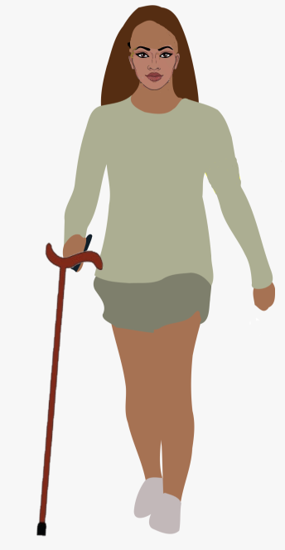
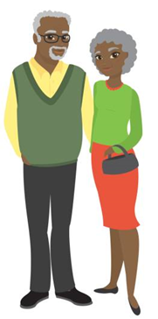
Why Did She Die?
Rita’s story (Page 1 of 6)
My name is Rita. I grew up in a village in Northwest province. When I was six, I was sick with polio but survived. My right leg is very weak, so I need to use a cane.
My parents sheltered me quite a lot and were a bit overprotective, but I can do everything my sisters and brothers can do. At school I was always intelligent and hardworking and often came first in my class.
I was delighted when I won a scholarship to go to university. Even though my parents were worried about how I would cope, I reassured them I would be fine, and I settled in really well.

Slide 71
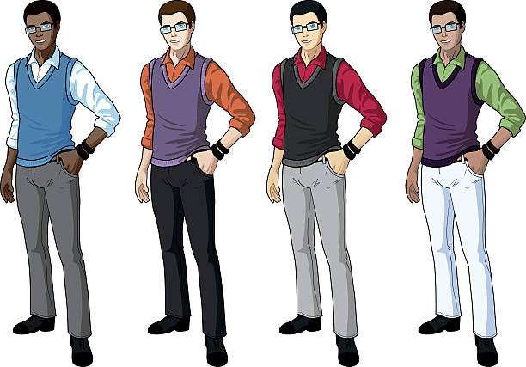
Why Did She Die?
Rita’s story (Page 2 of 6)
I loved university and my new life. After some time, I fell in love with my classmate, Tebogo. At first he was sweet with me, but after some time he became distant and unkind. One day a friend told me that Tebogo had another girlfriend. I was shocked and upset.
I confronted him, but instead of looking ashamed or apologetic, he became very angry. He called me a “cripple” and said I was lucky to get any man to pay attention to me at all.
He threw my cane to the other side of the room, so I could not get away, and then he forced himself on me. I told him to stop but he wouldn’t. Afterward, I was devastated at what had happened. I found my cane and left as quickly as I could.

Slide 72
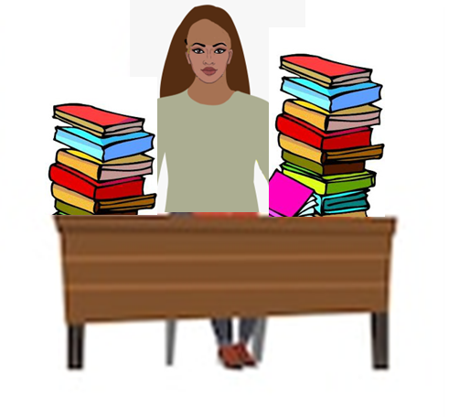

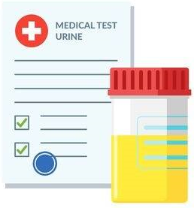
Why Did She Die?
Rita’s story (Page 3 of 6)
As the end of the academic year approached, I tried to focus on my future, studying as hard as I could and applying for jobs and internships. But since the day Tebogo attacked me, I had not been myself at all. I often felt tired and nauseous, but I tried to put it out of my mind.
When it was exam time, I felt worse, so I went to see a nurse at the student clinic. They did some routine tests and I was shocked to learn that I was pregnant. I couldn't believe it.

Slide 73

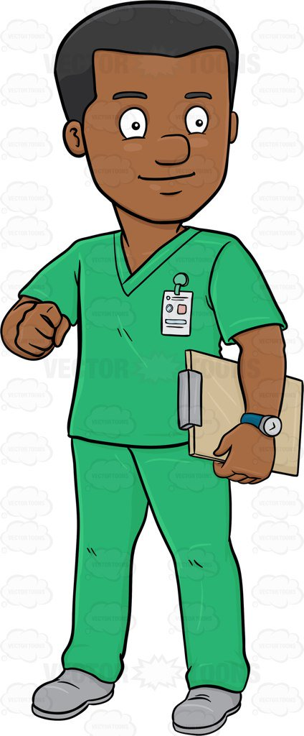
Why Did She Die?
Rita’s story (Page 4 of 6)
I didn't know anything about sex and pregnancy, and my period would surprise me every time it came. No one at home or school had ever talked to me about sex; it was all about school and future and getting a job. What else had I missed?
Quietly, I asked the nurse if it was possible to end the pregnancy. He didn't ask me anything about the circumstances, and I felt ashamed to say I had been raped.
Instead, he patted me on the shoulder and said that having a limp shouldn't be a barrier to being a mother. He said I should be pleased, and he told me to come back for antenatal visits.

Slide 74
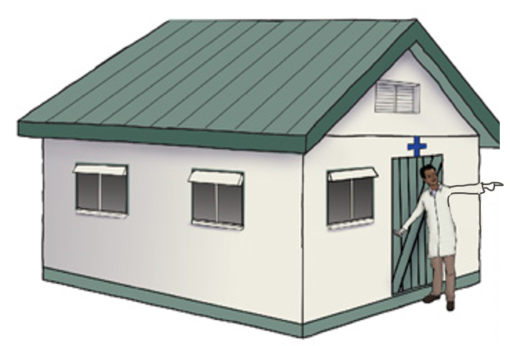
Why Did She Die?
Rita’s story (Page 5 of 6)
Thoughts were racing through my head. The idea of abandoning everything to have a child on my own—or worse, having to go back to Tebogo—was terrible. And how could I expect to get a job if I am pregnant? Getting a job as a woman with a disability is already very hard.
The district hospital was far away, and I couldn’t get there without help or a lot of money for transport. I went to another clinic to ask about ending the pregnancy, but they also turned me away, saying I was “too far gone.” I was terrified for my future.

Slide 75
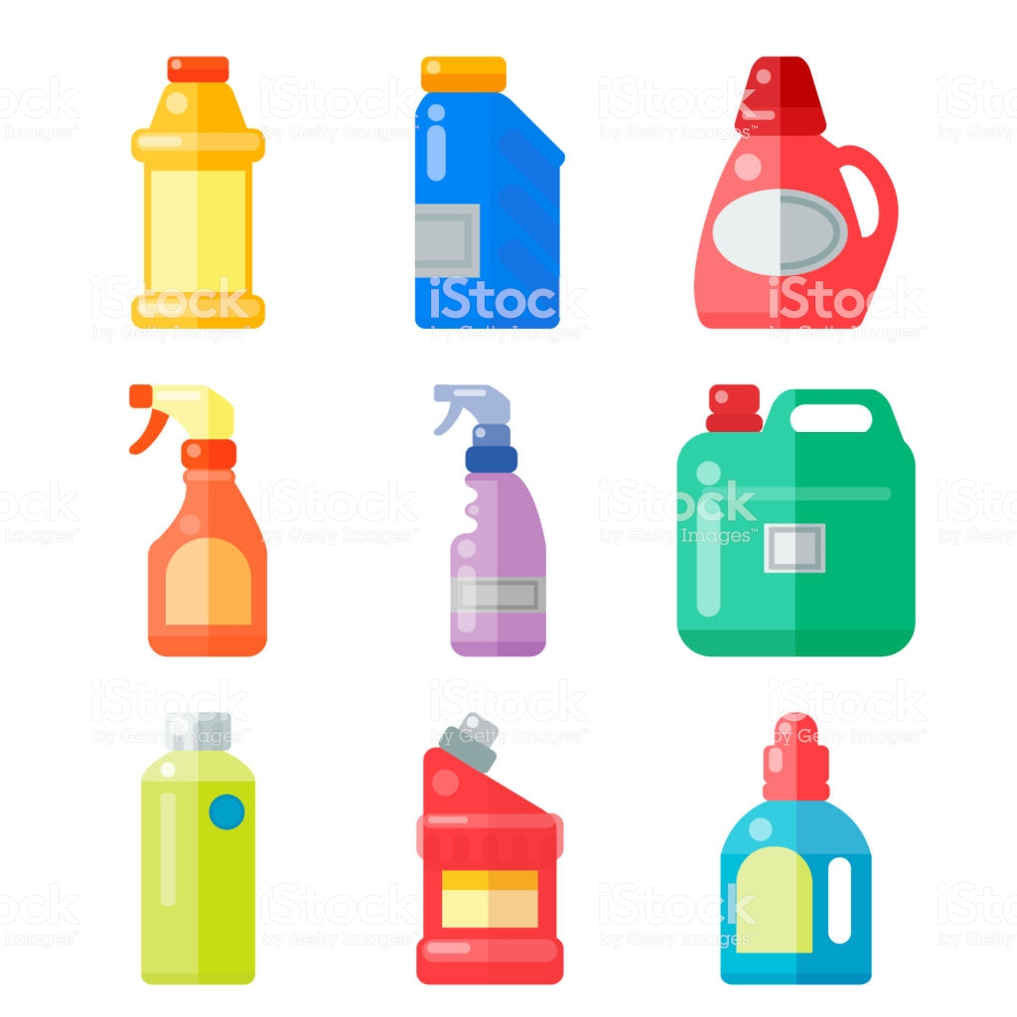
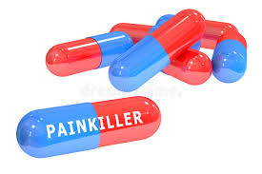

Why Did She Die?
Rita’s story (Page 6 of 6)
I was desperate. Back at home, I made a concoction of household chemicals and I drank it with a packet of painkillers.
I felt terribly sick but was sure that this must work to end the pregnancy. I gradually fell asleep.
Later that night, my roommate found me unconscious in my room.
She called for an ambulance, but by the time I arrived at the hospital, it was too late.

Slide 76
Why did Rita die?
Notes:
Solutions: what could have been done differently?
How can this impact our programming as SRH organisations?

Slide 77
Closing discussion
“Nothing about us, without us.”
“Nothing about me, without me.”
Notes:
Solutions: what could have been done differently?
How can this impact our programming as SRH organisations?

Slide 78
The Last Abortion

Slide 79
The Last Abortion
You are a policymaker in Zoomland where there will be ONE last safe and legal abortion.
7 women have applied to be granted the last abortion. You must evaluate their petitions with only the information provided.
As a group, discuss the scenarios and choose one woman to receive the last abortion. Be prepared to share the rationale for your choice.
Notes:
Here is the set up:
Imagine you all are in the fictional country called “Zoomland” where there can only be one more safe, legal abortion performed.
There are 7 women who have expressed their desire to terminate their pregnancy and have applied to be granted this last abortion.
Your small groups represent the policy makers who are reviewing the applications and have to decide who should receive the last abortion.
Your group must choose one… if you can’t agree on only one, then no one will receive an abortion.

Slide 80
Six scenarios
A 45-year-old woman is 18 weeks pregnant. She had stopped having regular menstrual cycles and did not believe she could become pregnant. Her 12-year-old son has cerebral palsy and she has joyfully devoted her life to his wellbeing. However, she does not feel financially nor emotionally able to parent another child.
A 25-year-old woman is eight weeks pregnant. She has two children under the age of four, and she lives with a man who regularly physically abuses her. As the children get older, she worries that they will also be hurt. She does not want to bring another child into an abusive household, especially if it will only make her more dependent on him for financial support, so that she cannot leave.

Slide 81
Continued
A 32-year-old woman with two young children is 10 weeks pregnant. She and her youngest child are HIV positive. Her husband died of AIDS-related illnesses two years ago and she now supports the family on her small income alone. Her health is not good and she has been hospitalized several times in the past year.
A 20-year-old woman with a learning disability is brought to the clinic by her aunt, who says that her niece needs an abortion. The aunt says she thinks her niece is about 7 or 8 weeks pregnant. She says her niece already has one child and that the family can’t afford to support another. The woman does not say anything.

Slide 82
Continued
A 30-year-old woman is married and is pregnant with her first child. A 20-week scan reveals signs of a fetal anomaly, which would have implications for the future health of the child. The woman has decided to have an abortion.
A 29-year-old woman was initially happy to learn that she was pregnant. However, she has a hereditary spinal condition that doctors told her increases the risk of complications during pregnancy and that she may become partially paralysed. She and her partner have decided to terminate the pregnancy.
A 16-year-old girl is now 14 weeks pregnant. She was not aware of the signs of pregnancy and after feeling sick for months she only recently discovered that she was pregnant. She is experiencing acute anxiety at the thought of being forced to continue this pregnancy.

Slide 83
Go to Jamboard

Slide 84
Key messages
The decision to grant some women an abortion and not others carries lifelong consequences for women, their families and communities. This is no less true for women living with disabilities than for all women living without disabilities.
Individual and social biases about women living with disabilities can lead health professionals, family members and friends to put pressure on women living with disabilities to make a decision about their pregnancy that they don’t want to make.
People living with disabilities have the same sexual and reproductive rights as people living without disabilities. This includes the right to access SRH services and the right to decide if you want to have children and how many. Almost all people living with disabilities, including people with intellectual disabilities, can be supported to make decisions about their sexual and reproductive health, including the decision to have an abortion. Our starting point should always be that they have the capacity to consent. Service provider organizations should have protocols in place to provide supported decision making.
Devi, Nandini & Stucki, Prof. Dr. med. Gerold. (2011). Moving towards substituted or supported decision-making? Article 12 of the Convention on the Rights of Persons with Disabilities. ALTER - European Journal of Disability Research.

