Slide 1
Youth act for safe abortion
A workshop for future health professionals
Notes:
Information for the facilitator: This presentation accompanies Youth act for safe abortion, a training guide for future health professionals (Borjesson et al., 2014). It covers Module 2 of the guide and is designed to help experienced facilitators lead workshops effectively. The order of the slides in this presentation reflect the order of the activities in Module 2 in the guide. Orange slides mark the start of new activities and that is a good time for you to refer to the guide for detailed activity instructions. The activity instructions tell you when it is time to present new slides. The order of the slides may need to be modified if you change the agenda. All citations listed in the presentation are available in the bibliography of the guide.

Slide 2
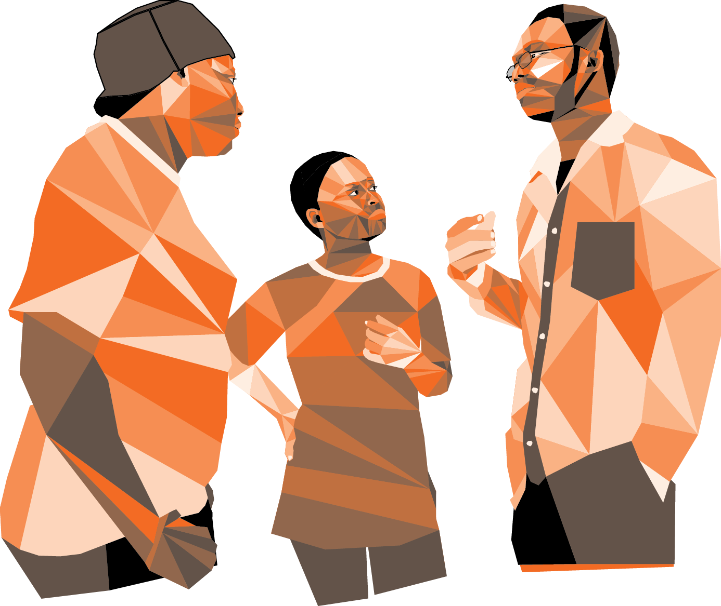
Human rights, gender and abortion
MODULE 2
Notes:
Instructions for the facilitator: Welcome participants to Module 2 and explain that this module introduces participants to Human Rights and provides rights-based arguments for universal access to safe, legal abortion. It also helps participants understand how gender norms and discrimination affect women’s and adolescents’ experiences with abortion. This module encourages participants to challenge preconceived notions and develop more critical perspectives of the different societies we live in.

Slide 3
Module 2 learning objectives
Articulate how human rights support access to safe abortion
Describe the relationship between gender discrimination and abortion
Explain how men can affect women’s experiences with abortion
Notes:
Instructions for the facilitator: Review the learning objectives for Module 2.

Slide 4
Module 2 activities
2.A: Access denied, human rights and abortion
2.B: Gender and abortion
2.C: Abortion as a men’s issue
VCAT 2: Why did she die?
Total: 3 hours and 15 min
Notes:
Instructions for the facilitator: Review the Module 2 activities that the group will participate in.
Access denied, Human Rights and abortion: Participants will increase their understanding of human rights and sexual and reproductive rights and examine, through real-life case studies, how a lack of safe abortion care can be a violation of these rights. Participants will also discuss how conditions in a woman’s community can affect whether or not her rights are fully realized.
Gender and abortion: Participants will explore how gender norms and social beliefs about sexuality affect women’s experiences with abortion. Participants will also discuss how these norms and beliefs can affect quality of abortion care.
Abortion is a men’s issue: Participants will identify reasons why abortion is not just a women’s issue and discuss how men can affect women’s experiences with abortion in different ways.
Why did she die?: This activity features a case study that highlights the sociocultural context around a woman’s unwanted pregnancy and abortion decision. Participants are confronted with the tragic consequences that can result when access to safe, legal abortion services is restricted and are asked to articulate their personal or professional responsibility to prevent deaths such as this one.

Slide 5
Access denied: Human rights and abortion
Activity 2.A
Notes:
Instructions for the facilitator: Lead participants through activity 2.A: Access denied, human rights and abortion, using the instructions in the guide. When prompted by the instructions, present and discuss the slides below. The Module 2 narrative ‘Human rights, gender and abortion’ provides more information about the topics on the slides.

Slide 6
What are human rights?
Basic prerogatives and protections that all humans are entitled to
Obligations that States should guarantee
Guides for how to live in ways that are fair and respectful for all people
Notes:
Instructions for the facilitator: Ask participants to mention examples of human rights that they know of. For example: equal treatment under the law; freedom from discrimination, ill-treatment and torture; freedom of thought, expression and religion; access to shelter, food, and water, and; the right to health and health-care, among others.

Slide 7
Principles of human rights
Universality
Inalienability
Non-discrimination
Indivisibility
Interdependency
Notes:
Instructions for the facilitator: Review what each of the principles mean. Before you share the information below, you can ask different participants to define each of the principles:
Universality: All humans are born with the same rights
Inalienability: The rights are unconditional and cannot be taken away
Non-discrimination: All the rights apply regardless of people’s differences, such as sex, gender, sexual identity, ethnicity, religion or political affiliation
Indivisible: All the rights are essential to the integrity of every human being, and no right is more important than another right
Interdependency: When one right is advanced or violated, other rights are affected as well

Slide 8
Violations of human rights
Human rights are often violated by States and threatened by institutions and individuals
Individuals can bring cases of violations to their national justice system
If the national justice system fails to address the case, it may be possible to try it in a regional court:
African Court on Human Rights
European Court on Human Rights
Inter-American Human Rights Court

Slide 9
What are sexual and reproductive rights?
Prerogatives and protections related to the exercise and expression of sexuality and human reproduction
Notes:
Instructions for the facilitator: Ask participants to mention examples of sexual and reproductive rights that they know of. For example: Free and informed decision-making about intimacy and sex, long-term relationships and marriage, and childbearing. You may wish to explain that most human rights can be applied to the sphere of sexuality and human reproduction too. Freedom from discrimination, ill-treatment and torture includes freedom from discrimination based on one’s gender or sexual identity and from sexual violence and abuse. The right to health necessitates that all people have access to comprehensive reproductive health-care services and commodities.

Slide 10
A right to abortion?
Access to safe abortion protects several human rights and sexual and reproductive rights
When a woman resorts to unsafe abortion these same rights can be violated
Notes:
Instructions for the facilitator: Ask participants to share examples of which human rights and sexual and reproductive rights may be violated if women and adolescents do not have access to safe abortion. You may wish to refer to Table 2.1 ‘Human Rights and abortion’ in the guide to add examples.

Slide 11
Abortion in international agreements
“In circumstances where abortion is not against the law, such abortion should be safe. In all cases, women should have access to quality services for the management of complications arising from abortion.”
(International Conference on Population and Development 1994)
Health systems should “train and equip health-service providers and take other measures to ensure that abortion is safe and accessible [for all indications for which it is legal].”
(Special Session of the UN General Assembly 1999)
Notes:
Instructions for the facilitator: Use the quotes on this and the next slide to share examples of how international and regional Human Rights’ agreements address abortion, including its safety and legality.

Slide 12
States should “consider reviewing laws containing punitive measures against women who have undergone illegal abortions.”
(Fourth World Conference on Women 1995)
States shall “protect the reproductive rights of women by authorizing medical abortion in cases of sexual assault, rape, incest, and where the continued pregnancy endangers the mental and physical health of the mother or the life of the mother or the foetus”
(African Commission on Human and People’s Rights 2003)

Slide 13
Protections for adolescents
The child’s best interests supersede other considerations
‘Evolving capacities’ promotes autonomy in accordance with the child’s abilities
Confidentiality ensures that health-care services are accessible
Notes:
Instructions for the facilitator: Discuss important rights that adolescents are entitled to. You may wish to say: “Adolescents have the same Human Rights as adults. They are also entitled to unique protections, which are outlined in the Convention on the Rights of the Child (CRC). The CRC was passed in 1989 and has been ratified by all countries in the world except two (Somalia and the United States).” Briefly explain how the protections listed on the slide can be applied to abortion:
The child’s best interests: must be the primary concern in all actions concerning the child (Article 3). Ensuring access to safe, legal abortion for an adolescent who wishes to terminate a pregnancy can protect her life and health, and thus be in her best interest.
The principle of evolving capacities: recognizes that parents and caregivers should provide direction in a manner consistent with the child’s capacities (Article 5). As a child’s capacities evolve, her rights and responsibilities gradually supersede those of her parents and caregivers. No adult should attempt to direct an adolescent’s abortion decision-making if the adolescent has the capacity to make the decision. National laws or practices that restrict adolescents’ right to consent to safe abortion services in accordance with their capacities can drive adolescents to seek life-threatening, unsafe abortions instead.
Confidentiality: All sexual and reproductive health-care services, including counseling, should be made available to adolescents on a basis that respects their privacy and confidentiality.

Slide 14
The Reproductive Justice framework
Women have the right to:
Prevent pregnancy
Continue or terminate a pregnancy
Parent their children with adequate social support in safe environments
Women’s reproductive health is directly linked to conditions in communities where they live
Access to safe abortion is just one of many priorities for women who are marginalized
Notes:
Instructions for the facilitator: Introduce participants to the concept of Reproductive Justice and explain how it can be applied to abortion. You can refer to Textbox 2.2 ‘Reproductive Justice and abortion’ in the guide for more examples. Explain to participants that “women who struggle to access safe abortion, or are arrested on charges of abortion in places where it is legally restricted, are often marginalized (poor, young, indigenous, migrants, undocumented, etc.) and lacking legal representation”.

Slide 15
Applying the ‘RJ’ framework
Consider abortion through multiple lenses (gender- and age-based discrimination, racism, poverty, migration, etc.)
Address interrelated socioeconomic issues
Respond to women’s needs holistically
Partner with the most affected women
Notes:
Instructions for the facilitator: Explain how the Reproductive Justice framework can be applied to abortion.

Slide 16
Gender and abortion
Activity 2.B
Notes:
Instructions for the facilitator: Lead participants through activity 2.B: Gender and abortion, using the instructions in the guide. When prompted by the instructions, present and discuss the slides below. The Module 2 narrative ‘Human rights, gender and abortion’ provides more information about the topics on the slides.

Slide 17
Introduction to gender
Gender
Sex
A person’s internal sense of self as a man, woman, neither, bigender, trans, etc.
A social system of categorizing people based on what is considered feminine and masculine
Biological attributes that divide people into male, female or intersex:
Chromosome composition
Appearance of genitalia
Presence of reproductive organs
Reproductive function
Notes:
Instructions for the facilitator: Ask participants to discuss the difference between gender and sex. You may also wish to explain:
The difference between gender identity and sexual orientation
That the gender a person is assigned at birth may not be how they identify now. Gender identity can change throughout life.
That people begin to learn and internalize their community’s gender norms at birth
That social beliefs about gender can lead to stereotyping, discrimination and violence, which more often affect women, transwomen and transmen

Slide 18
Gender-based violence:
Any threat or act of violence against persons who identify as (or are perceived to belong to) a certain gender, which results in, or is likely to result in, mental, physical or sexual harm or suffering, whether occurring in public or private life
Notes:
Instructions for the facilitator: Discuss how social beliefs about gender affect both women and men. For example: in cultures of hyper-masculinities men are expected to be dominant, powerful and violent, which can influence their behavior.
Discuss and give examples of gender-based discrimination and violence. For example: women’s access to formal and informal education, and their control of economic assets, is often restricted based on their subordinate status in society.
Affirm that gender equality - that all people have equal value and should be accorded equal treatment - is a Human Right.

Slide 19
Gender and unintended pregnancy
Unequal access to education, economic assets and health-care
Less control over own body and sexual relationships
Less agency to make decisions about contraceptive use and childbearing
More likely to experience sexual violence
Notes:
Instructions for the facilitator: Discuss how gender stereotypes, discrimination and violence affect women’s experiences with unintended pregnancy.

Slide 20
Social ideal of womanhood
Female sexuality is accepted solely for the purpose of reproduction
All women are expected to want to become mothers
Women are not seen as ‘real women’ until they have children
Notes:
Instructions for the facilitator: Discuss how the social ideal of womanhood affect women’s experiences with unintended pregnancy and abortion. Explain to participants that “the social ideal of womanhood is often equated with motherhood, and for many women worldwide, seeking abortion challenges deep-rooted beliefs and attitudes about womanhood.”

Slide 21
Gender and abortion decision-making
Limited agency and low self-esteem can affect women’s ability to make decision
Lack of respect for women’s autonomy and choices limit women’s opportunities to make decision
Decision whether to continue or end a pregnancy controlled by husband, mother-in-law or parents
Notes:
Instructions for the facilitator: Discuss how gender stereotypes, discrimination and violence affect abortion decision-making. Remind participants that women have the right to decide whether, when and with whom to have children, and that induced abortion should always be voluntary. A voluntary abortion is one that is done deliberately, under the woman’s petition and by her free choice. No woman or adolescent should be pressured, coerced or physically forced to undergo an abortion against her will or without her consent.

Slide 22
Gender and access to safe services
Lack of information that safe abortion is legal on demand or in certain circumstances
Limited freedom of mobility to access service points
No or restricted control of economic assets affect ability to pay for services
Spousal consent requirements for health-care services, including safe, legal abortion
Notes:
Instructions for the facilitator: Discuss how gender stereotypes, discrimination and violence affect women’s access to safe abortion services.

Slide 23
Gender and quality of care
Young and unmarried?
Providers who believe young, unmarried women have been promiscuous, may:
Withhold pain management during the abortion procedure
Charge higher fees or demand sexual ‘favors’
Married without children?
Providers who believe married woman without children should continue the pregnancy may:
Refuse to provide abortion services
Break women’s privacy and confidentiality, and demand spousal consent first
Notes:
Instructions for the facilitator: Discuss how gender stereotypes, discrimination and violence can affect quality of abortion care.

Slide 24
Safe abortion programs should:
Critically examine gender norms
Strive to strengthen already equitable norms
Challenge gender discrimination or raise awareness of it
Notes:
Information about this slide: Explain to participants that promotion of gender equality improves women’s access to sexual and reproductive health information and care (Interagency Gender Working Group 2010), including abortion. Therefore it is important that programs for safe abortion address gender.
[Image: Catholics for the Right to Decide advocate for the immediate reinstatement of therapeutic abortion in Nicaragua.]

Slide 25
Abortion as a men’s issue
Activity 2.C
Notes:
Instructions for the facilitator: Lead participants through activity 2.C: Abortion as a men’s issue, using the instructions in the guide. When prompted by the instructions, present and discuss the slides below. The Module 2 narrative ‘Human rights, gender and abortion’ provides more information about the topics on the slides.

Slide 26
Abortion in the lives of men
Men experience abortion in their:
personal lives as partners, fathers, sons and friends
professional lives as policymakers, lawyers and judges, and health-care professionals
Notes:
Instructions for the facilitator: Invite participants to think of roles in which men may experience abortion, both personally and professionally.

Slide 27
Men matter!
Men can support women in making and acting on reproductive health decisions:
Learn how gender discrimination and inequality contribute to unintended pregnancy and unsafe abortion
Explore how their own personal values, beliefs and practices affect women’s reproductive health
Take responsibility by living in mutually respectful, healthy relationships
Talk to family members and friends about reproductive choice, and advocate for improved access to safe services
Support women who need help to access safe services, including contraception and abortion
Notes:
Instructions for the facilitator: Explain to participants that unintended pregnancy and unsafe abortion cannot be addressed effectively if we reduce them to women’s issues that only women work on. Like in sexual violence prevention, men have important roles to play in reducing unintended pregnancy and increasing access to safe abortion.

Slide 28
Many men provide compassionate - sometimes life-changing - support to women who seek abortion
Notes:
Instructions for the facilitator: Allow participants to read the slide in silence. Briefly discuss how men can provide logistical and emotional support to women who seek abortion. You may wish to tell participants that “when a man accompanies a woman through an abortion process, he may feel concern for her and wonder how he can best support her, or he may have personal feelings about the pregnancy and the woman’s decision to terminate it. Health-care professionals can offer abortion related information and counseling to men too, although it should be done only with the woman’s free, informed consent (if jointly), or separate from the woman.”

Slide 29
Module 2 key messages
Human rights are basic prerogatives and protections, which all people are entitled to. Sexual and reproductive rights relate to the exercise and expression of sexuality and reproduction.
Access to safe abortion protects several of these rights. For example: liberty and security of person, non-discrimination, health, and whether and when to have children
Gender discrimination contributes to unintended pregnancy, restricts women’s autonomous decision-making, and limits access to safe abortion services
Men can take responsibility in their own relationships, and advocate for women’s reproductive choices in their communities and beyond
Notes:
Instructions for the facilitator: At the end of Module 2, summarize key messages. Ask participants to read out loud the bullets listed on this slide. Invite them to share any additional key messages they can think of from the module.

Slide 30
References
All citations and resources mentioned in this presentation are listed in the bibliography of Youth act for safe abortion, a training guide for future health professionals

