Slide 1
The case for abortion in humanitarian settings
Adapted from: McGinn, T., & Casey, S.E. (2016). Why don’t humanitarian organizations provide safe abortion services? Conflict and Health,10(8). https://conflictandhealth.biomedcentral.com/articles/10.1186/s13031-016-0075-8

Slide 2
Safe abortion is usually unavailable to women in humanitarian settings
Photo © Farzana Hossen
Notes:
The fact is that safe abortion is largely unavailable to women in humanitarian settings. Few organizations provide it and most women do not have access to it. Let’s talk through the reasons why this is so.

Slide 3
4 myths prevent safe abortion provision in humanitarian settings
There is no need
Abortion is too complicated to provide in crises
Donors don’t fund abortion services
Abortion is illegal in these settings
Notes:
So why aren’t humanitarian organizations providing safe comprehensive abortion care?
Based on numerous discussions and observations over many years, Inter-Agency Working Group (IAWG) on Reproductive Health in Crises colleagues at Columbia University have identified four main reasons—all misperceptions, or what we’d call “myths”—that prevent organizations from including safe abortion care as part of basic health care in humanitarian settings.
[Source: McGinn, T. & Casey, S.E. (2016). Why don’t humanitarian organizations provide safe abortion services? Conflict and health, 10(8).]

Slide 4
Myth #1: There is no need
Fact: There IS a need In humanitarian settings:
Collapse of health systems means reduced access to emergency obstetric care, family planning, and postabortion care (treatment for complications of unsafe abortion)
Women are at greater risk of sexual violence, which can lead to more unintended pregnancies and unsafe abortions
Photo: Sushavan Nandy/NurPhoto/Getty Images
Notes:
First, let’s talk about the contention that there is no need for abortion care.
Globally, unsafe abortion accounts for 8-18% of maternal deaths, and in many countries or regions within countries it’s far higher than that. Unsafe abortion also leaves 5 million women with temporary or permanent disabilities each year.
Global data clearly indicate that unsafe abortion occurs in every country, regardless of legal or social context, because women everywhere experience unwanted pregnancies and many women are determined to end them.
For reasons on the screen, the need for safe abortion services likely increases in humanitarian settings.
Sexual violence has long been associated with war and has been documented in numerous humanitarian settings. Survivors of rape experience negative physical, psychological and social outcomes, that may be exacerbated when the rape results in pregnancy.
Unintended pregnancies and subsequently unsafe abortions happen everywhere and are a major cause of maternal mortality, so making safe abortion available is critical to saving women’s lives.
Photo Sushavan Nandy/NurPhoto/Getty Images

Slide 5
Myth #2: Abortion is too complicated
Fact: Abortion care is simple
Induced abortion is a very safe medical procedure, according to WHO
Mid-level providers can safely provide manual vacuum aspiration (MVA) and medical abortion
MVA and misoprostol are available in specific reproductive health kits
Notes:
Second, let’s discuss the misperception that abortion is too complicated for humanitarian actors to provide.
In fact, with proper training, early abortion is among the safest and simplest of all medical procedures:
It’s safer than childbirth.
Legal induced abortion is markedly safer than childbirth. The risk of death associated with childbirth is approximately 14 times higher than that with abortion. Similarly, the overall morbidity associated with childbirth exceeds that with abortion. [Source: Raymond, E., & Grimes, D. (2012). The comparative safety of legal induced abortion and childbirth in the United States. Obstetrics & Gynecology, 119, 215–219.
The risk of death from early abortion in the United States is the same as from receiving an injection of penicillin (0.6 deaths/100,000 procedures)
Manual vacuum aspiration and medication abortion are the abortion methods recommended by the WHO. These methods can be safely and effectively performed in the first trimester by trained mid-level providers at the primary health care level. Neither requires electricity, running water, or sophisticated equipment.
Moreover, most of the equipment, medications and infection-prevention procedures needed for safe abortion services are the same as those needed for basic emergency obstetric care and other gynecology services. The procedure is very similar to postabortion care—that is, treatment of complications from unsafe abortion, which is already included in the Minimum Initial Service Package (MISP). Therefore, an organization that supports primary health-care services in humanitarian settings could provide safe abortion services with little additional input.

Slide 6
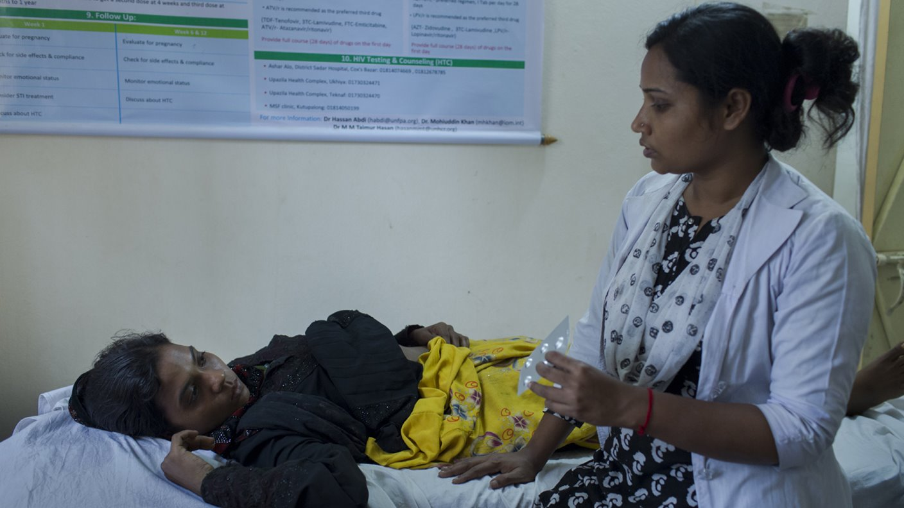
Myth #3: Donors don’t fund abortion
Fact: Many donors DO fund abortion care
The U.S. government does fund postabortion care
Other bilateral and foundation donors do fund safe abortion care
The Global Gag Rule does not apply to humanitarian funding
Photo © Farzana Hossen
Notes:
The third misperception is that donors won’t support provision of abortion care.
It is true that the US government, a major donor for humanitarian aid, doesn’t fund abortion care, and of course the Global Gag Rule prohibits any foreign organization that receives USAID funding from working on abortion even with other funds.
But many bilateral and foundation donors do fund safe abortion care. Norway, Sweden, the Netherlands, the UK, and Canada, for example.
And it is important to note that the Global Gag Rule does not apply to US humanitarian funding.

Slide 7
Myth #4: Abortion is illegal
Fact: Abortion is legal under some circumstances in most countries
International agreements support access to safe abortion for survivors of rape. Such agreements include: the Geneva Convention, Article 3; UN Security Resolutions 2106 and 2122; and the Maputo Protocol.
Indications for legal abortion | To save a woman’s life | To protect a woman’s physical health | To protect a woman’s mental health | Cases of rape or incest | Cases of fetal impairment | Economic or social factors | On request
Number of countries | 190 | 132 | 126 | 99 | 91 | 69 | 58
Notes:
Finally, let’s address the misperception that abortion is illegal in many settings.
Only 5 countries ban abortion entirely: Dominican Republic, El Salvador, Malta, Nicaragua and the Vatican
As reflected on the slide, 99% of the world’s population lives in a country where safe abortion is permitted under some circumstances.
(Note: This table is additive. This means that all countries listed “to protect a woman’s physical health” also permit abortion to save the life of the woman, etc.)
There are also a number of international and regional agreements, such as those indicated on the slide, that support the imperative to provide safe abortion in crisis settings.

Slide 8
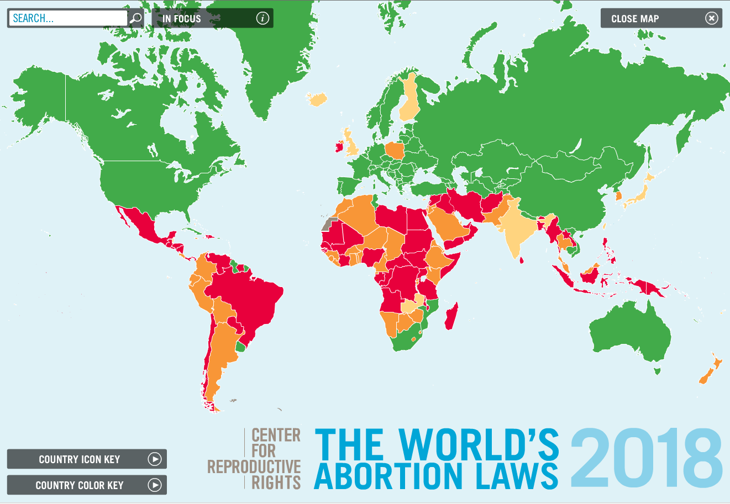
Notes:
Here’s a map of the world’s abortion laws to give you an idea of what laws look like at the national level around the world.
The world is changing quickly and increasingly governments are changing laws to expand legal access to abortion to comply with international human rights standards. Since 1994, approximately 40 countries have made their laws less restrictive.
SOURCE: Center for Reproductive Rights: http://worldabortionlaws.com/
Map key:
Red = abortion legal only to save a woman’s life, or else prohibited altogether
Orange = legal to preserve health and life
Yellow = Legal to preserve health and life and on socioeconomic grounds
Green = Available without restriction as to reason
Gray = Unavailable

Slide 9
REVIEW: Reasons why safe abortion is not provided in humanitarian settings
Reason | True | False
There is no need |  | 
Abortion is too complicated |  | 
Donors don’t fund abortion |  | 
Abortion is illegal |  | 
Notes:
On examination, then, the reasons (or myths) that the Columbia University authors identified simply are not true:
The need for safe abortion services to reduce maternal mortality and morbidity is clear.
These services can very safely be provided in health centers by mid-level providers.
Although the U.S. government does not fund abortion-related activities, other donors including many European governments and private foundations do.
Abortion is permitted under some circumstances in all but five countries around the world.
There is a lot more to say about each of these misperceptions, and of course there are challenges to providing safe abortion care in humanitarian settings that are very real. It can be complicated:
For example, we know from our humanitarian implementing partners that abortion stigma exists at all levels within humanitarian aid organizations, from top leaders down to the facility level—which is why Ipas has adapted our Values Clarification and Attitude Transformation—or VCAT—trainings for use in humanitarian settings and have offered these trainings with great success to our humanitarian partners.
And we know there is a severe lack of trained providers and that established safe abortion training models aren’t feasible in the midst of an acute crisis. But training models can and have been adapted to be more nimble.
There is also a staggering lack of evidence on SRHR, and especially abortion, in humanitarian settings to guide programming.
However, we don’t need to do research to know that women in refugee camps are at greater risk of sexual violence and unwanted pregnancy, that LARCs work, that safe abortion care saves lives. We need to start the work and build the evidence base.
So yes, it can be complicated, but it is not TOO complicated!

Slide 10
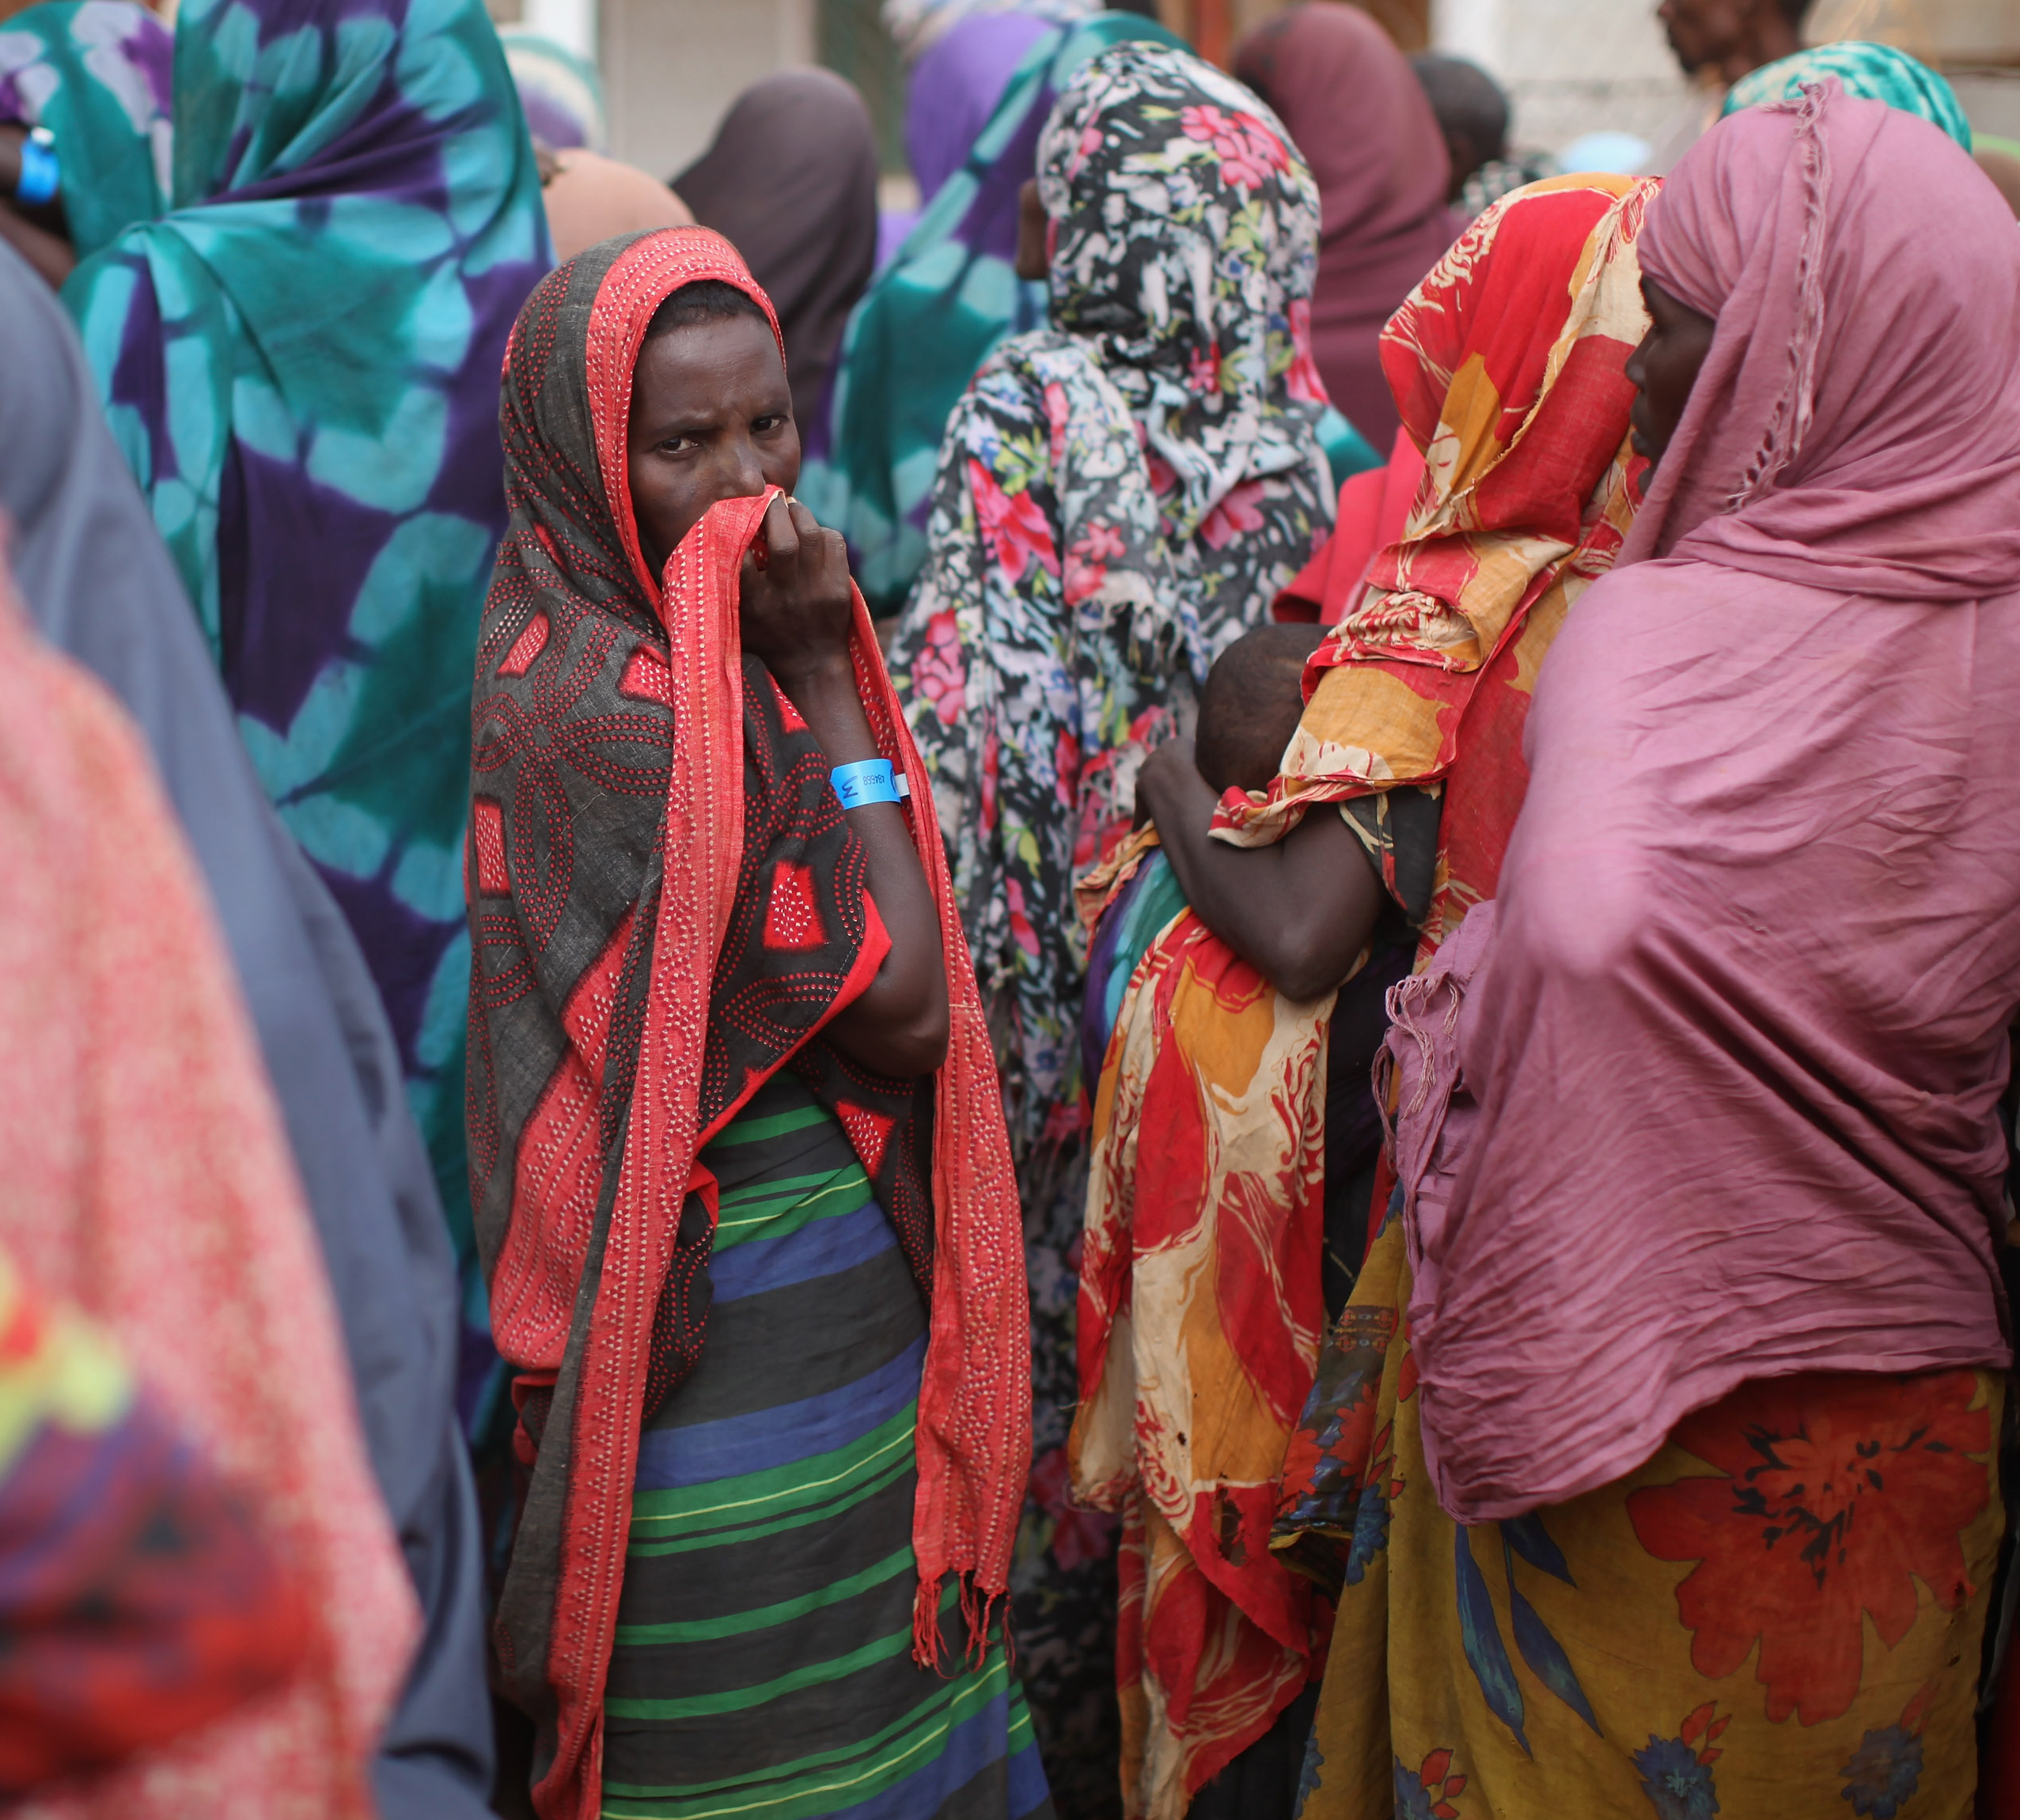
What can humanitarian agencies do?
Question the reasons safe abortion is not provided
Promote accurate language and discussion about abortion
Provide safe abortion care with non-U.S. government funds
Promote health and human rights by providing safe abortion in the many places and circumstances in which it is permitted
Photo Oli Scarff/Getty Images News/Getty Images
Notes:
So the question remains - Why don’t we provide the option of safe abortion, at least for women who are pregnant from rape in crisis settings? What can each of us do within our agencies?
First, have the conversation with your colleagues. What reasons are given for limiting your agency’s greater involvement in safe abortion? Once you use evidence to get beyond the basic reasons we’ve just discussed, you can explore other reasons that influence agency policy. Often a good place to start is discussing the importance of offering safe abortion care for survivors of rape.
Second, promote accurate language around abortion. Let’s not talk about abortion being “illegal.” It is hardly ever illegal. It may be restricted, but that means it is permitted under some circumstances. This broadens our options for providing this necessary service.
Third, use your non-U.S. government funds to advance your safe abortion programs, at least for women who are pregnant from rape in crisis settings.
Finally, you will advance both health and human rights when you improve your services to include safe abortion in the many places and circumstances in which it can be done. This will mark a tremendous advance for women and their communities.

Slide 11
10 steps to start or expand safe abortion programming
Have frank discussions
Develop and disseminate an internal policy
Create a plan
Develop standardized messages
Analyze relevant laws and identify entry points
Source: Inter-Agency Working Group (IAWG) on Reproductive Health in Crises http://iawg.net/resource/safe-abortion-care-10-steps-startingexpanding-programming/
Notes:
A “10 steps” document from IAWG highlights some of the best practices for initiating safe abortion care programming; these came from a small study done within IAWG member agencies. This document is available from the IAWG website at the address on the screen (http://iawg.net/resource/safe-abortion-care-10-steps-startingexpanding-programming/)
The 10 steps range from having frank discussions about the advantages and disadvantages of beginning safe abortion care programming with organization leadership, the first step in the list, to Build safe abortion care clinical and management capacity, listed as the last step.
The last 5 steps are on the next slide…

Slide 12
10 steps, continued
Discuss legal context
Conduct values clarification
Consider opportunities
Identify local safe abortion care champions
Build safe abortion care clinical and management capacity
Source: Inter-Agency Working Group (IAWG) on Reproductive Health in Crises http://iawg.net/resource/safe-abortion-care-10-steps-startingexpanding-programming/
Notes:
Here are the rest of the 10 steps.
The list of steps illustrates that moving into safe abortion care programming may be challenging and require much internal work, especially around organizational change issues, before establishing services.
Note the order is not necessarily prescriptive—for instance, values clarification activities may need to come sooner in the process, perhaps even precede or be concurrent with the “frank discussions” and development of internal policies.

Slide 13
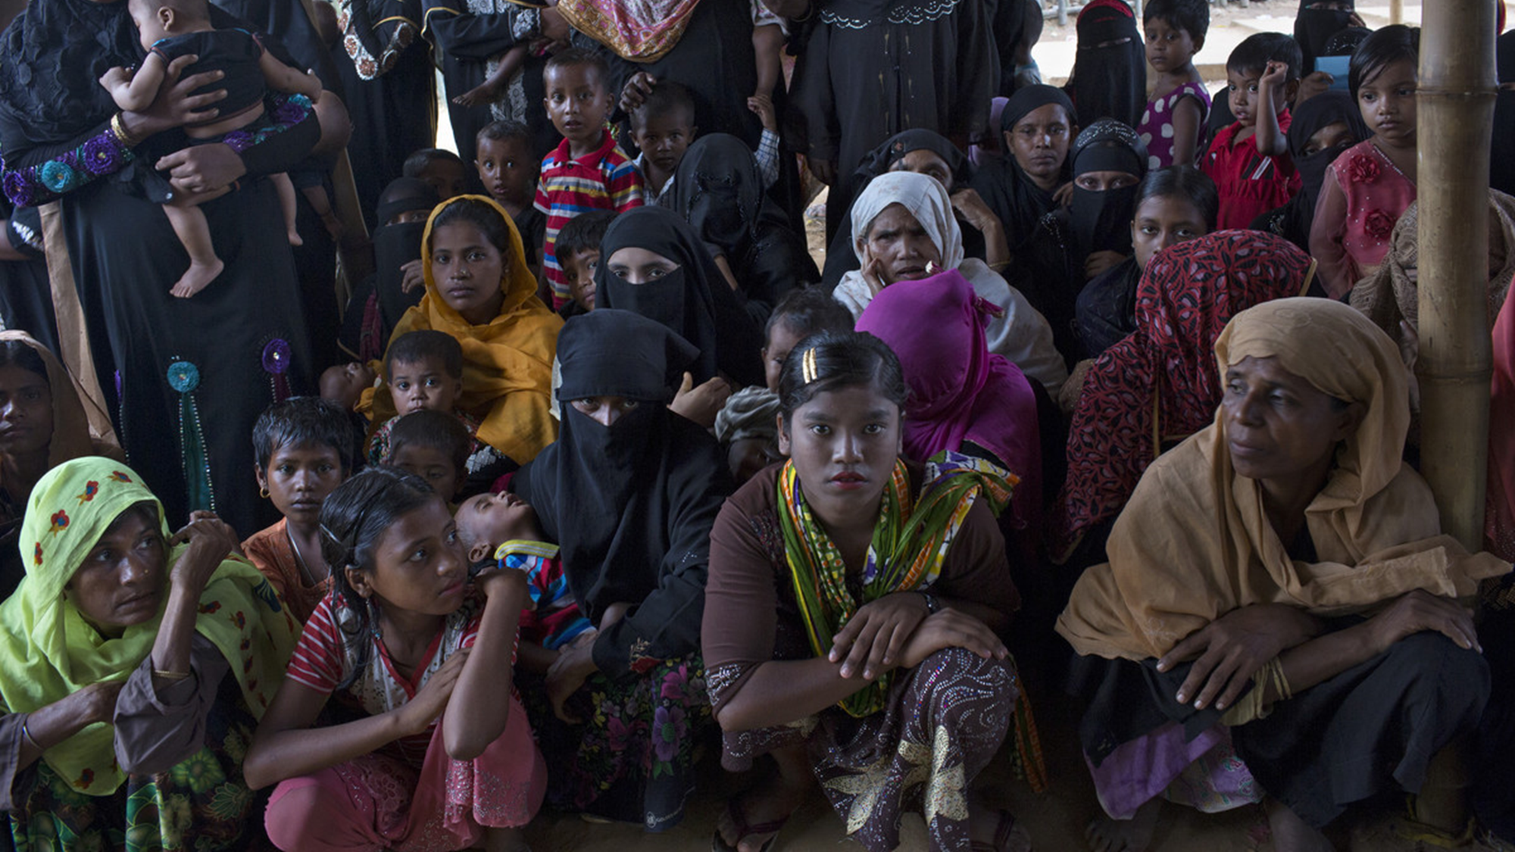
Thank you!
Photo © Farzana Hossen

Slide 14
References
Center for Reproductive Rights. (2018). The World’s Abortion Laws Map 2018. Interactive website: http://worldabortionlaws.com/map/
McGinn, T., & Casey, S.E. (2016). Why don’t humanitarian organizations provide safe abortion services? Conflict and Health, 10(8). https://conflictandhealth.biomedcentral.com/articles/10.1186/s13031-016-0075-8
Raymond, E., & Grimes, D. (2012).The comparative safety of legal induced abortion and childbirth in the United States. Obstetrics & Gynecology, 119, 215–219.
Schulte-Hillen, C., Staderini, N., & Saint-Sauveur, J. (2016). Why Médecins Sans Frontières (MSF) provides safe abortion care and what that involves. Conflict and Health, 10(19). http://conflictandhealth.biomedcentral.com/articles/10.1186/s13031-016-0086-5
World Health Organization. (2012). Safe abortion: Technical and policy guidance for health systems (2nd ed.). Geneva: World Health Organization. http://www.who.int/reproductivehealth/publications/unsafe_abortion/9789241548434/en/
World Health Organization. (2015). Health worker roles in providing safe abortion care and post-abortion contraception. Geneva: World Health Organization. http://srhr.org/safeabortion/

